Slide 1

Welcome to our class

Slide 2

Unit 2: What’s your name?
Lesson 1

Slide 3

Warm-up

Slide 4
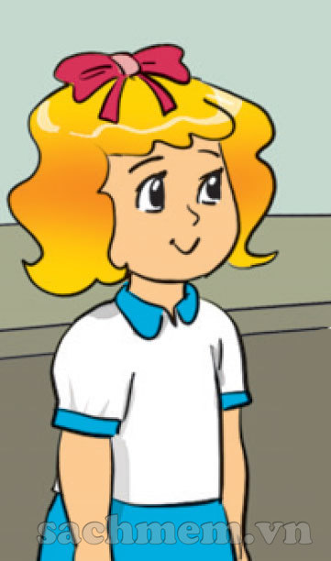
Linda

Slide 5
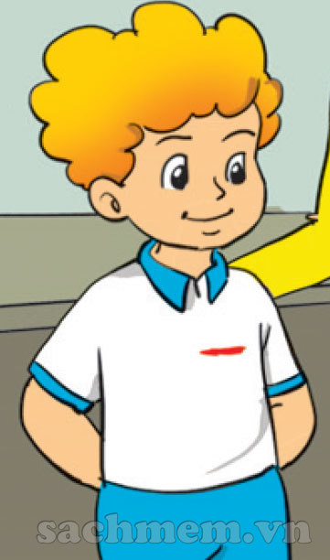
Peter

Slide 6
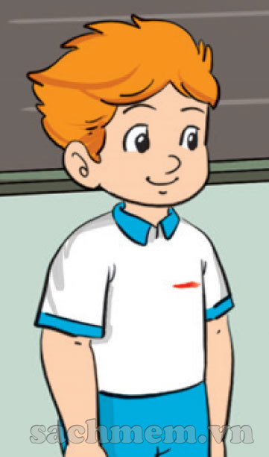
Tony

Slide 7
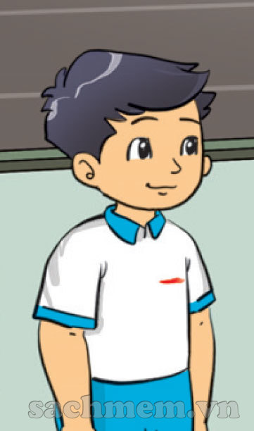
Quan

Slide 8
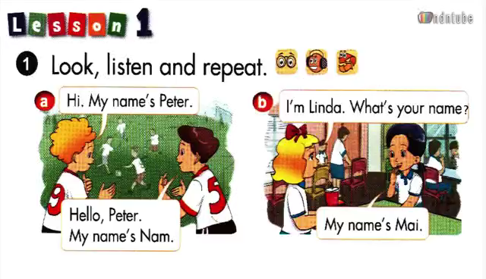


Slide 9
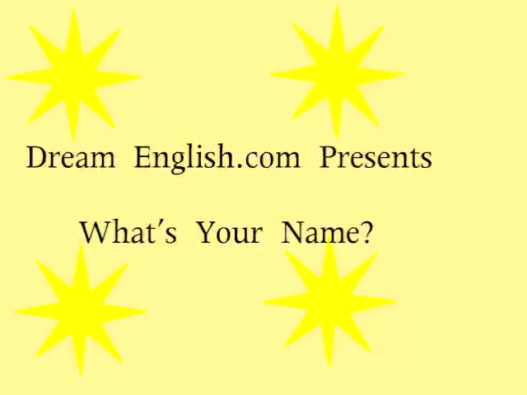

Slide 10
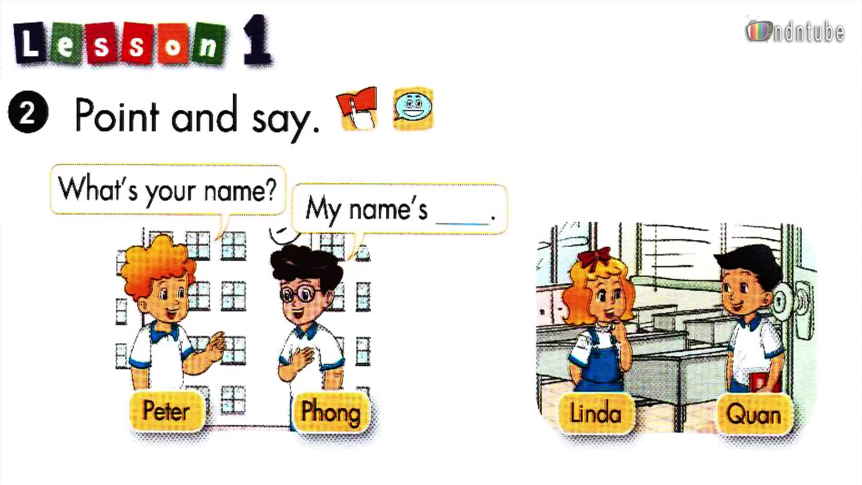
Phong

Slide 11
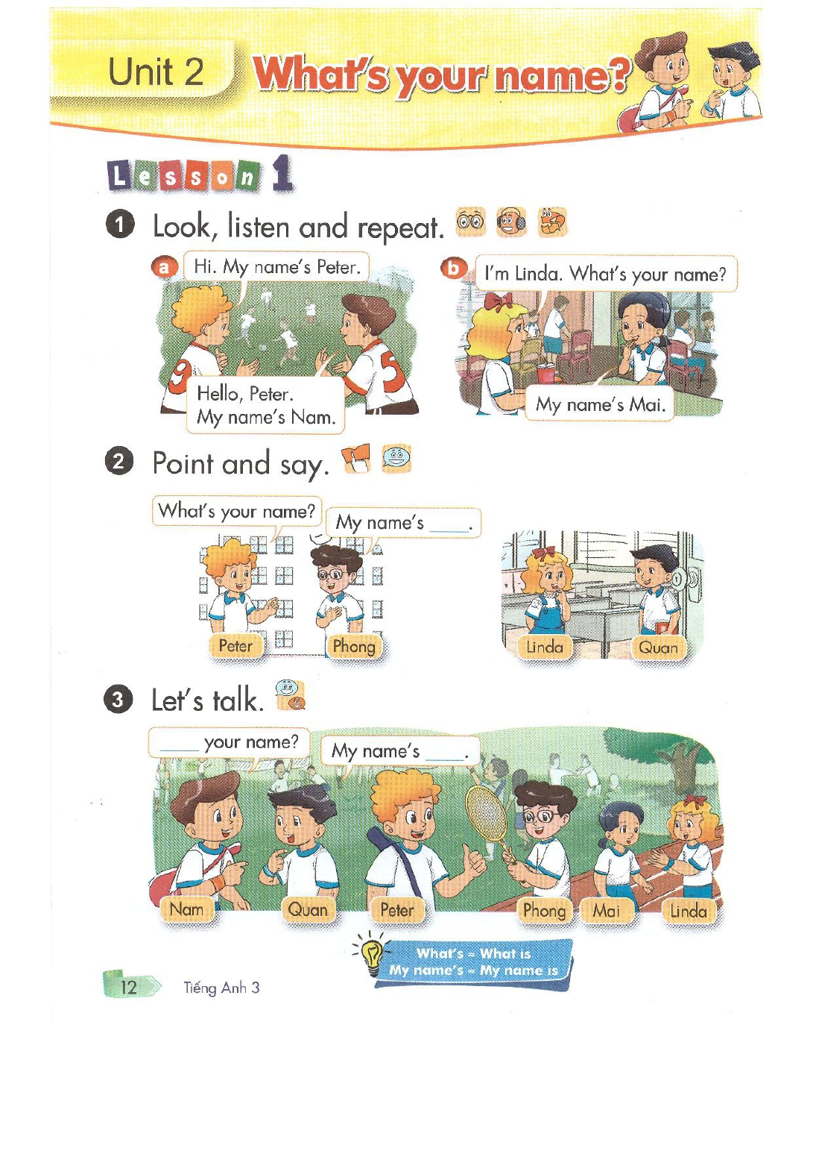
What’s
Quan

Slide 12
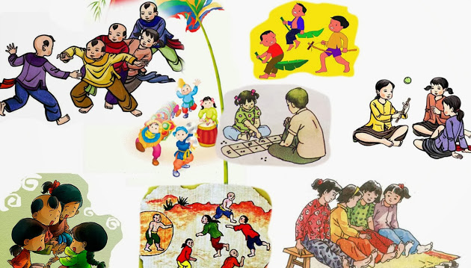
Let’s play: Role- play

Slide 13
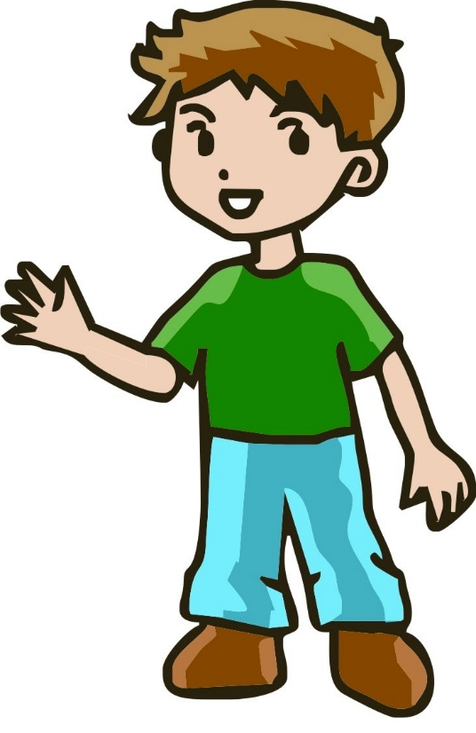
What’s your name?
My name’s Linda

Slide 14
What’s your name?
My name’s Quan

Slide 15
What’s your name?
My name’s Tony

Slide 16
What’s your name?
My name’s Peter

Slide 17
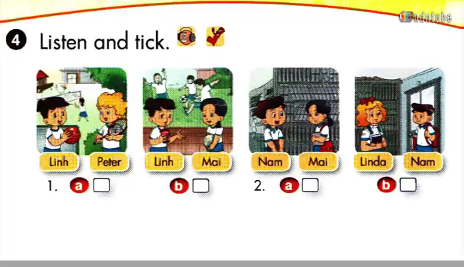

Slide 18
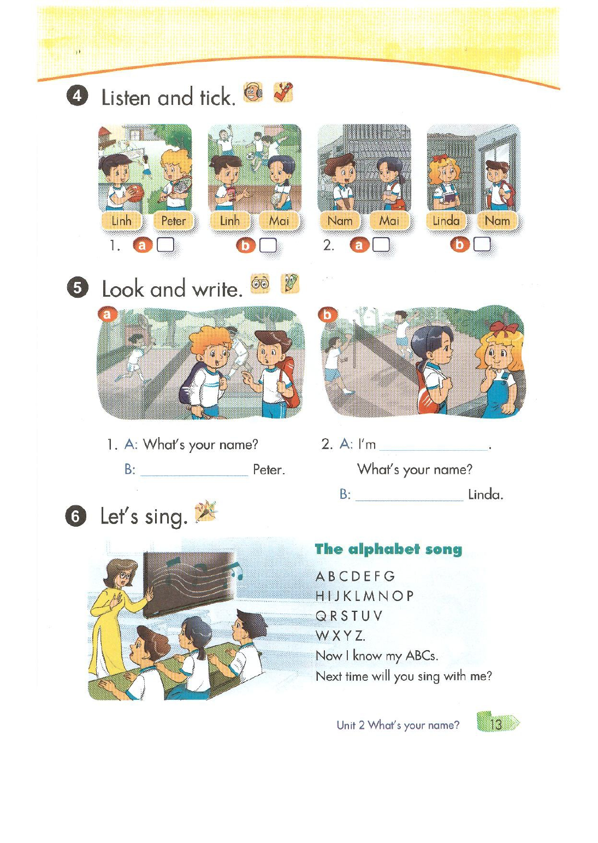
Mai
My name’s
My name’s

Slide 19
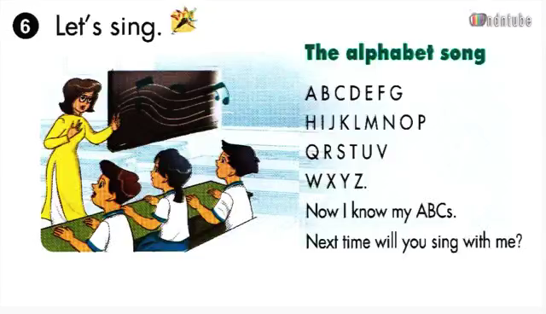

Slide 20

Thank you
Good bye!

