Slide 1
Hello, class!
Chúng mình nhớ tắt mic và đổi tên thiết bị thành tên của mình để
cô giáo điểm danh nhé!
Cô sẽ mời ra ngoài những bạn tự ý bật mic và vẽ lên bài giảng của cô!

Slide 2


Slide 3
Monday, February ^{1st} 2021
Unit 12: What does your father do?
Lesson 3
Doctor/ hospital
Jobs/ Places

Slide 4
Monday, February ^{1st} 2021
Unit 12: What does your father do?
Lesson 3

Slide 5
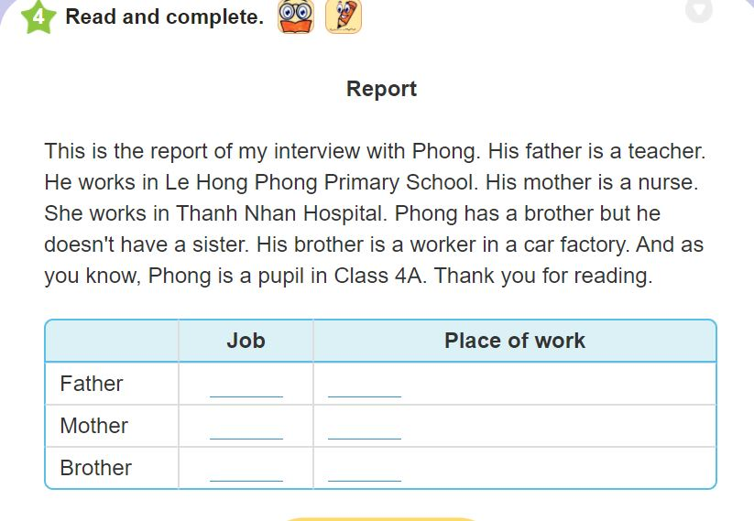
Teacher
Le Hong Phong Primary School
Nurse
Thanh Nhan Hospital
Worker
A car factory

Slide 6
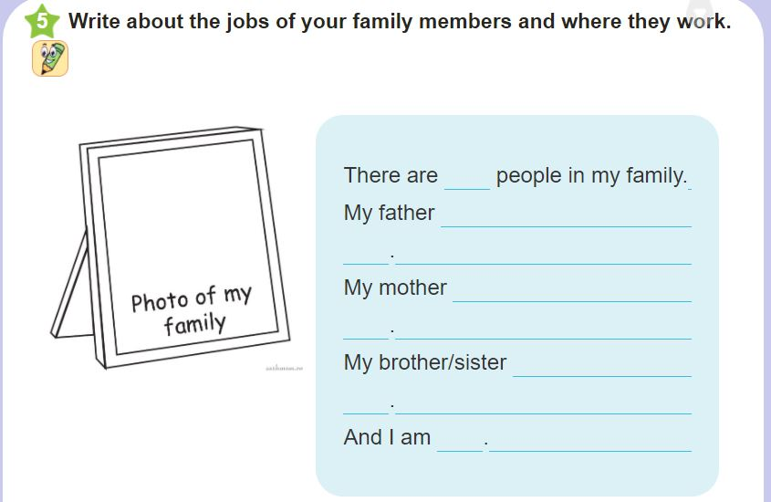

Slide 7
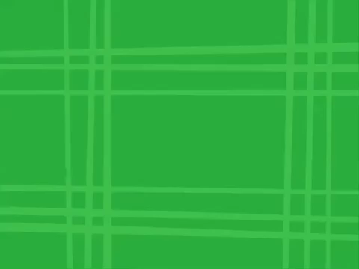

Slide 8
Wednesday, February 3rd 2021
Unit 13: Would you like some milk?
Lesson 1

Slide 9
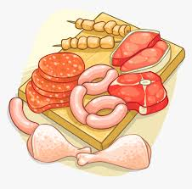
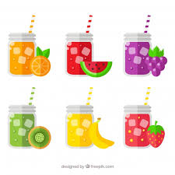
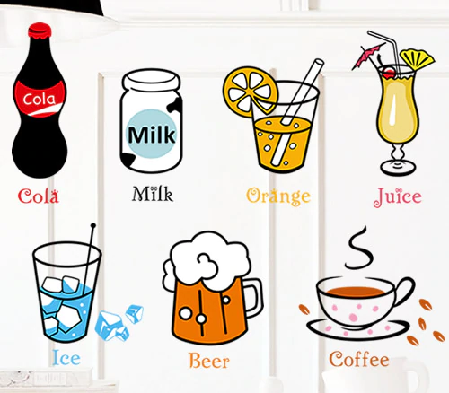

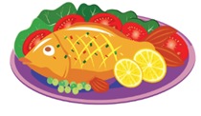
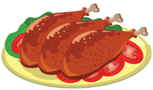
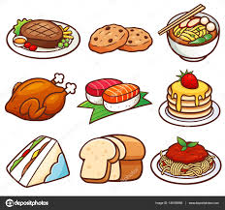
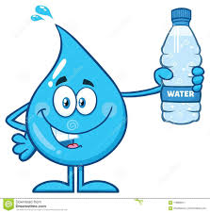
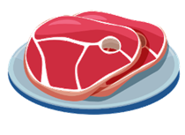
Wednesday, February 3rd 2021
Unit 13: Would you like some milk?
Lesson 1
A. New words
- favourite
- food
- drink
- meat
- beef
- pork
- chicken
- fish
- juice
- water

Slide 10

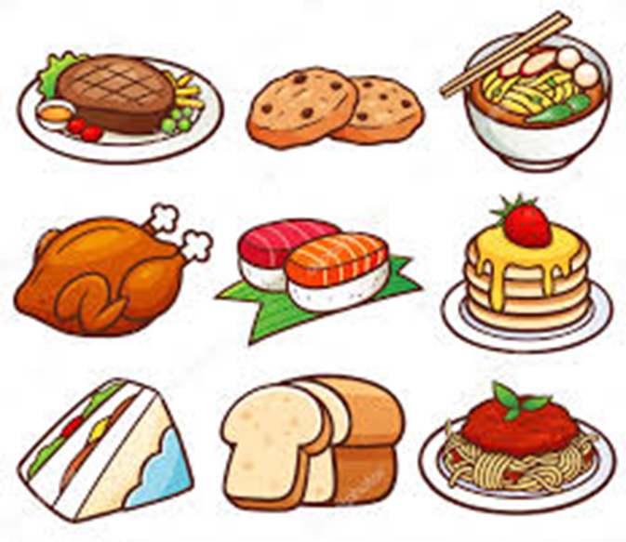
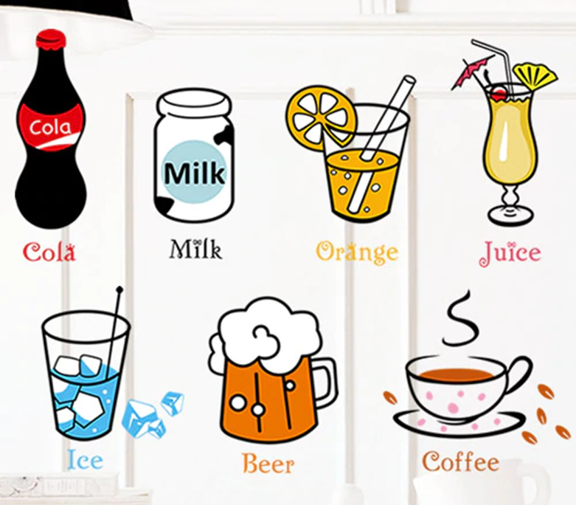

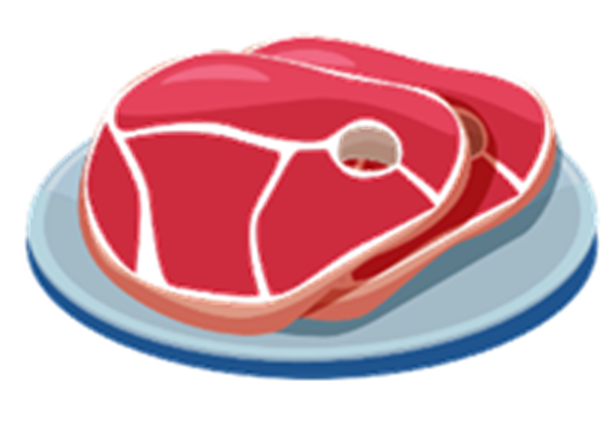
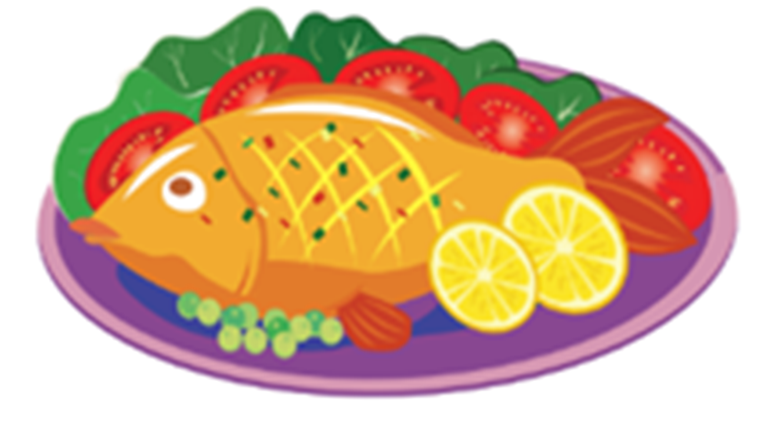



*GAME: What’s missing?

Slide 11

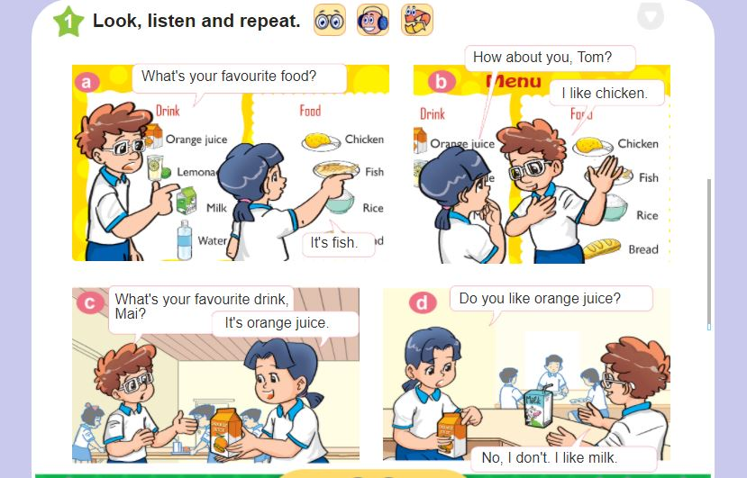
Wednesday, February 3rd 2021
Unit 13: Would you like some milk?
Lesson 1

Slide 12

Wednesday, February 3rd 2021
Unit 13: Would you like some milk?
Lesson 1
B. Form:
What’s your favourite______?
food
drink?
fish
It’s______________ .
orange juice.

Slide 13
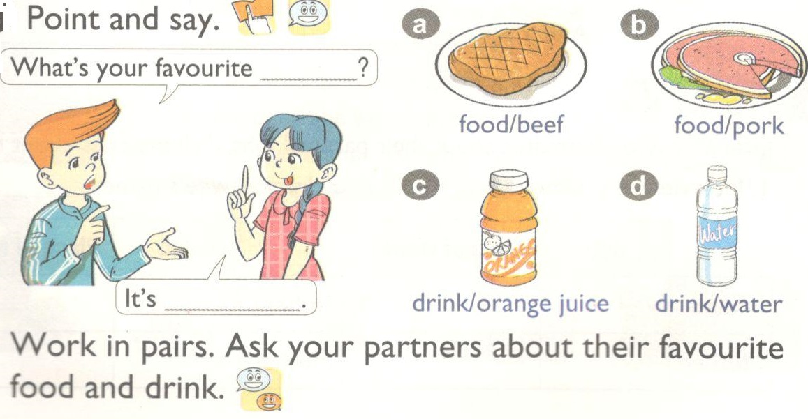
Wednesday, February 3rd 2021
Unit 13: Would you like some milk?
Lesson 1

Slide 14
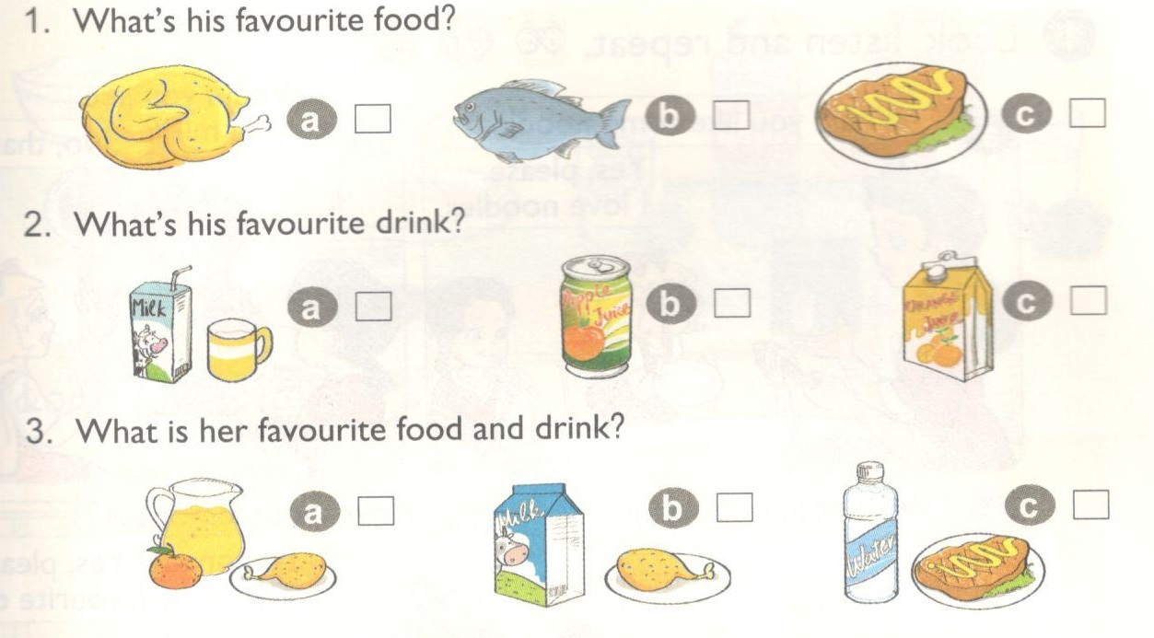

Wednesday, February 3rd 2021
Unit 13: Would you like some milk?
Lesson 1
3. Listen and tick

Slide 15
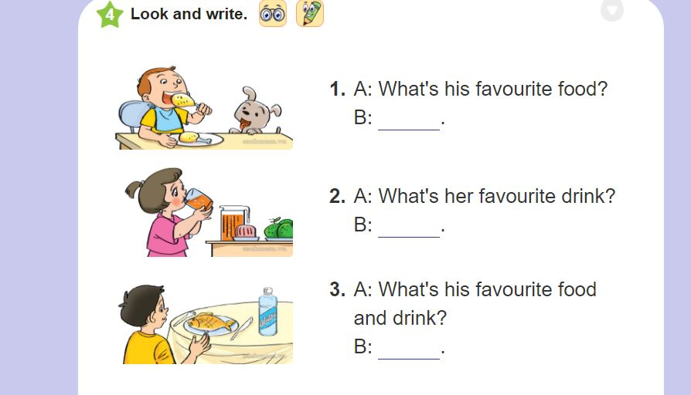
It’s chicken.
It’s orange juice.
It’s fish and water.

Slide 16
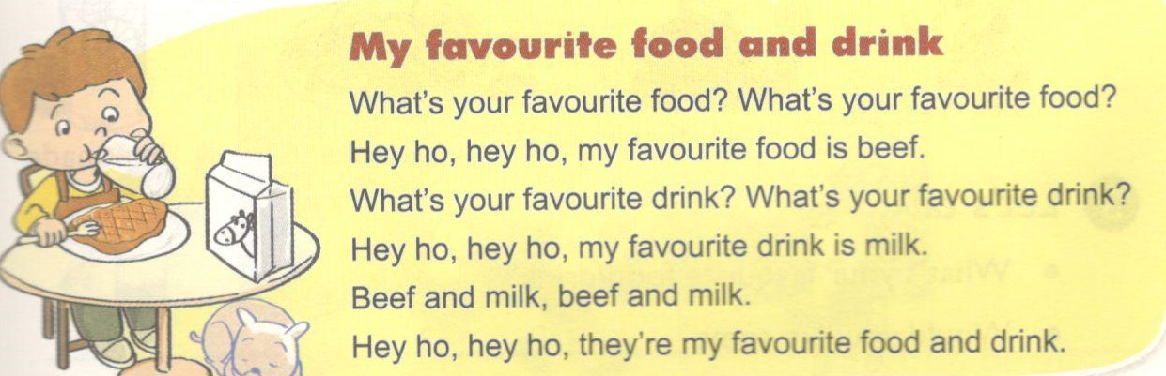
Wednesday, February 3rd 2021
Unit 13: Would you like some milk?
Lesson 1

Slide 17
Wednesday, February 3rd 2021
Unit 13: Would you like some milk?
Lesson 1
Homework:
Learn by heart the new words and form.
Do exercises on WB.

Slide 18
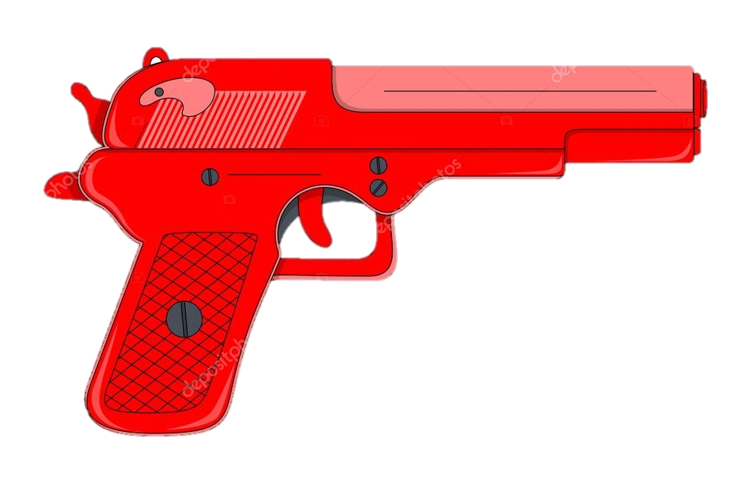



1
2
3
4
5
6

Slide 19
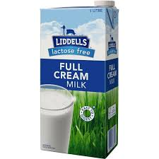
What’s your favourite food and drink?
- It’s milk and chicken.

Slide 20

What’s your favourite food?
- It’s beef.

Slide 21
What’s your favourite drink?
- It’s water.

Slide 22
What’s your favourite drink?
- It’s orange juice.

Slide 23
What’s your favourite food and drink?
- It’s water and fish.

Slide 24
What’s your favourite food?
- It’s pork.

Slide 26


Slide 27
