Slide 1



Saturday,March 14th,2020
Welcome to my English team

Slide 2

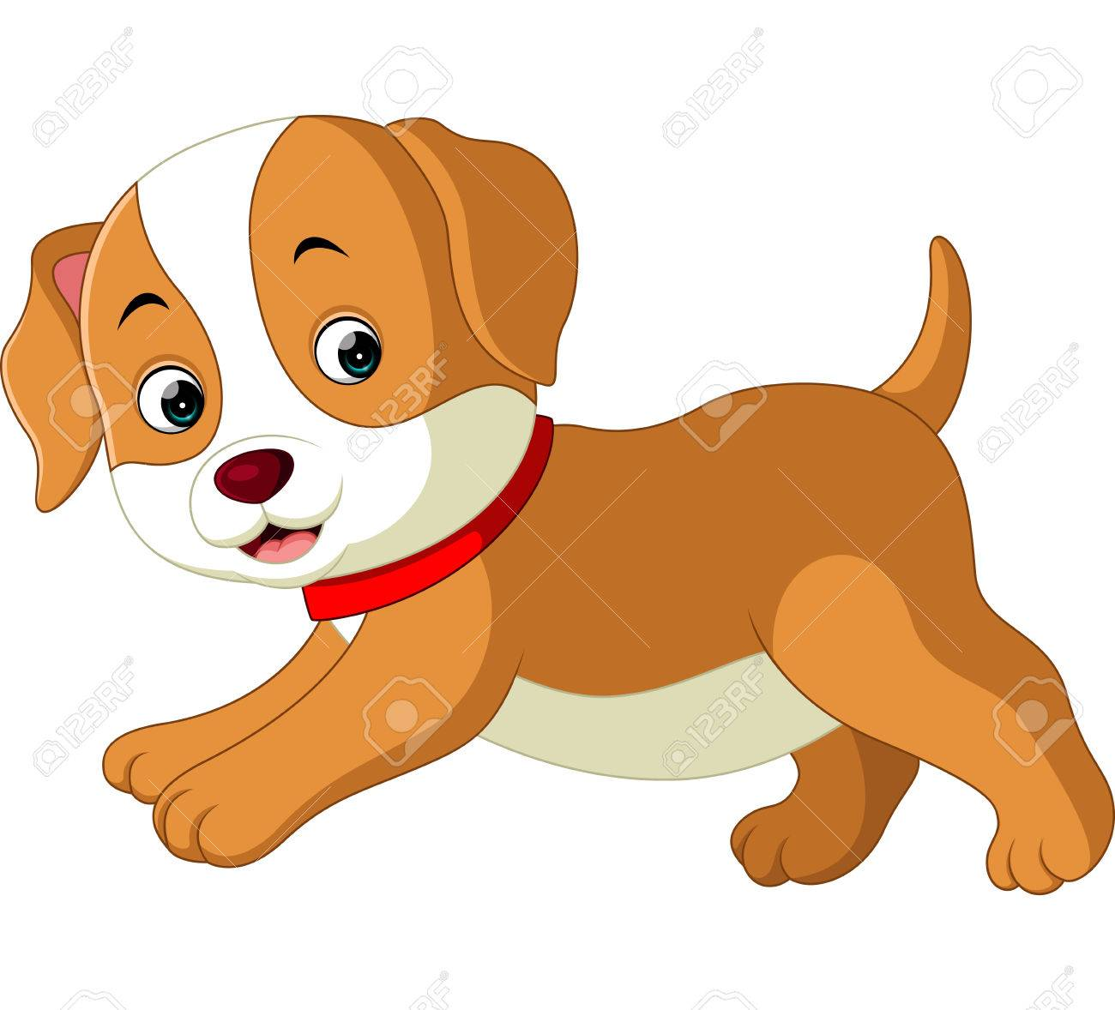
1. Listen to the sounds.

Slide 3
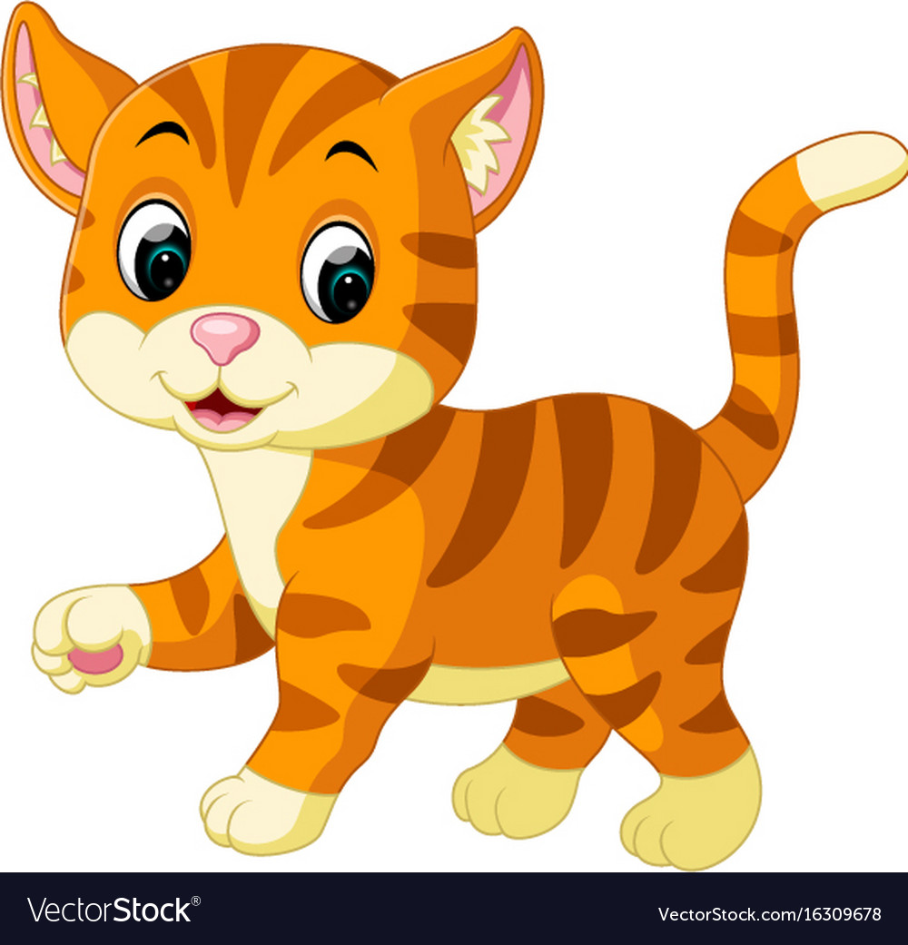
2. Listen to the sounds.

Slide 4
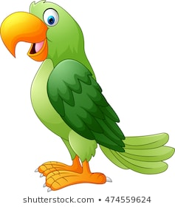
3. Listen to the sounds.

Slide 5

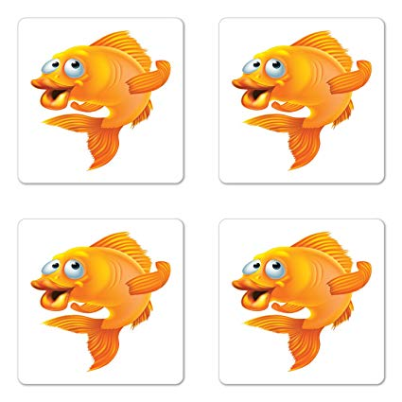
4. ______ you have any goldfish ?
a. Do
b. Are

Slide 6
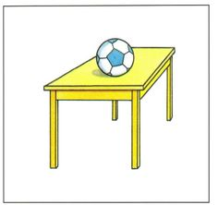
5. Where are the balls ?
They’re _____ the table.
a. on
b. in

Slide 7


Unit 16 : Do you have any pets ?
(Lesson 2: 1, 2 &3 )

Slide 8
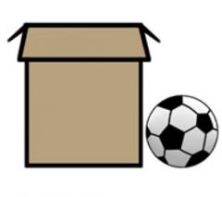
Unit 16 : Do you have any pets ?
(Lesson 2: 1, 2 &3 )
Next to : bên cạnh

Slide 9

Unit 16 : Do you have any pets ?
(Lesson 2: 1, 2 &3 )
In front of : đằng trước

Slide 10
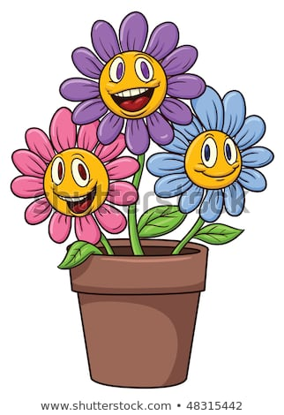
Unit 16 : Do you have any pets ?
(Lesson 2: 1, 2 &3 )
Flower pot : bình hoa

Slide 11
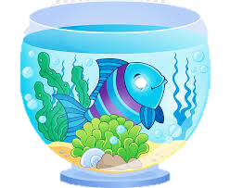
Unit 16 : Do you have any pets ?
(Lesson 2: 1, 2 &3 )
Fish tank: bể cá

Slide 12
Unit 16 : Do you have any pets ?
(Lesson 2: 1, 2 &3 )
A. Vocabulary
Flower pot:
Fish tank:
Next to
In front of >< behind

Slide 13
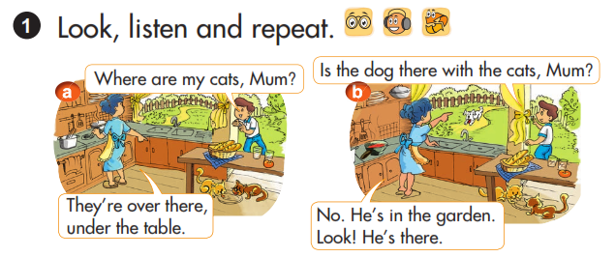
Unit 16 : Do you have any pets ?
(Lesson 2: 1, 2 &3 )

Slide 14
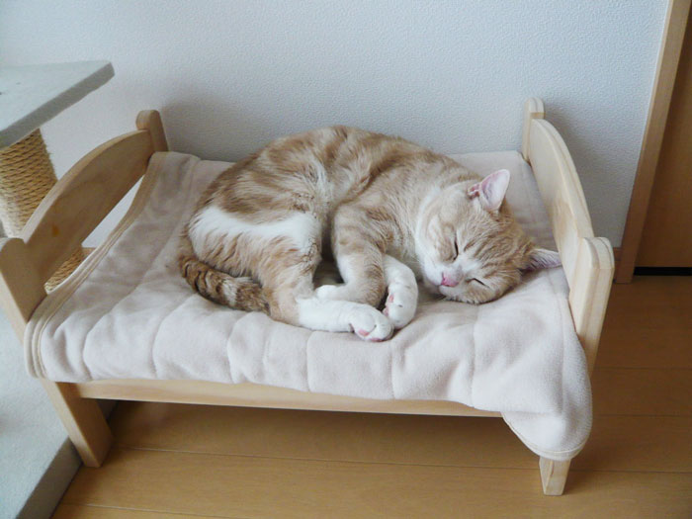
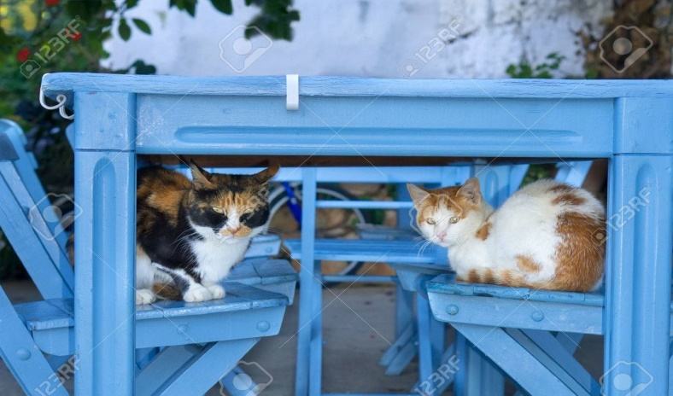
Unit 16 : Do you have any pets ?
(Lesson 2: 1, 2 &3 )
Where
is
the cat ?
It’s
on the bed.
Where
are
the cats ?
They’re
under the table.

Slide 15
Unit 16 : Do you have any pets ?
(Lesson 2: 1, 2 &3 )
B. Model sentence:
Where are the cats?
- They’re under the table.

Slide 16
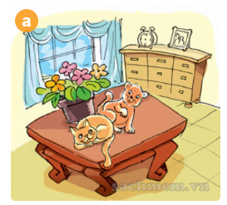
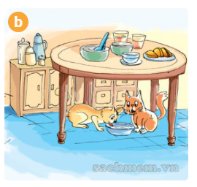
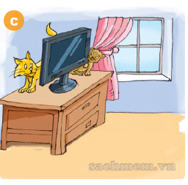
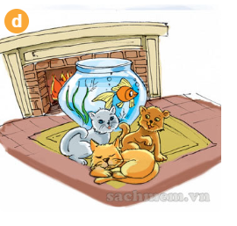
Where are the cats?
They’re__
next to the flower pot
under the table
behind the TV
in front of the fish tank

Slide 17

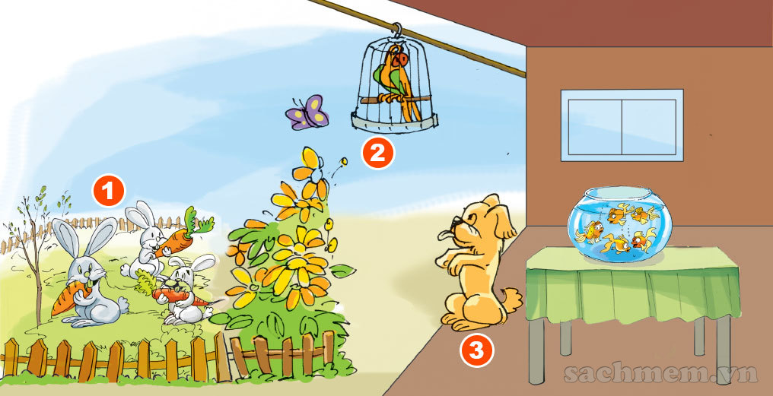
Where is the ___ ?
It’s _______.
Where are the ____ ?
They’re _____
4

Slide 18
1
2
3
4
5
6
7
8
9

Slide 19

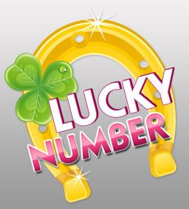



Slide 20
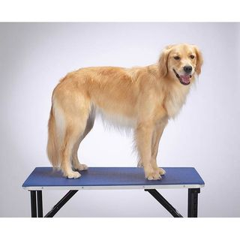
2.Where ____ the dog ?
It’s on the table.
a. is
b. are

Slide 21
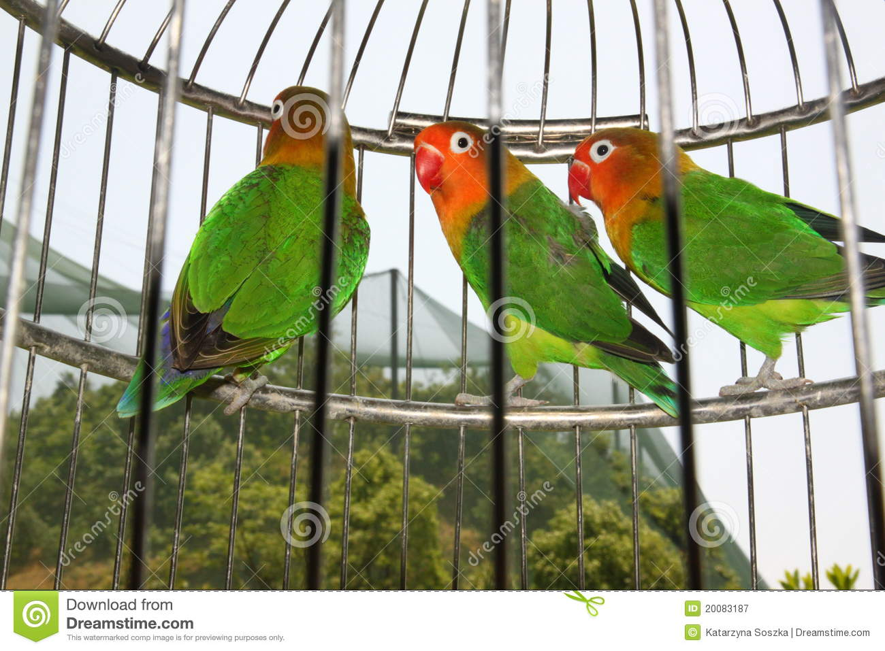
3.Where are the parrots ?
They’re ____ the cage .
a. on
b. in

Slide 22
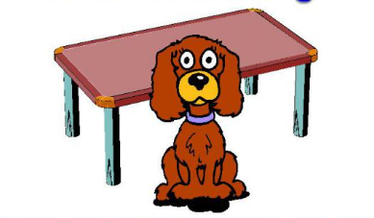
4.Where is the dog?
It’s _____ the table.
a. behind
b. in front of

Slide 23
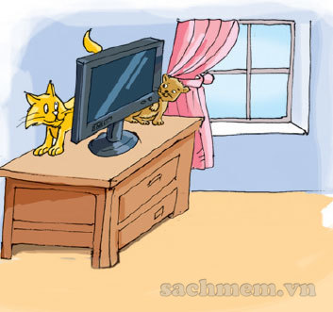
6.Where are the cats ?
_______ behind the TV.
a. They’re
b. It’s

Slide 24
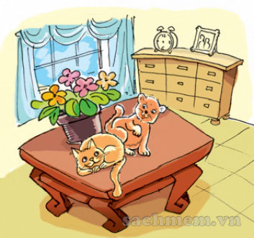
7.Where are the cats ?
They’re _____ the flower pot.
a. behind
b. next to

Slide 25
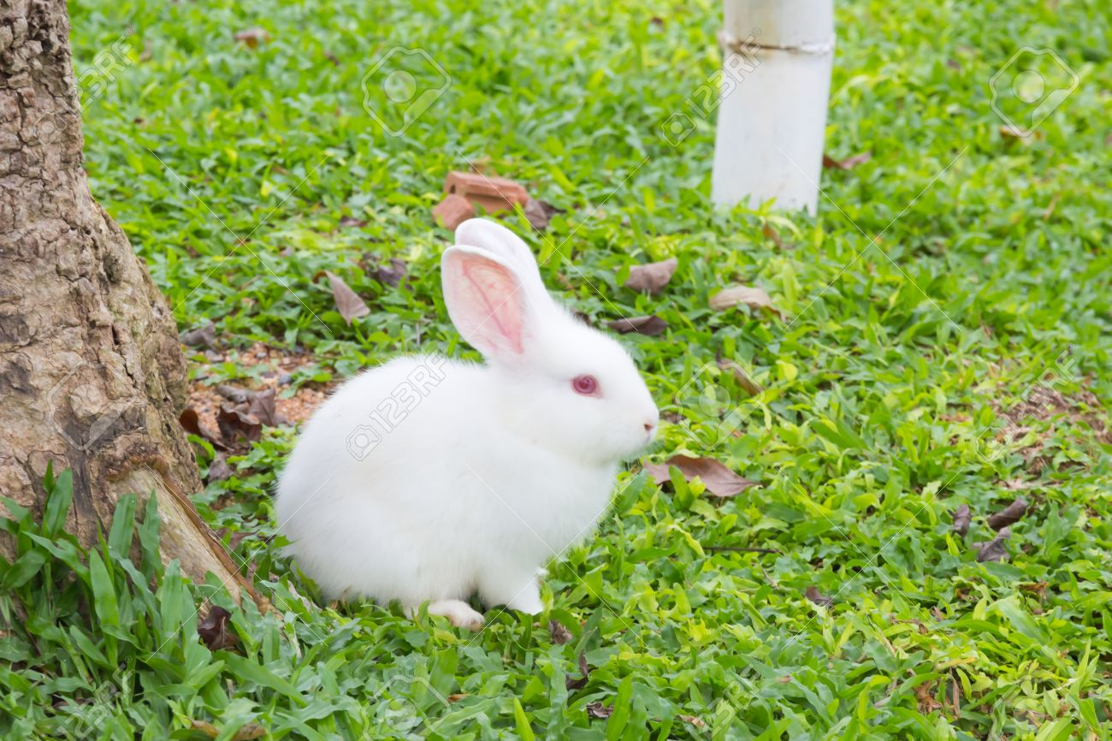
7.Where is the _____ ?
It’s in the garden.
a. rabbits
b. rabbit

Slide 26
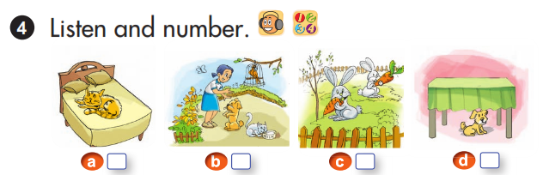
Unit 16 : Do you have any pets ?
(Lesson 2: 1, 2 &3 )
2
1
4
3

Slide 27
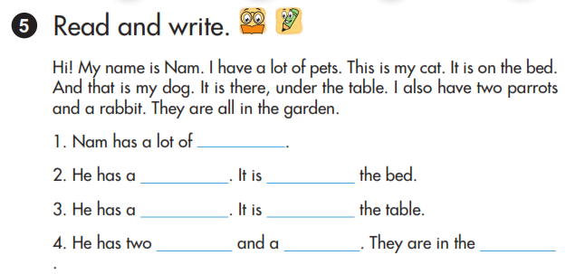
Unit 16 : Do you have any pets ?
(Lesson 2: 1, 2 &3 )
pets
cat
on
dog
under
parrots
rabbit
garden

Slide 28

Write each new words 3 lines
Practice more the structures you have learnt.
Prepare new lesson (lesson 2 : 3,4,5)

