Slide 1

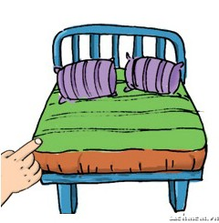

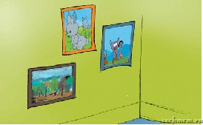
MATCHING:
A
C
chair
bed
pictures
D
B
poster

Slide 2
English 3
Unit 14: Are there any posters in the room?
Lesson 1 (page 24)
Notes:
2

Slide 3
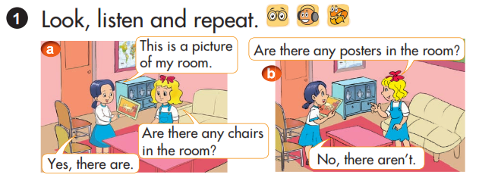

Slide 4

I. New words:
A map : bản đồ
maps : những chiếc bản đồ

Slide 5


maps
I. New words:

Slide 6


A sofa : ghế xô-pha
sofas : những chiếc ghế xô-pha

Slide 7
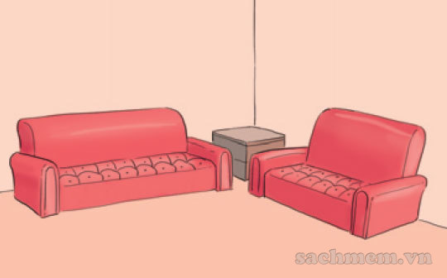
sofas

Slide 8

A wardrobe: tủ quần áo
wardrobes: những chiếc tủ quần áo

Slide 9
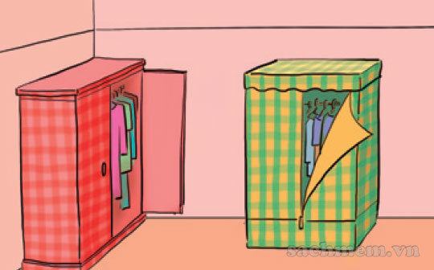
wardrobes

Slide 10

a cupboard : tủ chén bát
cupboards :những chiếc tủ chén bát

Slide 11
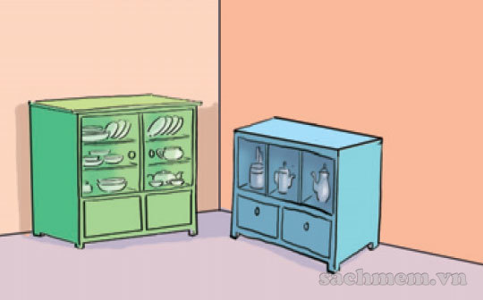
cupboards

Slide 12
I. New words:
1. maps
        :những tấm bản đồ
:những chiếc ghế xô-pha
:những chiếc tủ quần áo
:những chiếc tủ chén bát
2. sofas
3. wardrobes
4. cupboards

Slide 13
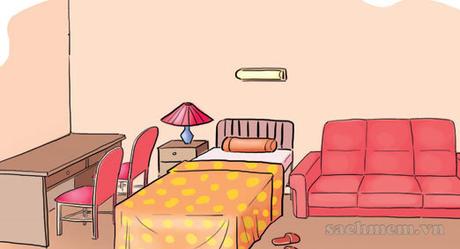
Ex 1:Are there any chairs in the room?
Yes, there are.
II. Model sentences:
Are there any …. in the room?
+Yes, there are.
- No, there aren’t.
there aren’t = there are not
Ex 2:Are there any maps in the room?
No, there aren’t.

Slide 14
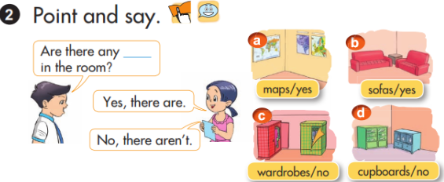

Slide 15
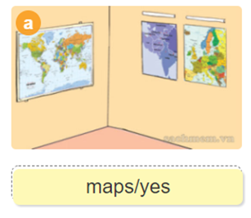
Are there any maps in the room?
Yes, there are.

Slide 16
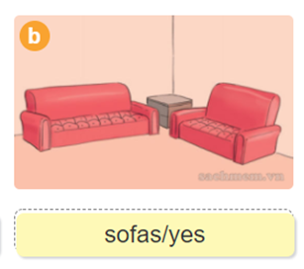
Are there any sofas in the room?
Yes, there are.

Slide 17
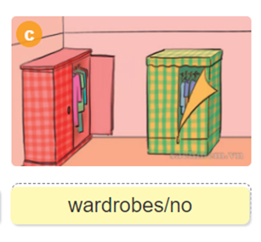
Are there any wardrobes in the room?
No, there aren’t.

Slide 18
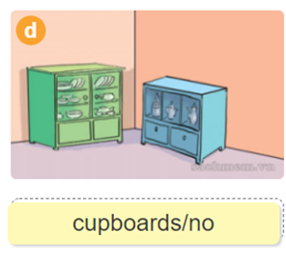
Are there any cupboars in the room?
No, there aren’t.

Slide 19
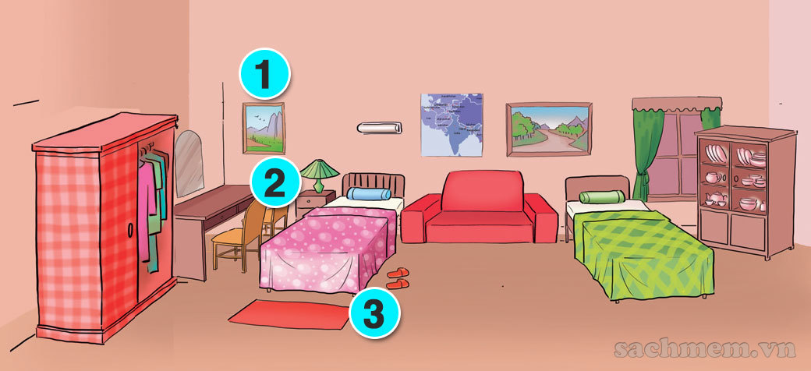
3. Let’s talk.
1,Are there any chairs in the room?............
2,Are there any pictures in the room?............
3,Are there any beds the in the room?...........
4,Are there any cupboards in the room?...........

Slide 20
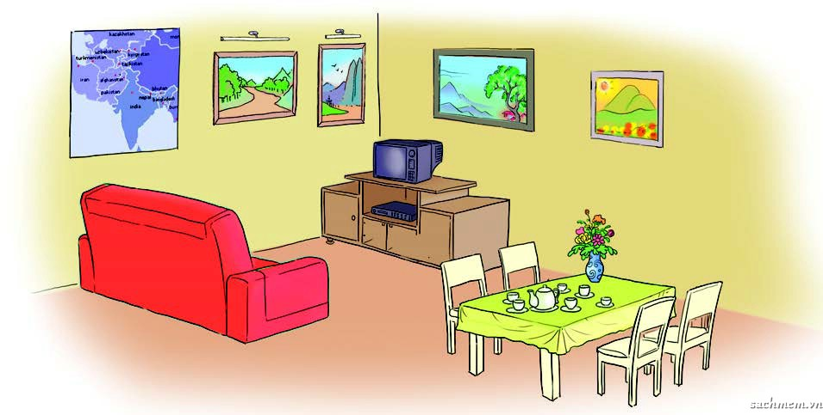
5. Look, read and write.
four pictures
One map
four chairs
One sofa
Are there any……..in the room?
Yes,there are
No,there aren’t

Slide 21

5. Look, read and write.
This is a living room.
2. There is a TV on the …….
in the room.
3. There are four pictures and a big
…… on the wall.
4. There are four ………… near the table.
cupboard
map
chairs

Slide 22
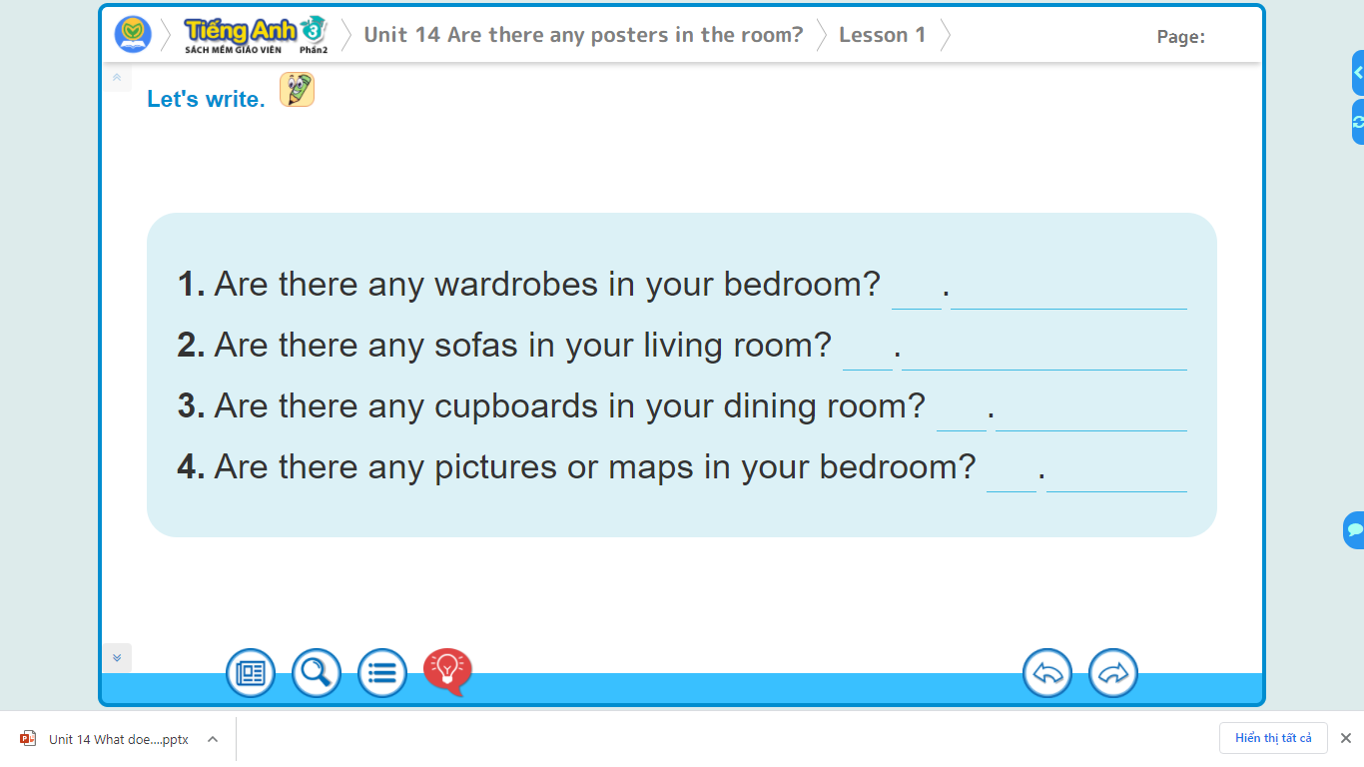
6. Let’s write.

Slide 23
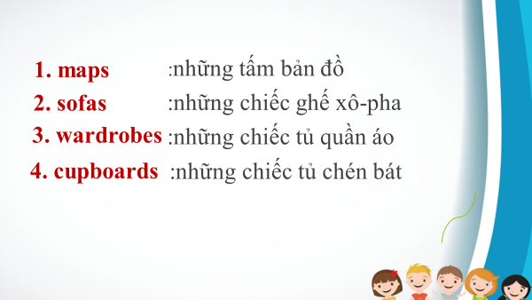
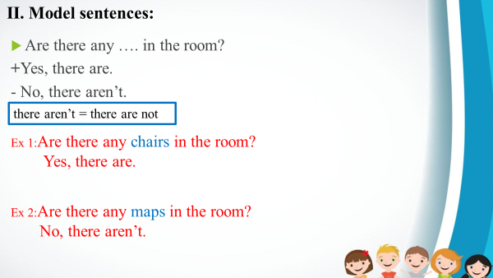
Unit 14: Are there any posters in the room?
Lesson 1 (page 24)
I. New words:
II. Model sentences:
Notes:
23

Slide 24
Goodbye. See you later!

