Slide 1

TIEN PHONG PRIMARY SCHOOL
Welcome
to my class

Slide 2

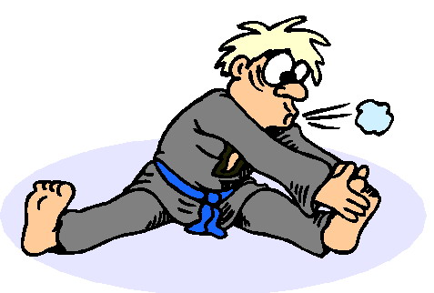

Slide 3
Warm up:
Lucky Number
1
2
3
4
5
6
7
8
9
10
1
2
3
4
5
6
7
8
9
10

Slide 4

sweet shop

Slide 5

pharmacy

Slide 6

supermarket

Slide 7
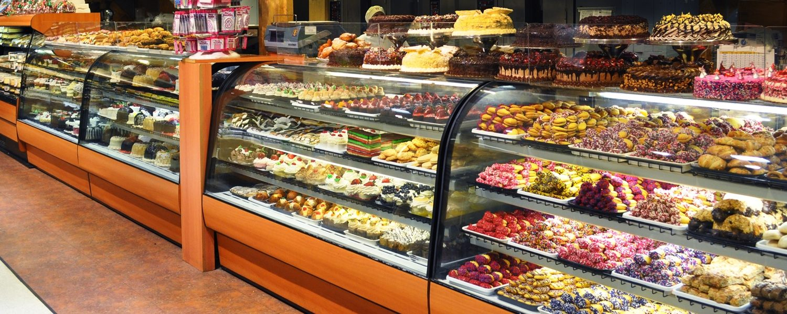
bakery

Slide 8
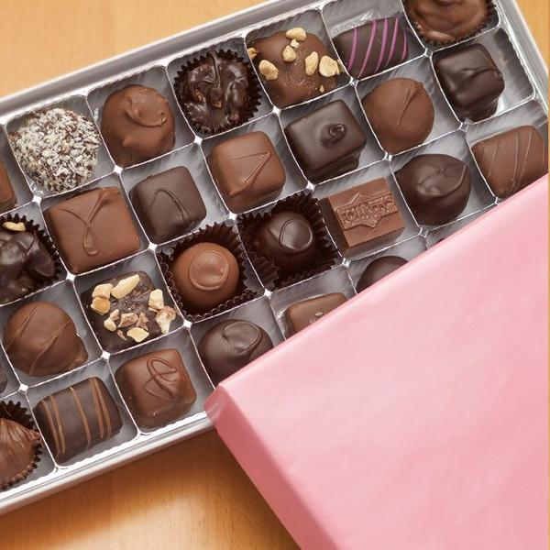
chocolate

Slide 9
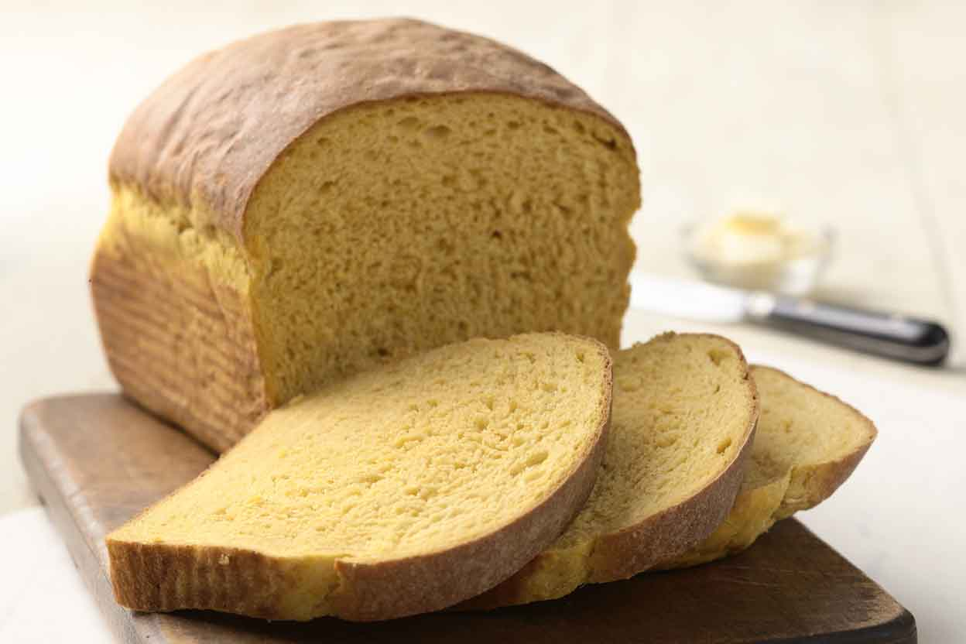
bread

Slide 10
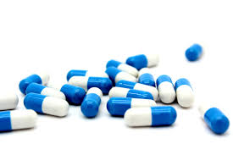
medicine

Slide 11


Slide 12

UNIT 16:
Let’s go to the bookshop
LESSON 2:
1 – 2 – 3

Slide 13


Slide 14
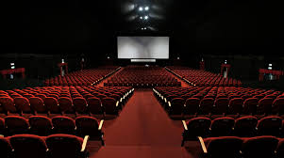
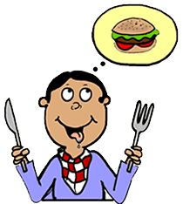
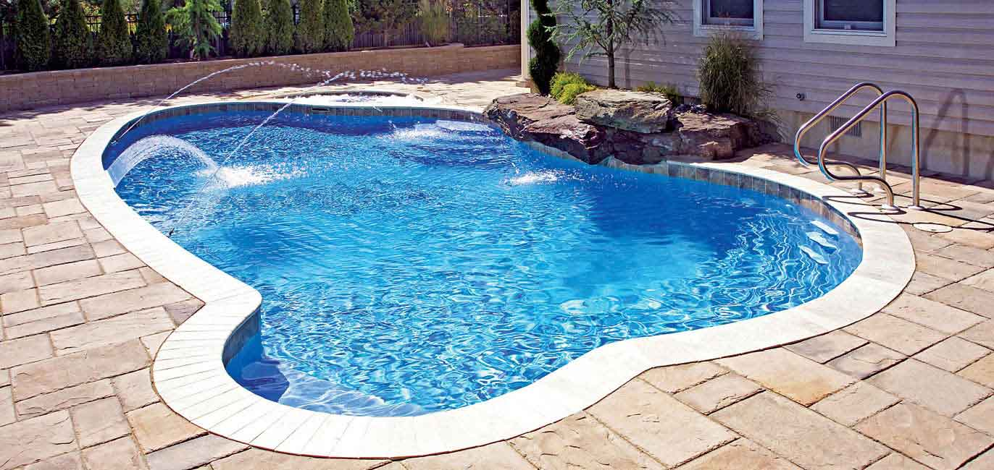
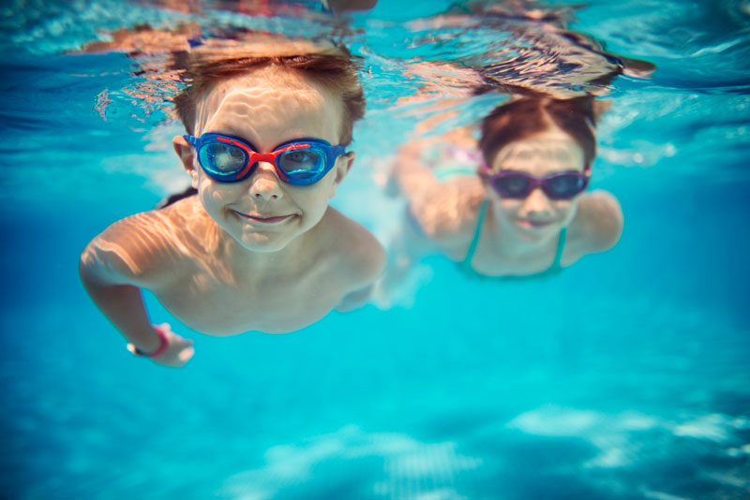
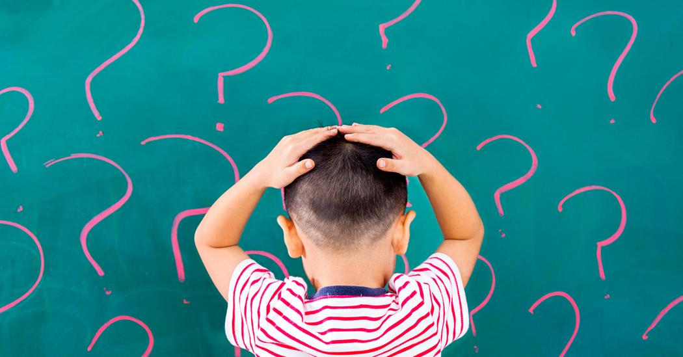

swimming pool : bể bơi
cinema : rạp chiếu phim
because : bởi vì
swim : bơi
why : tại sao ?
hungry : đói bụng

Slide 15
Check vocabulary

Slide 16

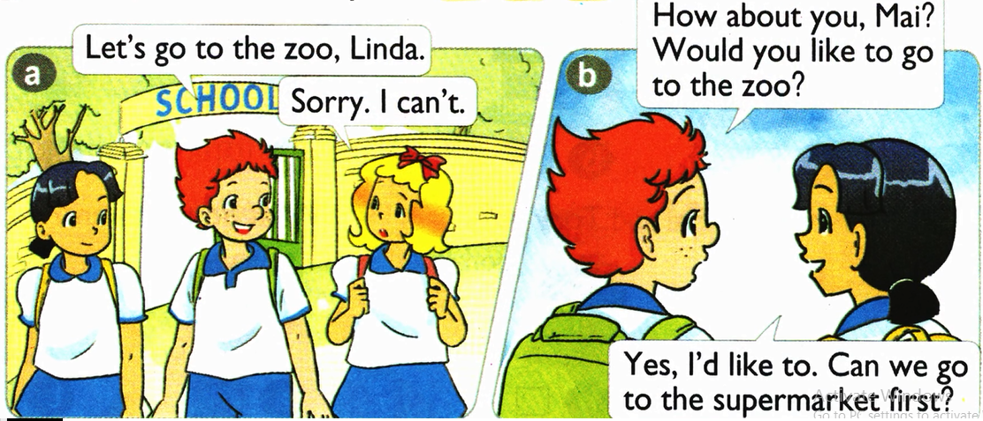
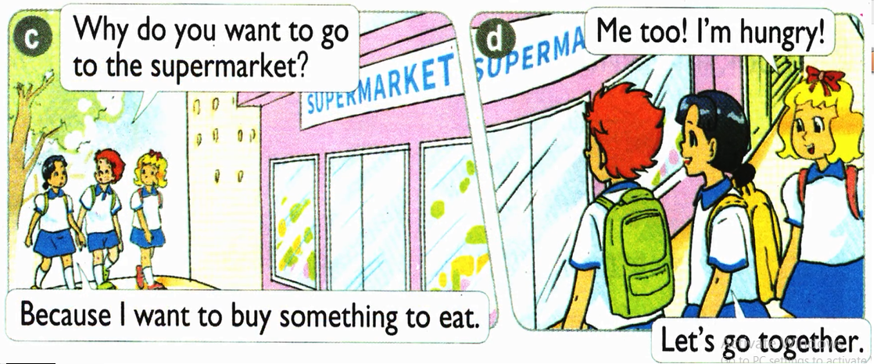
1. Look, listen and repeat.

Slide 17
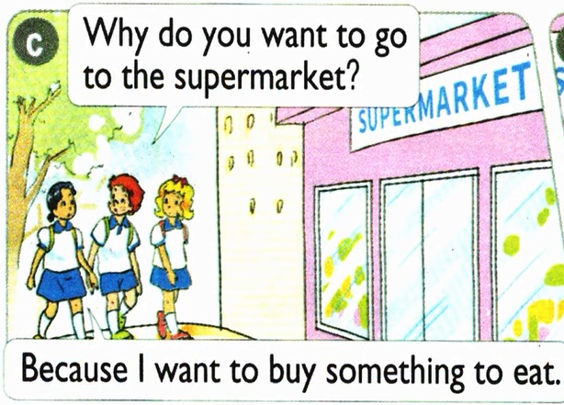
Model sentence

Slide 18
Model sentence
Ex: Why do you want to go
the supermarket?
- Because I want to buy something to eat.
Why do you want to go to the _______?
- Because I want to _________.

Slide 19
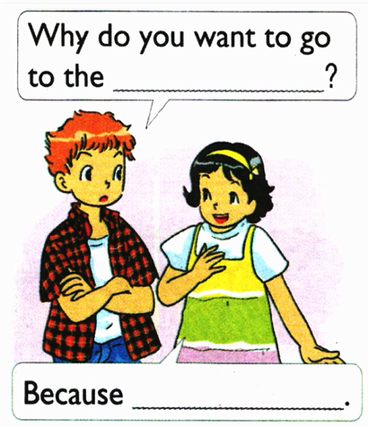
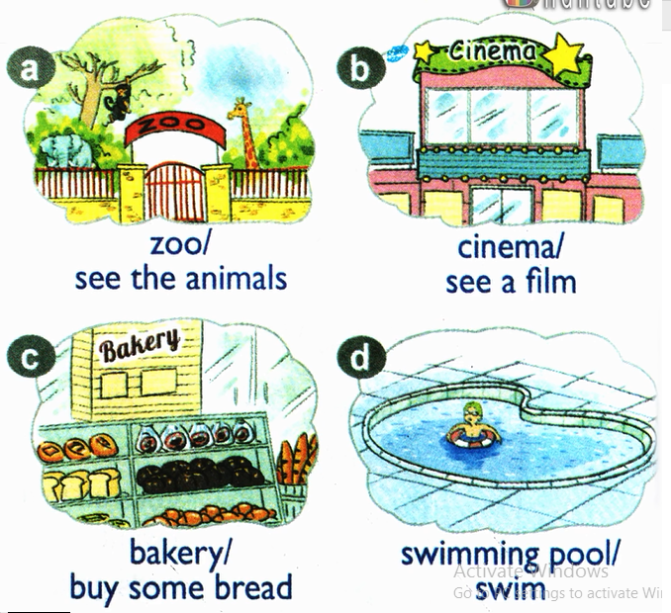
2. Point and say.
zoo
I want to see the animals

Slide 20
2. Point and say.

Slide 21
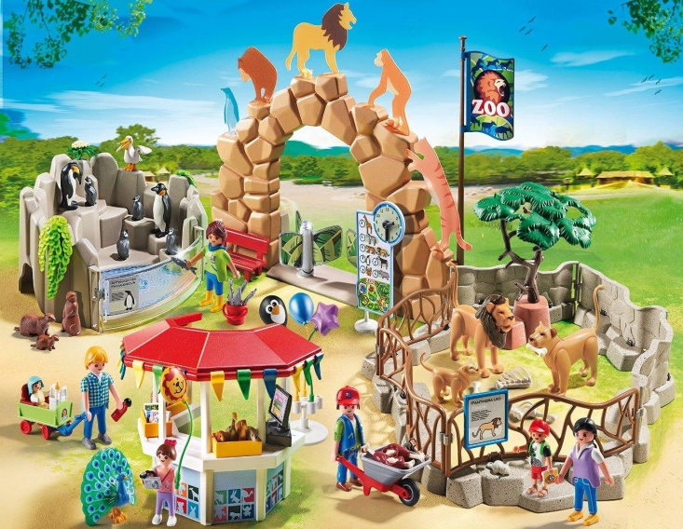
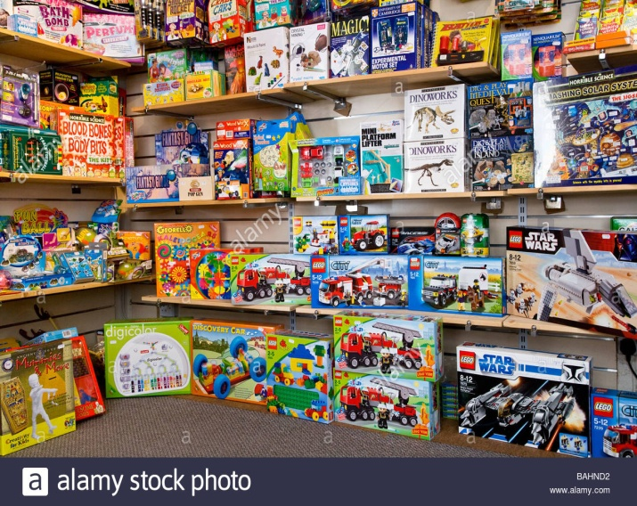
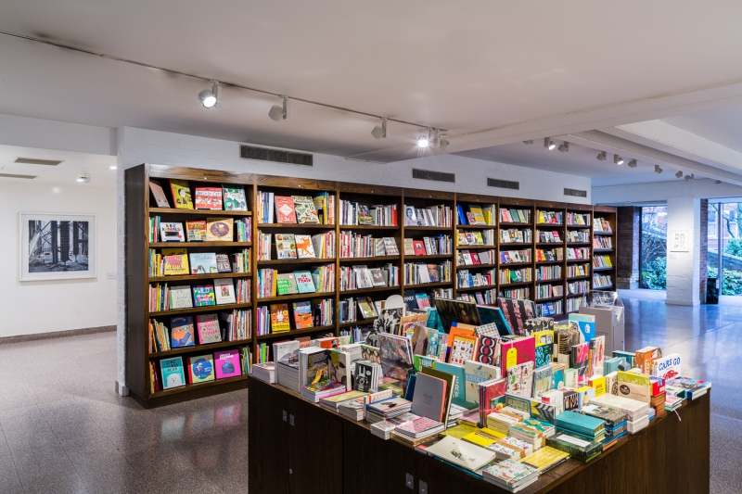
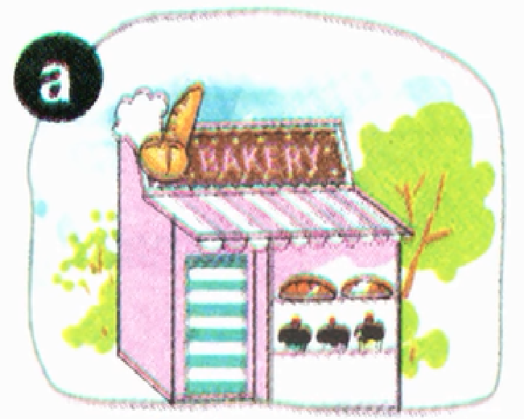
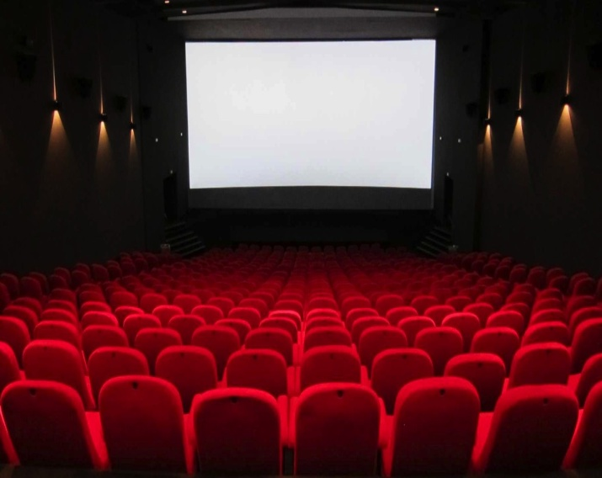
3. Let’s talk.
Let’s go to the ……………
Why do you want to go to the…………

Slide 22
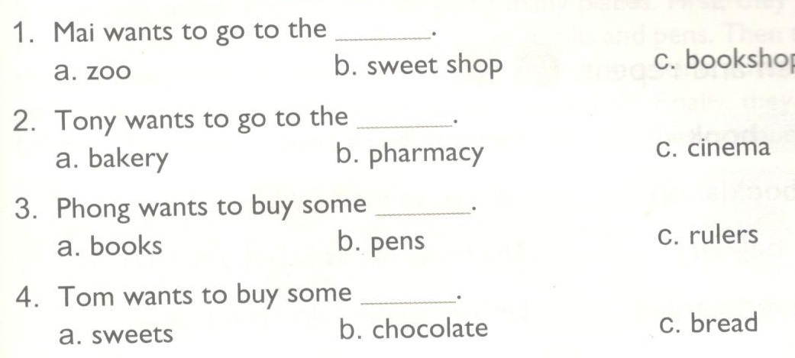
4. Listen and circle.

Slide 23
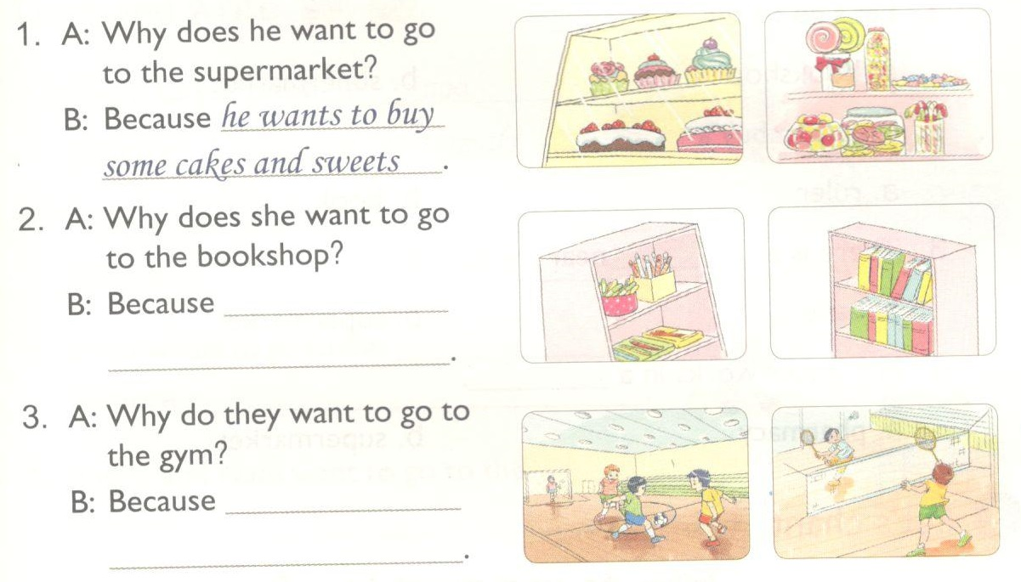
5. Look and write.
she wants to buy
some pens and books.
they want to play
football and badminton.

Slide 24

Consolution
Homework:
Choose the best answer
1. How…………….books are there? – There are four.
much B. many C. about
Do exercises in workbook
- Learn by heart the new words.
2. How many………………..are there in the room?
– There are four fans.
A. door B. fan C. fans
3. How many chairs are there in the room?
There…………..thirty-two chairs.
A. is B. a C. are
4. How many computers………there in the room?
There………..a computer.
A. are/is B. is/are C. Ɵ

Slide 25

THANK YOU
FOR YOUR Listen!
GOOD BYE

