Slide 1
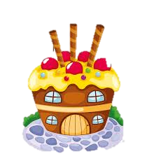

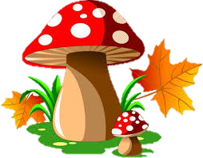
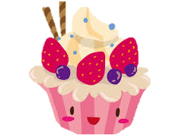
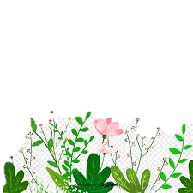
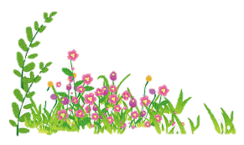
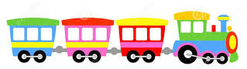
Monday, March 8th 2021
Unit 15: When’s Children day?
Lesson 2

Slide 2

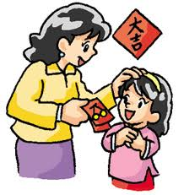
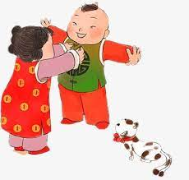
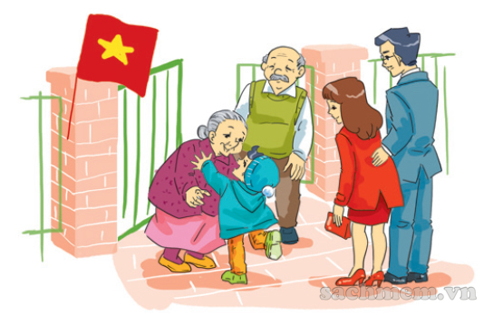
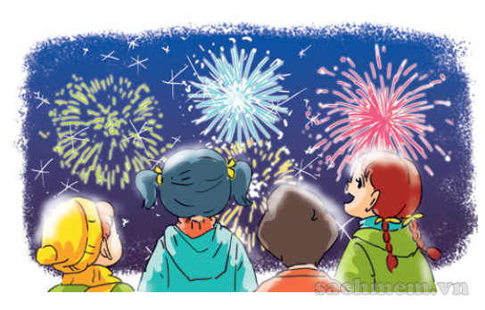
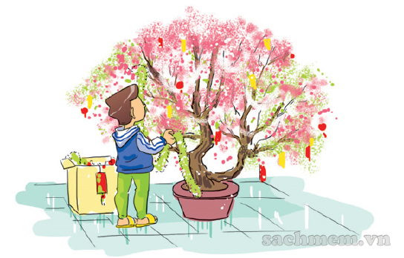
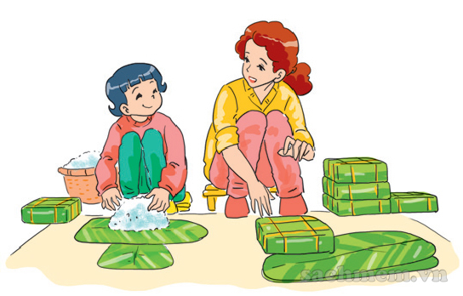
01
New words:
- Make banh chung
- Decorate the house
- Watch firework displays
- Visit grandparents
- Wear new/ nice clothes
- Get lucky money

Slide 3
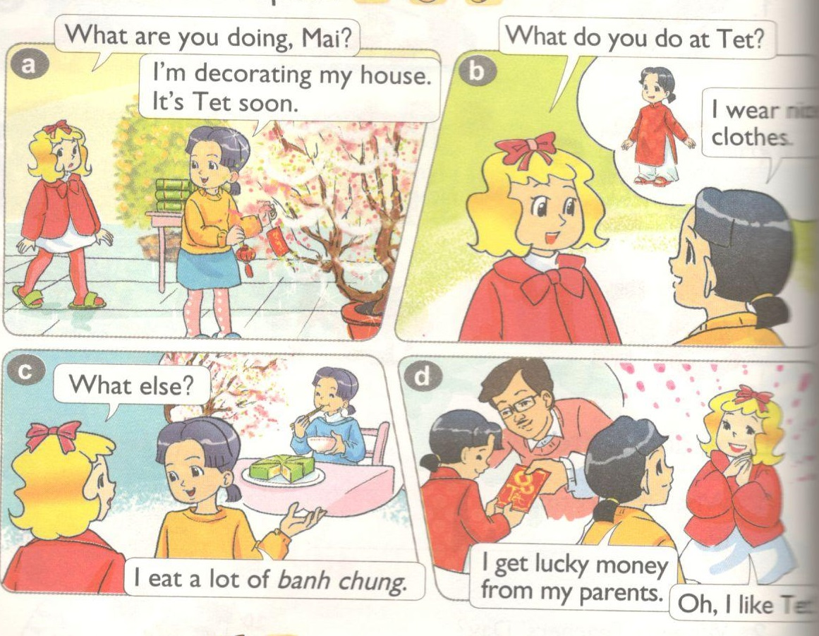

Slide 4
02
Structures:
What do you do at Tet?
I make banh chung.

Slide 5


2. Point and say:
What do you do at Tet?
I _____________.

Slide 6
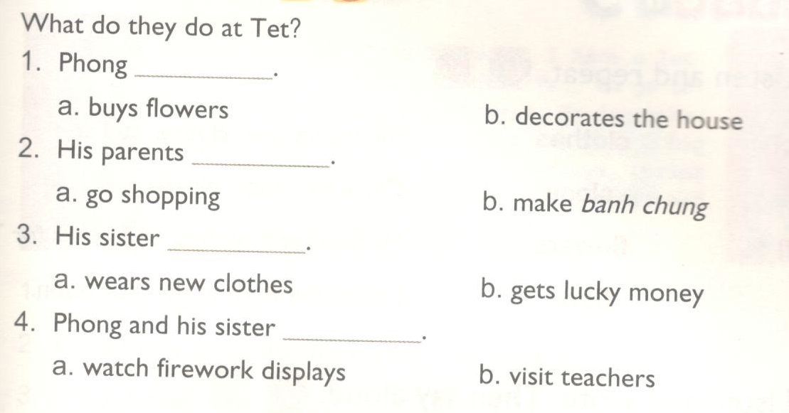
4. Listen and circle.

Slide 7
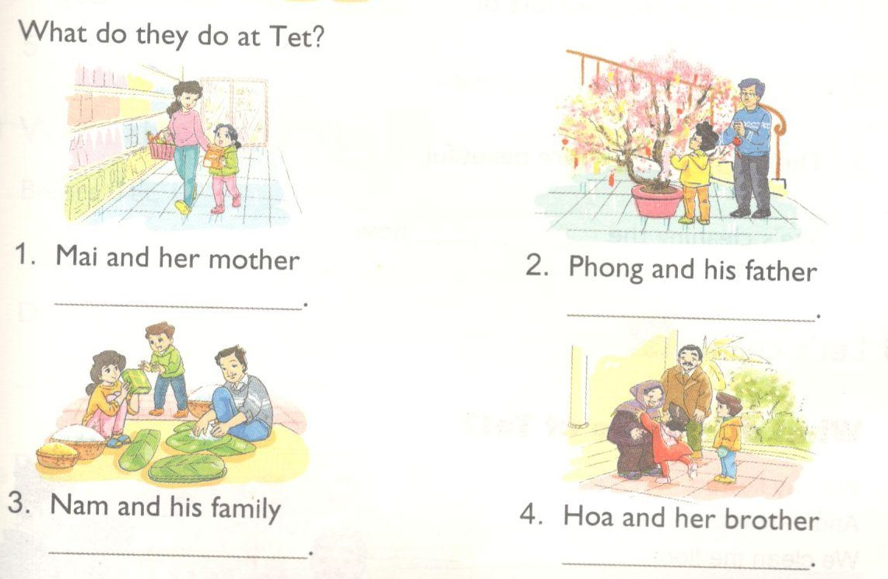
5. Look and write.
go shopping
decorate the house
make banh chung
visit grandparents

Slide 8
02
Structures:

Slide 9
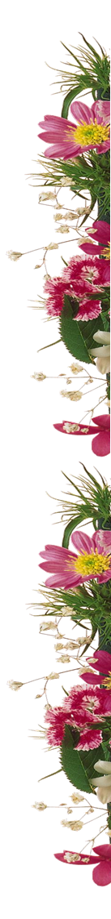
Homelink
Learn by heart the vocabulary and the form
Do exercises on WB (Unit 14) and Handout (Unit 14)

