Slide 1
Unit 11: THIS IS MY FAMILY
Lesson 3
br
brother
br
gr
grandmother
gr

Slide 2

br
brother
That’s my brother
gr
grandmother
My grandmother’s fifty – five years old

Slide 3
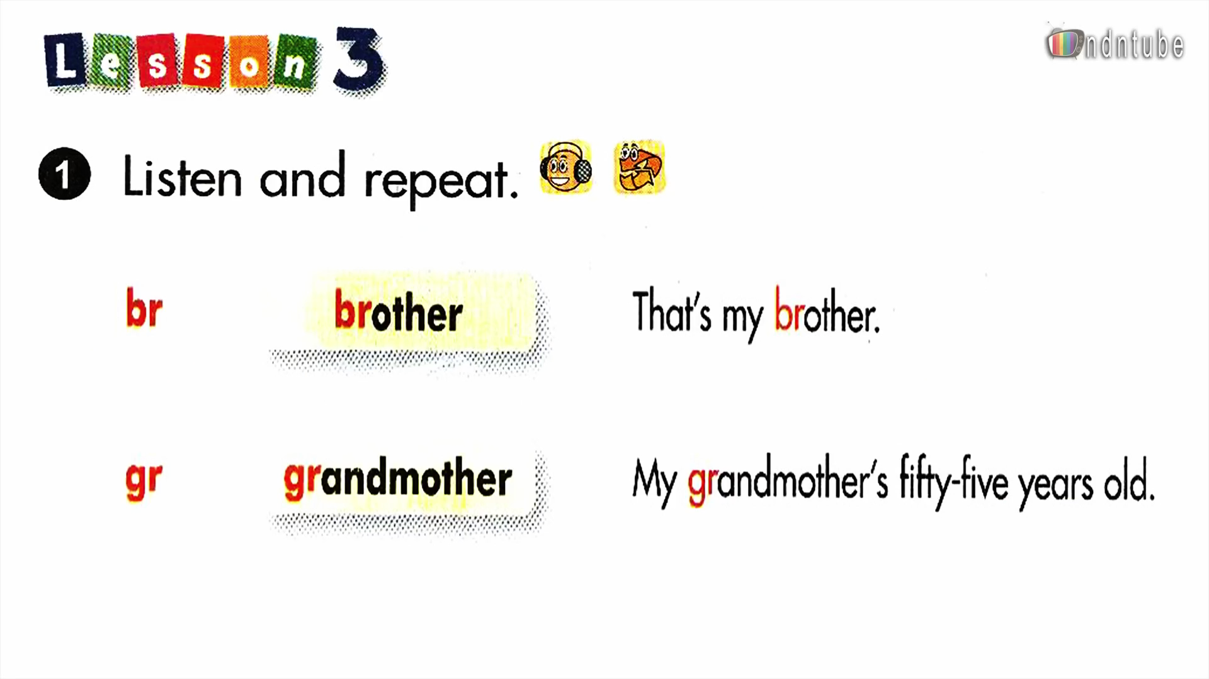

Slide 4

br
brother
bread
grandmother
green
brown
gr
grandfather

Slide 5




1. My______________ is fifteen
brother
2. My________________ is fifty – three years old.
grandfather

Slide 6

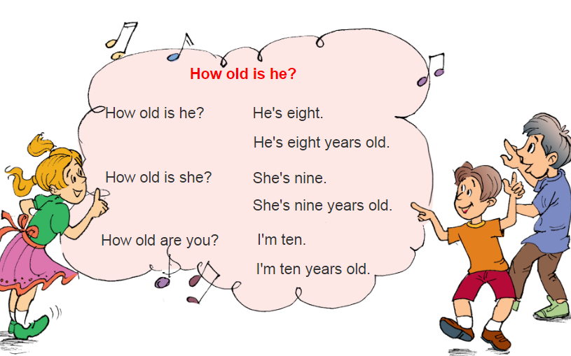
Unit 11: THIS IS MY FAMILY
Lesson 3

