Slide 1

Warm up : Let’s sing .
Baby shark .

Slide 2

Unit 12 : This is my house .
Lesson 1 .

Slide 3
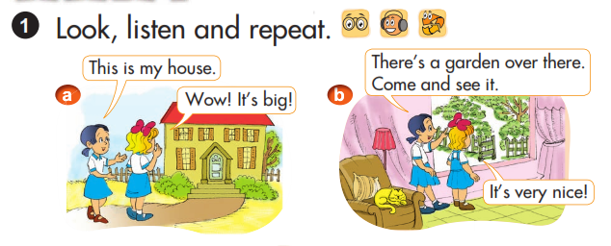


Slide 4
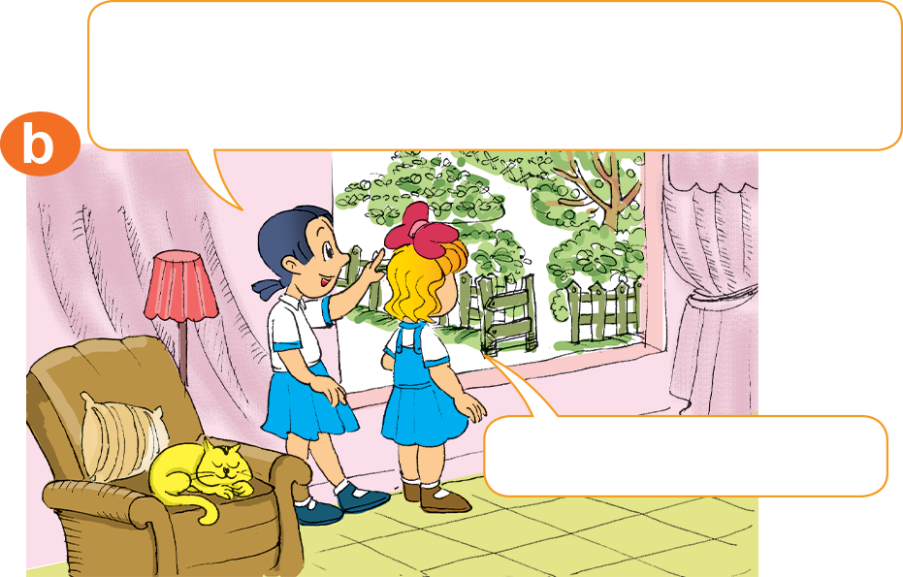
There’s a garden.
It’s very nice.

Slide 5


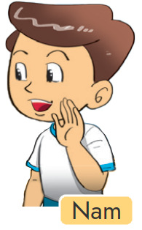
1. Model sentence : Cách giới thiệu về 1 phòng nào đó trong ngôi nhà .
There’s a + tên phòng.
It’s very nice.
Example: There’s bedroom.
=> It’s very nice.

Slide 6
2. Vocabulary .
- House :
Ngôi nhà
- Living room :
Phòng khách
- Kitchen :
Phòng bếp
- Dining room :
Phòng ăn
- Bedroom :
Phòng ngủ
- Bathroom :
Phòng tắm
- Garden :
Khu vườn

Slide 7
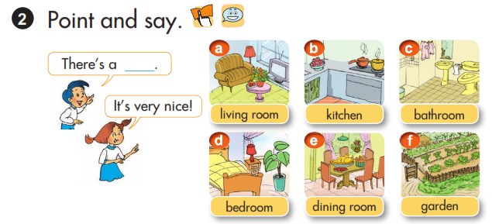

Slide 8
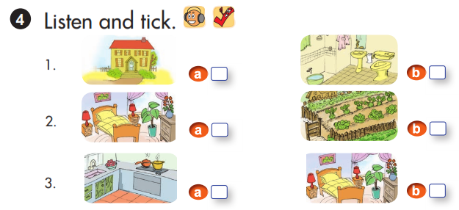
√
√
√

Slide 9
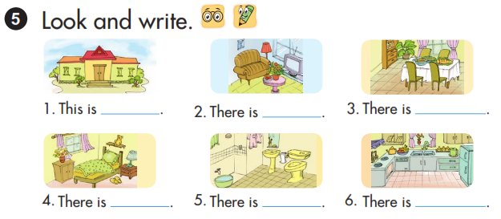
my house.
A living
room
A dining
room
A bedroom
A bathroom
A kitchen

Slide 10

6. Let’s sing .
The way I clean my house
This is the way I clean my house,
Clean my house, clean my house.
This is the way I clean my house
So early in the morning!
This is the way I clean my room,
Clean my room, clean my room.
This is the way I clean my room,
So early in the morning.

