Slide 1

Unit 13
What do you do in your free time
Lesson: 1
1. Look, listen and repeat:

Slide 2


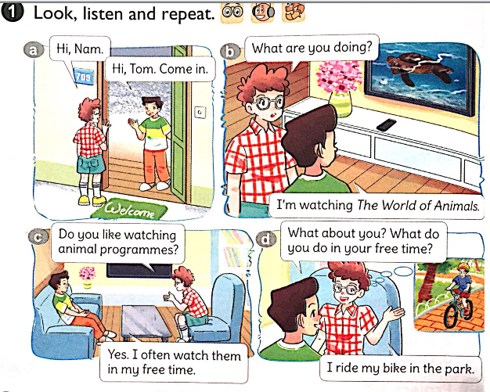

Slide 3
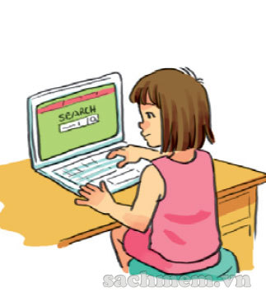
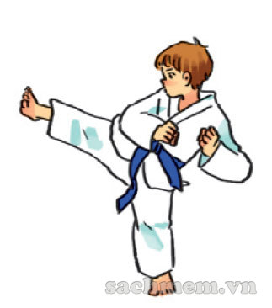
2. Point and say: a. vocabulary
surf the internet: Lướt/ truy cập internet
free time: thời gian rảnh
do karate: tập ka ra tê
programmes: chương trình
b. sentence pattern
What do you do in your free time?
I ride my bike in the park.
I go to the cinema.

Slide 4
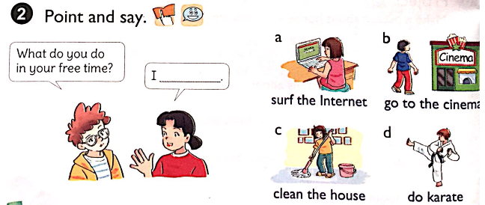
What do you do in your free time?
I ride my bike in the park.

Slide 5
3. Let's talk
Ask and answer questions about what you and your friends do in your free time.
Do you like ……… ?
Yes, I do
No, I don’t
What do you do in your free time ?
I ………………………

Slide 6
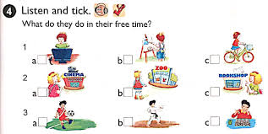


Slide 7
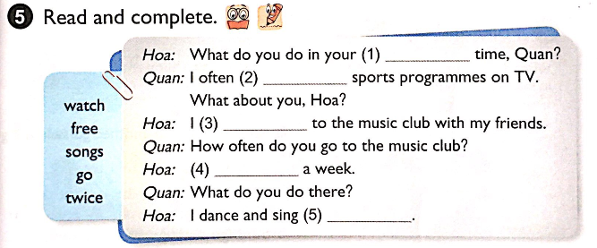
free
watch
go
twice
songs

Slide 8
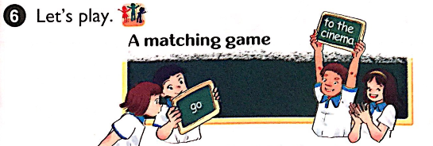
Go to the cinema Clean the house
Surf the Internet Do karate

Slide 9
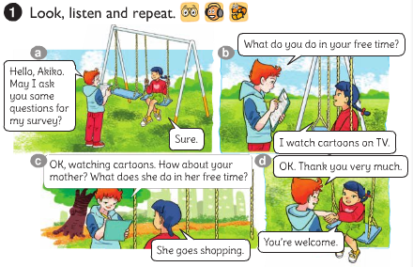
Unit 13:What do you do in your free time? Lesson 2

Slide 10
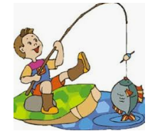
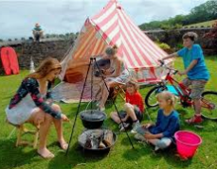
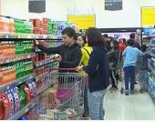
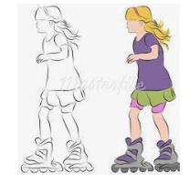
2. Point and say: a, Vocabulary
- go fishing:
đi câu
- go shopping:
đi mua sắm
- go skating:
đi trượt băng
- go camping:
đi cắm trại

Slide 11
RUB OUT AND REMEMBER
- go fishing:
đi câu
- go shopping:
đi mua sắm
- go skating:
đi trượt băng
- go camping:
đi cắm trại

Slide 12
2. Point and say: a, Vocabulary
- go fishing:
đi câu
- go shopping:
đi mua sắm
- go skating:
đi trượt băng
- go camping:
đi cắm trại
b, Sentence pattern
What does your…..do in his/her free time?
He / She …………………..
Note:
I go fishing.
He / She goes fishing.

Slide 13
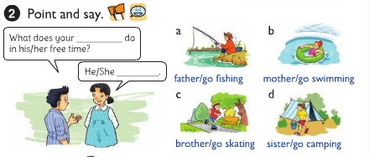
father
What does your … … … . do in his/her free time?
goes fishing.
He / She …………………..

Slide 14
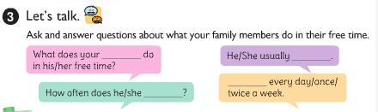
mother
What does your …. do in his/ her free time?
He/ She usually ……
she goes shopping
she goes shopping
… every day/ week/ twice a week.
How often does he / she ….….?
do it?

Slide 15

4. Listen and circle a, b or c
1.Phong often goes ___________ in his free time.
a. fishing b. camping c. skating
2. His father______________ twice a week.
a. does karate b. plays football c. works in the garden
3. His mother goes ___________ at weekends.
a. swimming b. shopping c. camping
4. His sister ___________ in her free time.
a. surfs the internet b. does homework c. cleans the house

Slide 16
5. Write about what your family members do in their free time.
1. What do you do in your free time?
________________________________
I often go shopping in my free time.
2. How often do you do it?
________________________________
Twice a week.
3. What does your father do in his free time?
________________________________
He listens to music in his free time.
4.What does your mother do in her free time?
________________________________
She cooks in her free time.

Slide 17
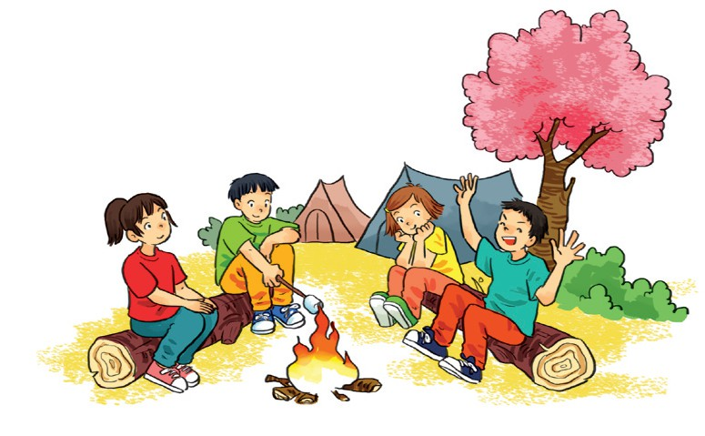
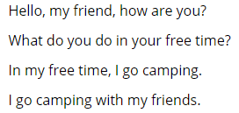
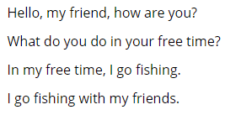
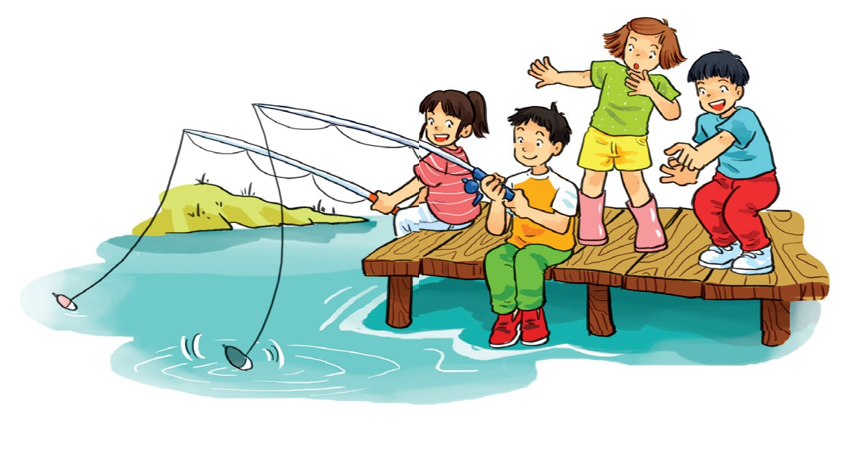
6. Let’s sing

Slide 18
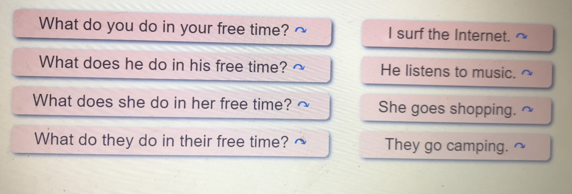
Lesson 3
1. Listen and repeat

Slide 19
2. Listen and circle a or b
1.What do you do in your free time?I______
a. clean the house b. watch cartoons
2.What does she do in her free time?She_____
a. goes skating b. goes fishing
3.What does he do in his free time? He_____
a. does karate b. goes to the cinema
4.What do they do in their free time?They___
a. work in the house b. go shopping

Slide 20
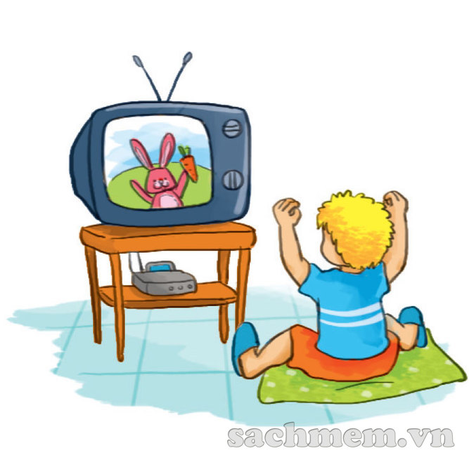
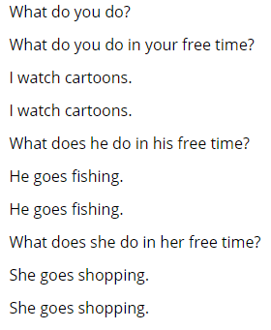
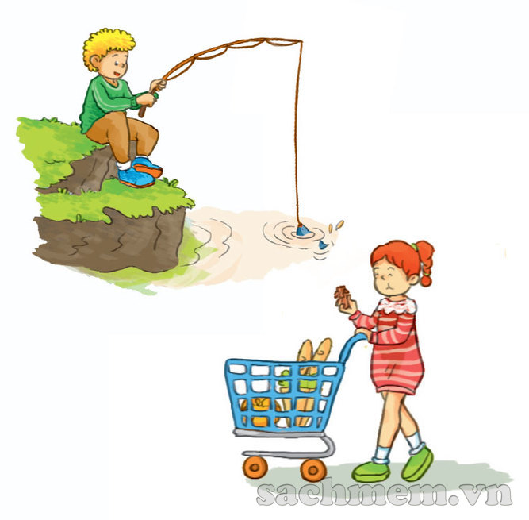
3. Let’s chant

Slide 21
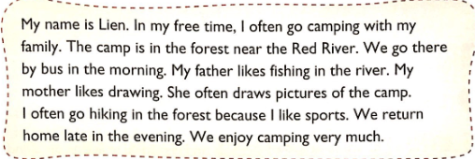
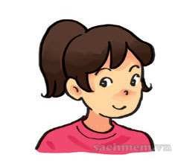
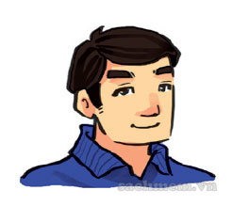
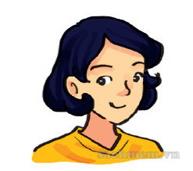
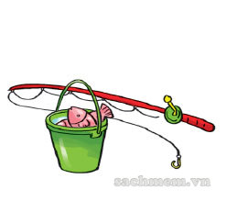

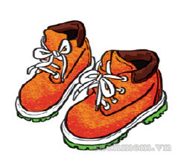
4. Read and draw lines to match.
1
2
3
Lien
Lien’s father
Lien’s mother
a
b
c

Slide 22
5. Write about what your family do at weekends
Thuy
My name is _______________________
listen to music
At weekends, I often ________________
My father _________________________
watches TV
goes to the supermarket
My mother ________________________
plays game
My brother/ sister __________________
6. Project
Interview two classmates about what they do in their free time.

