Slide 1
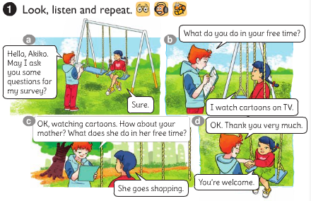
Unit 13:What do you do in your free time? Lesson 2

Slide 2
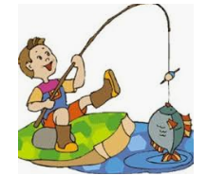
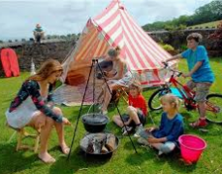
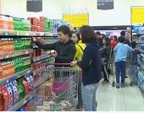
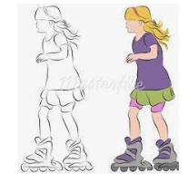
2. Point and say: a, Vocabulary
- go fishing:
đi câu
- go shopping:
đi mua sắm
- go skating:
đi trượt băng
- go camping:
đi cắm trại

Slide 3
RUB OUT AND REMEMBER
- go fishing:
đi câu
- go shopping:
đi mua sắm
- go skating:
đi trượt băng
- go camping:
đi cắm trại

Slide 4
2. Point and say: a, Vocabulary
- go fishing:
đi câu
- go shopping:
đi mua sắm
- go skating:
đi trượt băng
- go camping:
đi cắm trại
b, Sentence pattern
What does your…..do in his/her free time?
He / She …………………..
Note:
I go fishing.
He / She goes fishing.

Slide 5
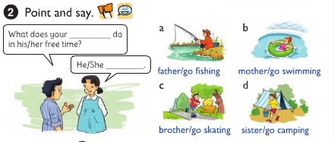
father
What does your … … … . do in his/her free time?
goes fishing.
He / She …………………..

Slide 6
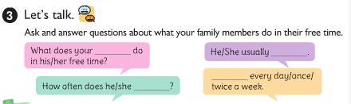
mother
What does your …. do in his/ her free time?
He/ She usually ……
she goes shopping
she goes shopping
… every day/ week/ twice a week.
How often does he / she ….….?
do it?

Slide 7

4. Listen and circle a, b or c
1.Phong often goes ___________ in his free time.
a. fishing b. camping c. skating
2. His father______________ twice a week.
a. does karate b. plays football c. works in the garden
3. His mother goes ___________ at weekends.
a. swimming b. shopping c. camping
4. His sister ___________ in her free time.
a. surfs the internet b. does homework c. cleans the house

Slide 8
5. Write about what your family members do in their free time.
1. What do you do in your free time?
________________________________
I often go shopping in my free time.
2. How often do you do it?
________________________________
Twice a week.
3. What does your father do in his free time?
________________________________
He listens to music in his free time.
4.What does your mother do in her free time?
________________________________
She cooks in her free time.

Slide 9
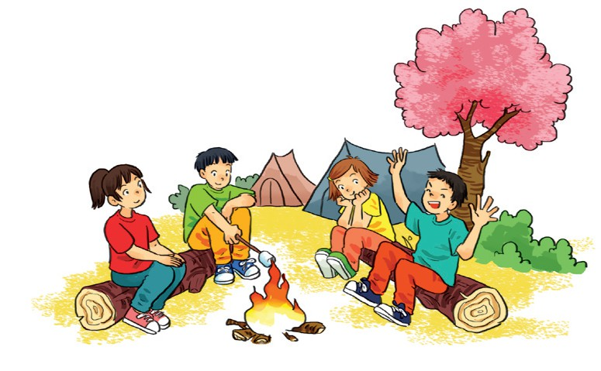
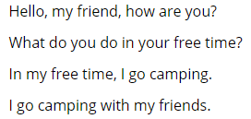
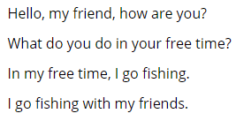
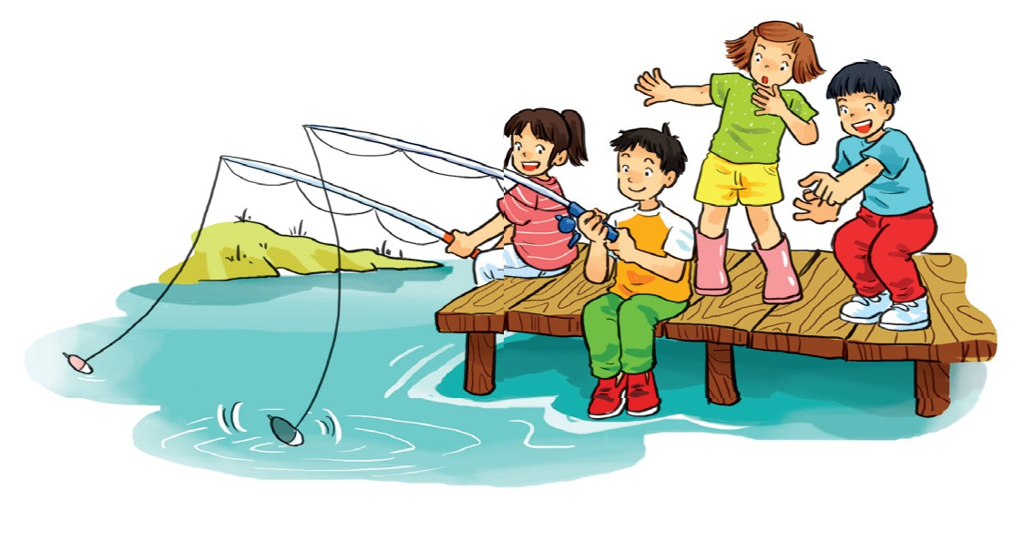
6. Let’s sing

