Slide 1
Unit 13:What do you do in your free time? Lesson 3

Slide 2
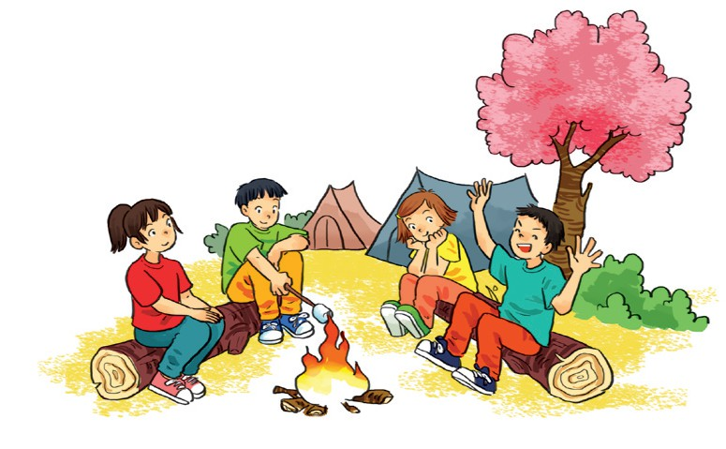
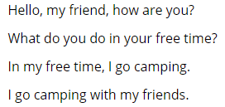
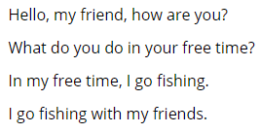
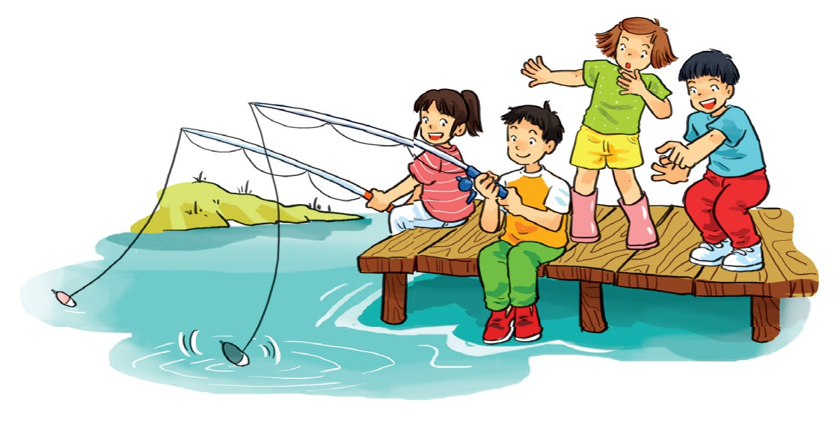
6. Let’s sing

Slide 3
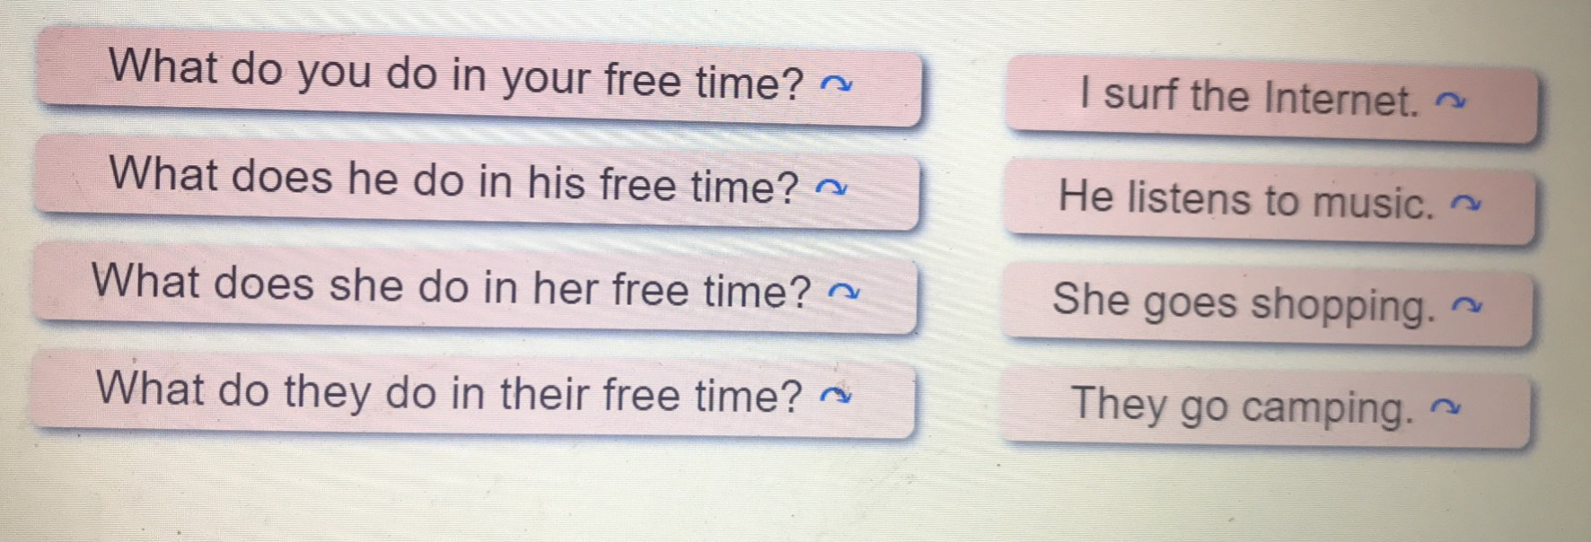
1. Listen and repeat

Slide 4

2. Listen and circle a or b
1.What do you do in your free time?I______
a. clean the house b. watch cartoons
2.What does she do in her free time?She_____
a. goes skating b. goes fishing
3.What does he do in his free time? He_____
a. does karate b. goes to the cinema
4.What do they do in their free time?They___
a. work in the house b. go shopping

Slide 5
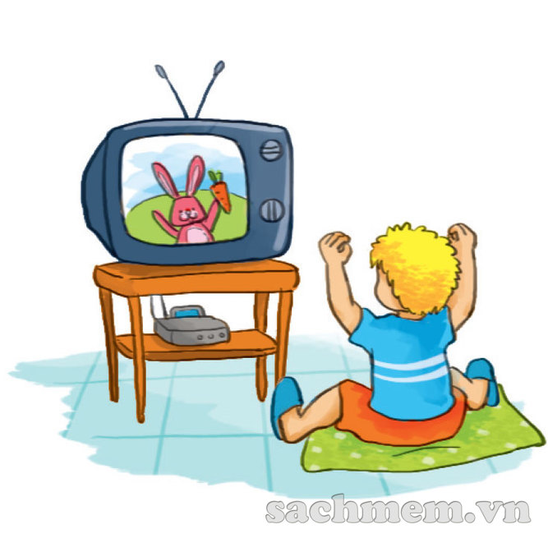
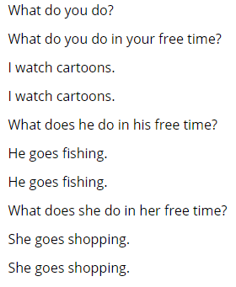
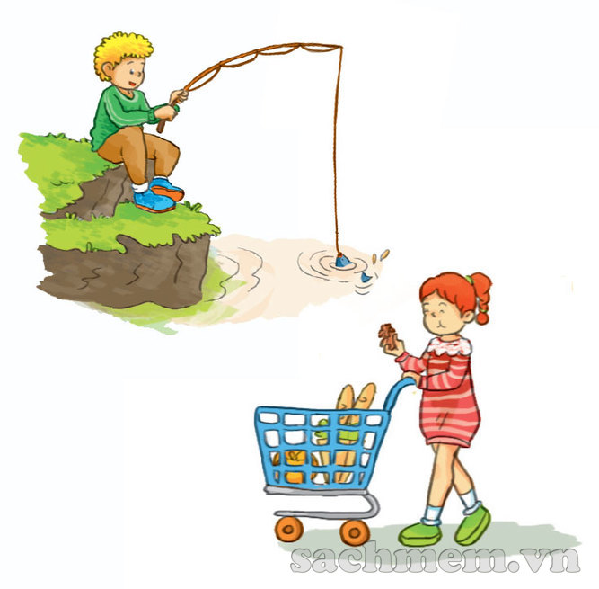
3. Let’s chant

Slide 6
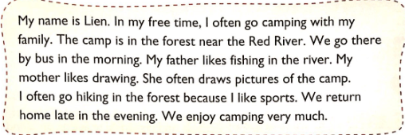
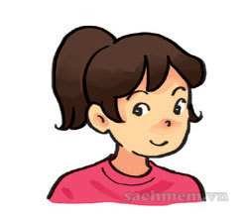
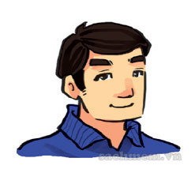
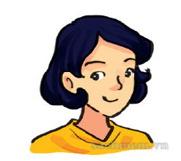
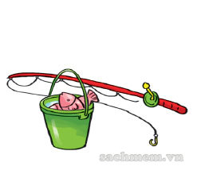
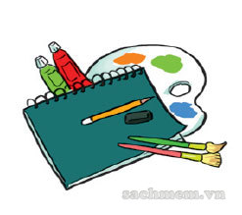
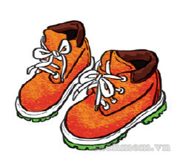
4. Read and draw lines to match.
1
2
3
Lien
Lien’s father
Lien’s mother
a
b
c

Slide 7
5. Write about what your family do at weekends
Thuy
My name is _______________________
listen to music
At weekends, I often ________________
My father _________________________
watches TV
goes to the supermarket
My mother ________________________
plays game
My brother/ sister __________________
6. Project
Interview two classmates about what they do in their free time.

