Slide 1

Unit 7: That’s my school Lesson 2: 4-6

Slide 2

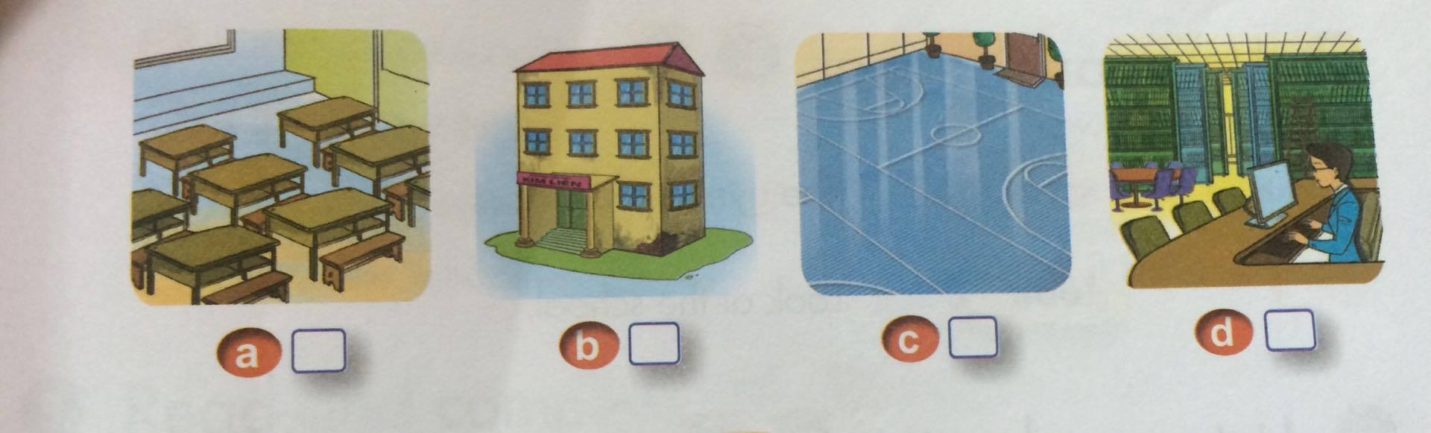
4. Listen and number
3
1
4
2

Slide 3
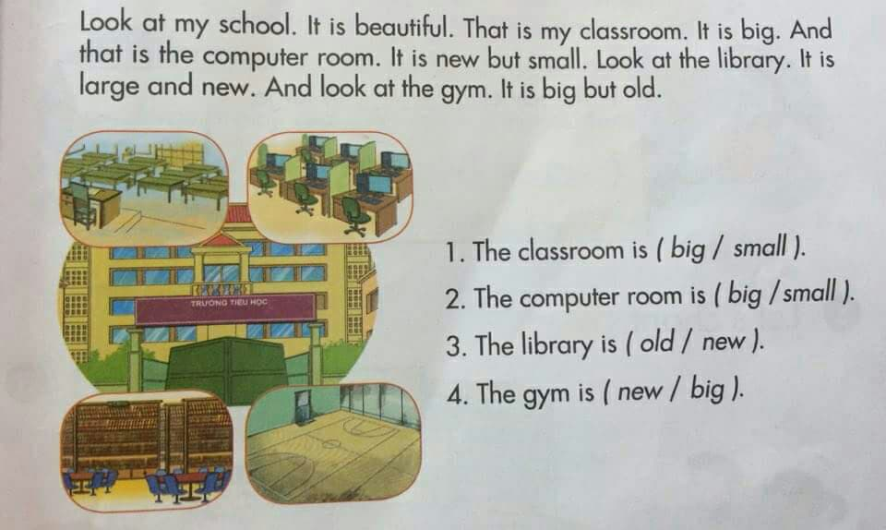
5. Read and circle

Slide 4
6. Write about your school.
Is the school big ?
Is the computer room new ?
Is the gym large ?
d. Is the library big ?

Slide 5
Example:
Hi, my name is Dung. My school is Sao Mai Primary school. It is very big. This is my classroom. It is beautiful. And that is the computer room. It is new and modem. The gym is small but beautiful. The library is big but old. I love my school.

