Slide 1
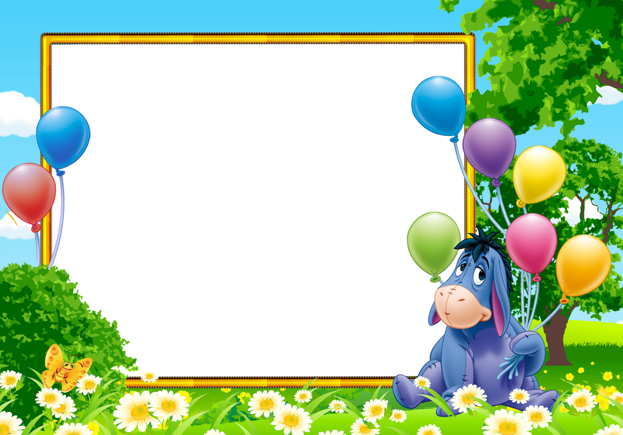
Welcom To My Team!

Slide 2

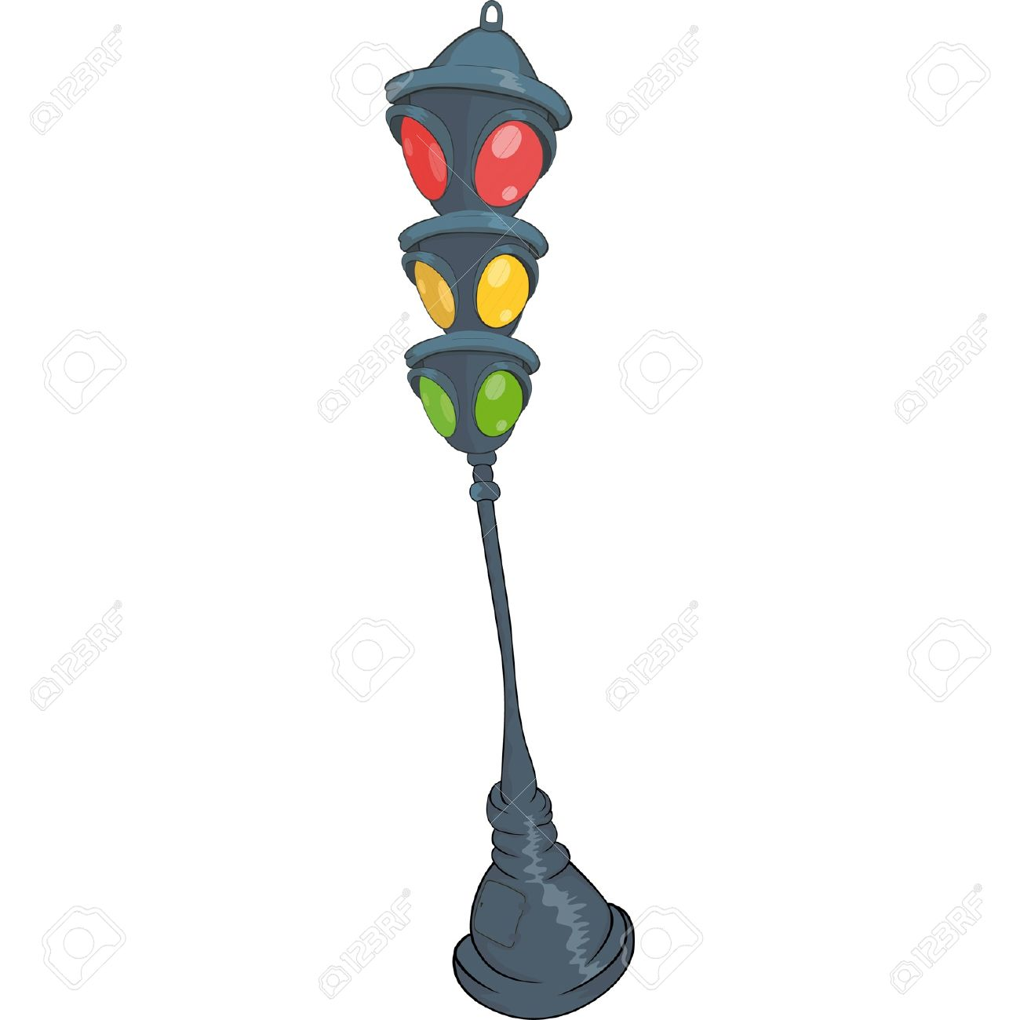

Play game
The Bus

Slide 3
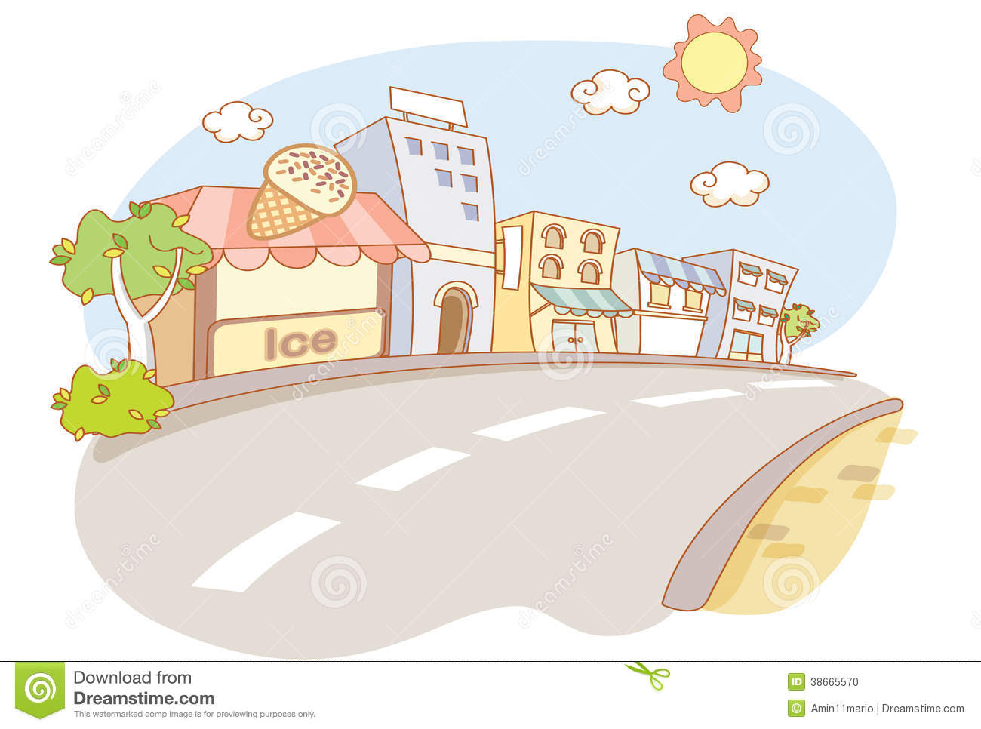
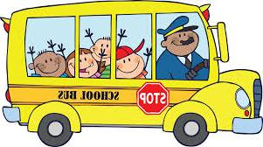
Truck

Slide 4
Kite

Slide 5
Parrot

Slide 6
Ship

Slide 7
Goldfish

Slide 8
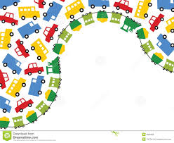
Unit 17: WHAT TOYS DO YOU LIKE?
Lesson 3: 1, 2, 3

Slide 9

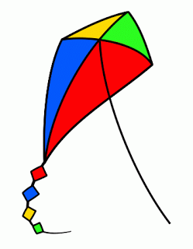
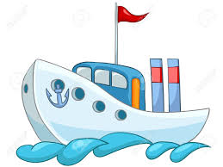
1. Listen and repeat.
i - e
Kite
This is my Kite
like
nine
fine
white
five
i
ship
I like ships
fill
rabbit
in
pink

Slide 10

2.Listen and write.
1.Make question for number 1.
2. Answer the number 2.
What toys do you have ?
1, I have a new _______.
kite
2, Do you like _______ ?
ships
Yes, I do .
No, I don’t .

Slide 11
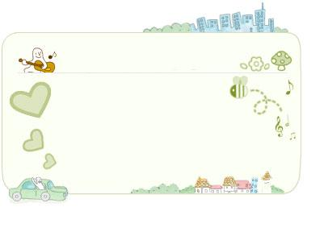
Let’s chant
Do you like toys?
Do you like toys?
Yes, I do. Yes, I do.
Do you like trucks ?
No, I don’t. No, I don’t .
What toys do you like ?
I like ships. I like ships.
How many ships do you have ?
I have four. I have four.
Do you like pets?
Yes, I do. Yes, I do.
Do you like dogs ?
No, I don’t. No, I don’t.
What pets do you like ?
I like cats. I like cats.
How many cats do you have ?
I have two. I have two.

Slide 12
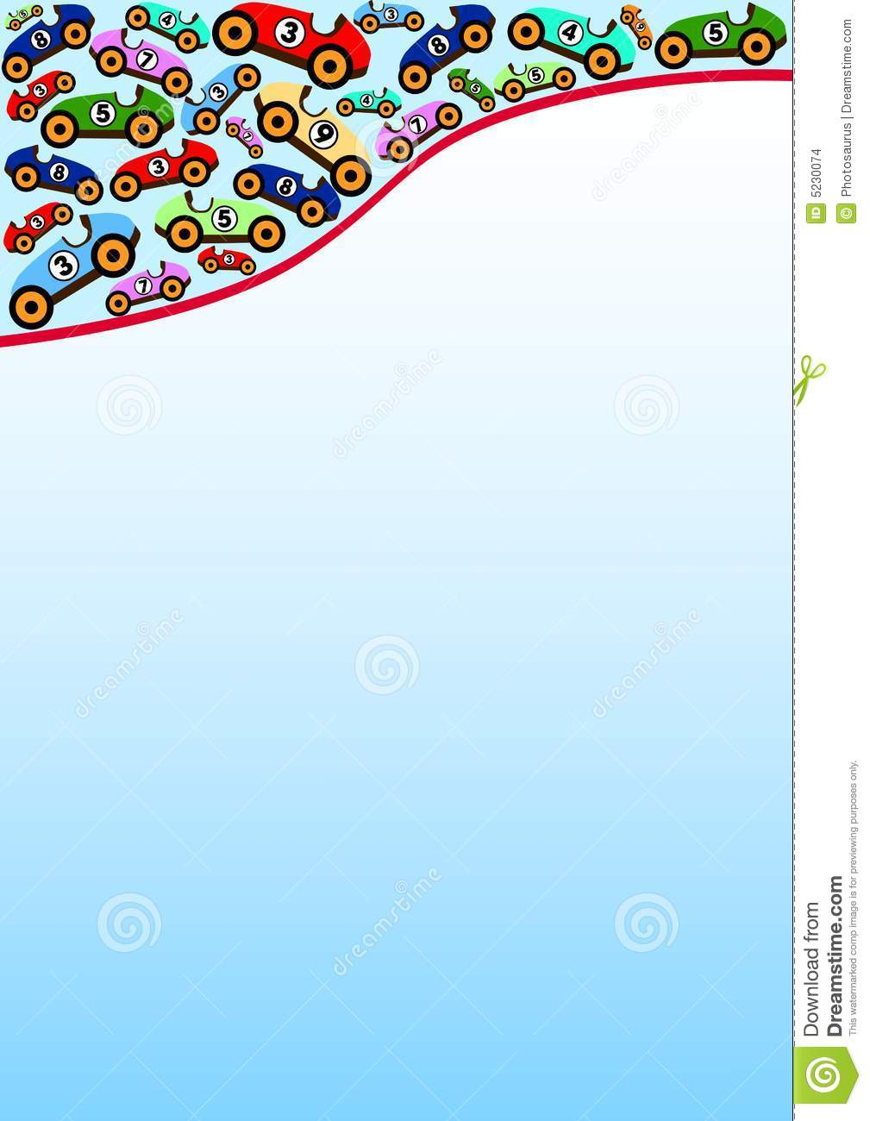
Home Link
Do exercises in workbook and ex 5, 6.
Learn by heart the new words.
Thank you!

Slide 13
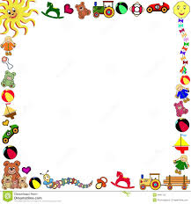
Read and match
1
Do you like toys ?
a
Robots
2
What toys do you like ?
b
Nine
3
What pets do you like ?
c
Yes, I do
4
How many cats do you have?
d
Cats.

Slide 14
Read and complete
like
has
trucks
how
ten
cats
I have many toys. I have five ________, three planes and ______ yo– yos. My friend Mary has some pets. She _____ two dogs and three _________. What about you ? What toys do you _________? _______ many pets do you have ?
1
2
3
4
5
6

