Slide 1

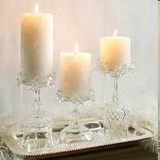

WELCOME TO OUR CLASS
Class : 3A
Thanks for your attention!
Good Bye!
Teacher: Ms.Nhung
Quang Tien primary school

Slide 2
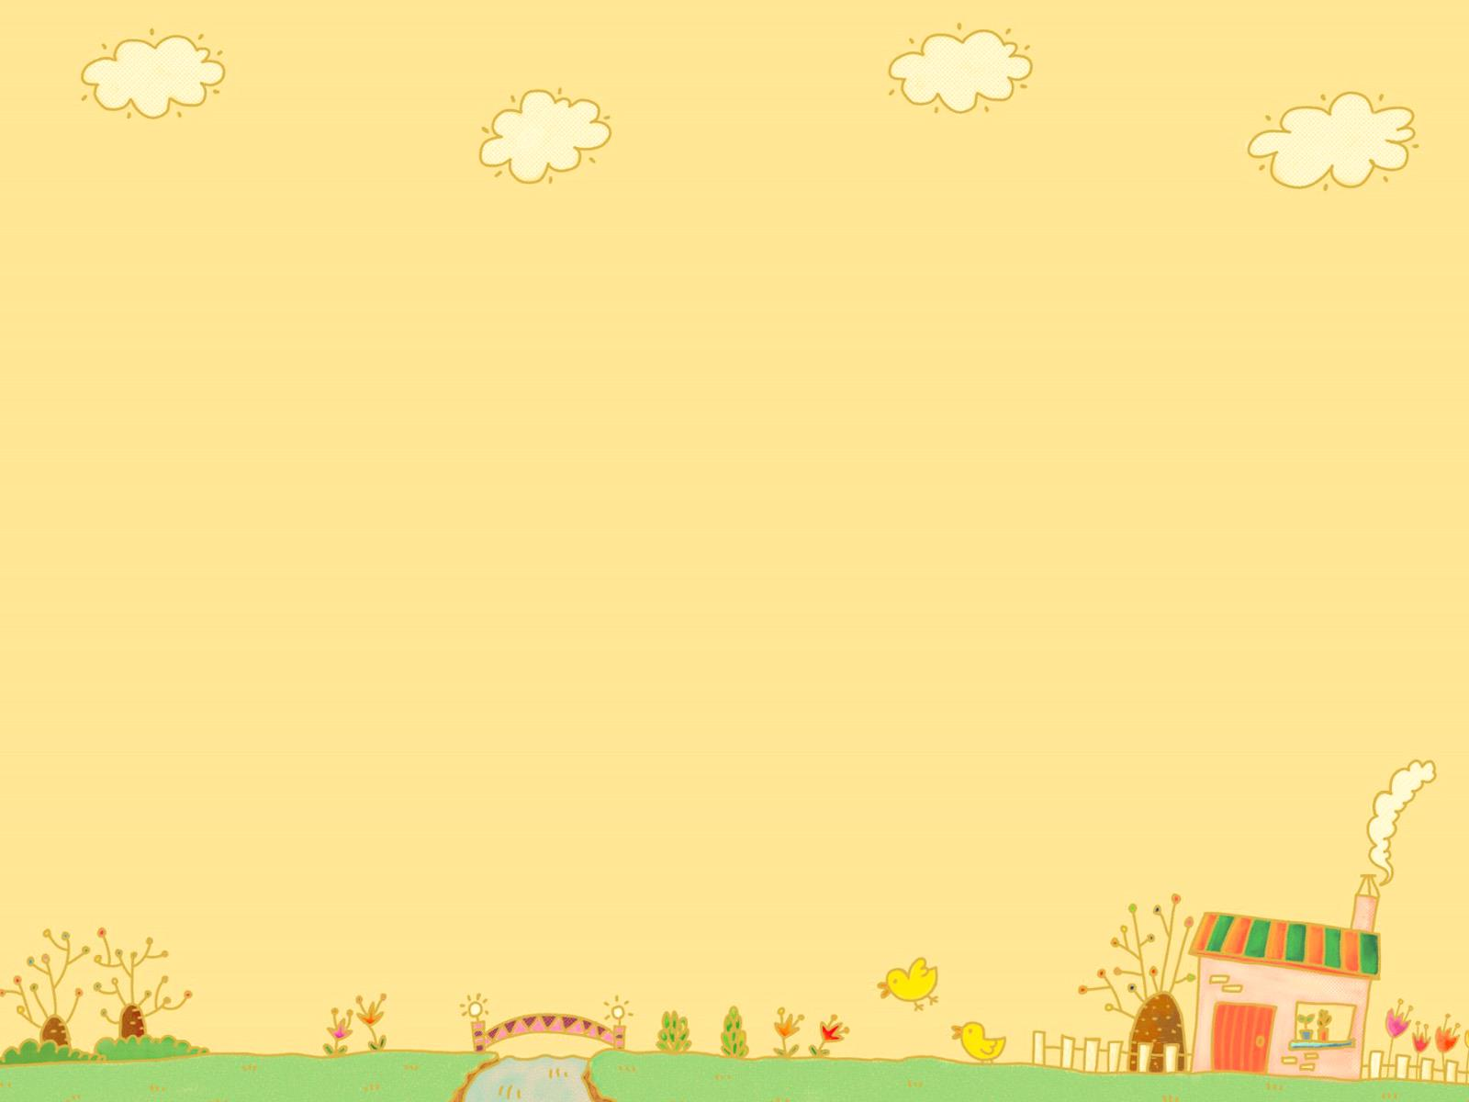
Secret toys

Slide 3
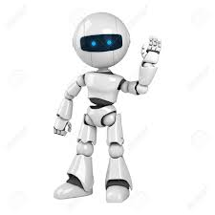
A Robot

Slide 4
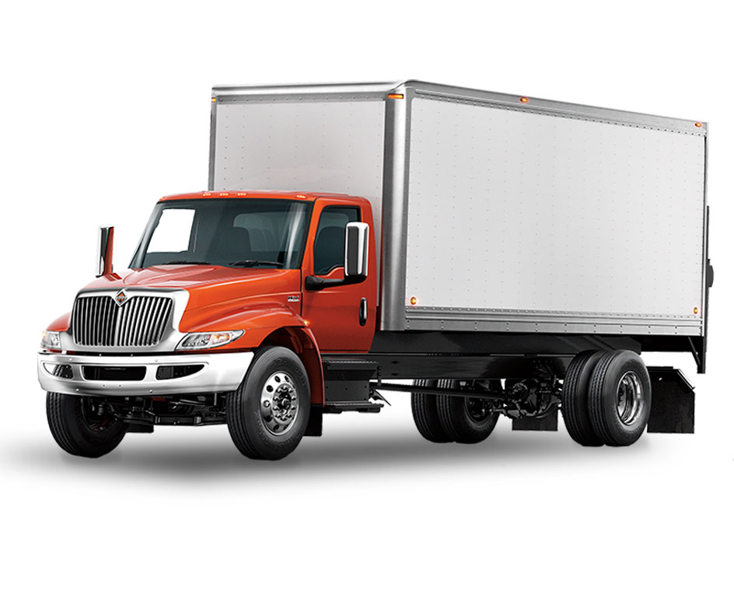
A Truck

Slide 5
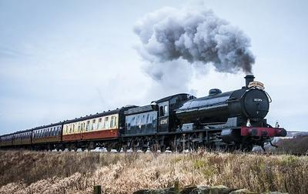
A Train

Slide 6
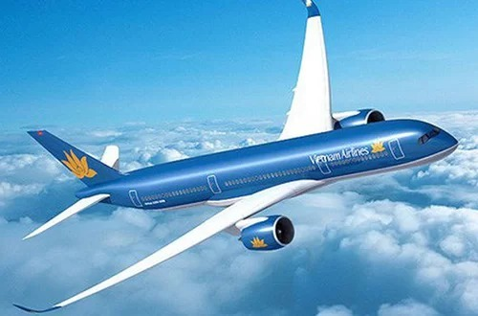
A Plane

Slide 7
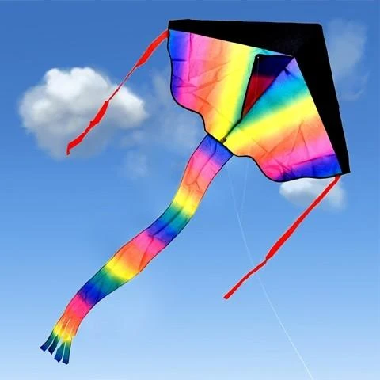
A Kite

Slide 8
Unit 18: What are you doing?
Lesson 1

Slide 9
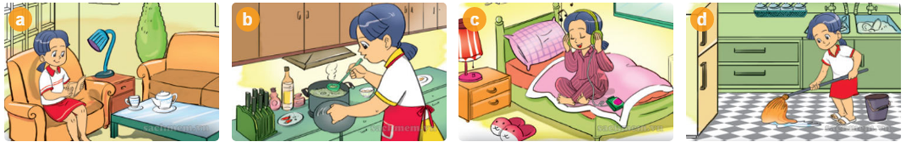
Vocabulary
Reading book
( đọc sách)

Slide 10

Vocabulary
Cooking
( nấu ăn)

Slide 11
Vocabulary
Listening to music
(nghe nhạc)

Slide 12
Vocabulary
Cleaning the floor
( lau sàn)

Slide 13
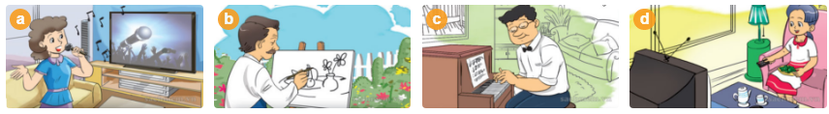
Vocabulary
Watching TV
( xem ti vi)

Slide 14

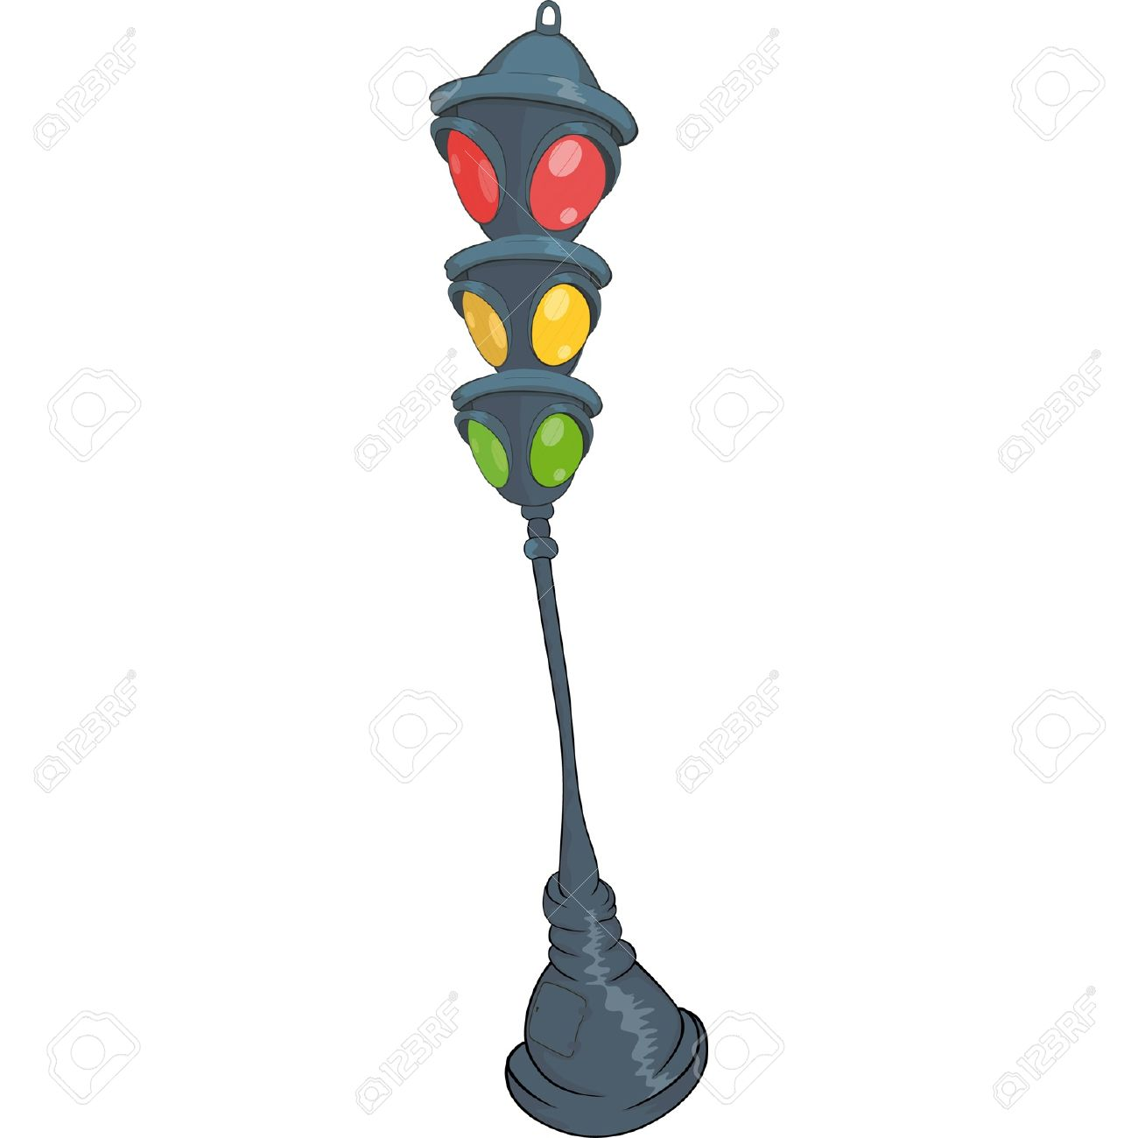

Play game
The Bus

Slide 15
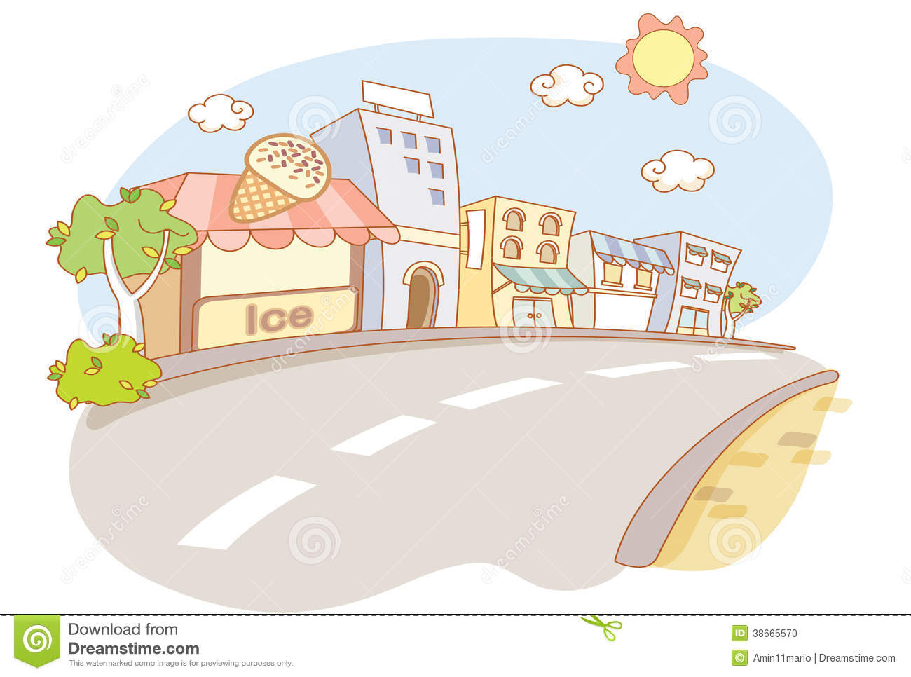
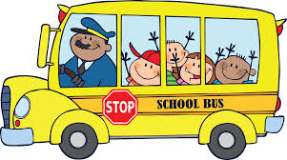
Reading

Slide 16
Watching TV

Slide 17
Listening to music

Slide 18
Cooking

Slide 19
Cleaning the floor

Slide 20

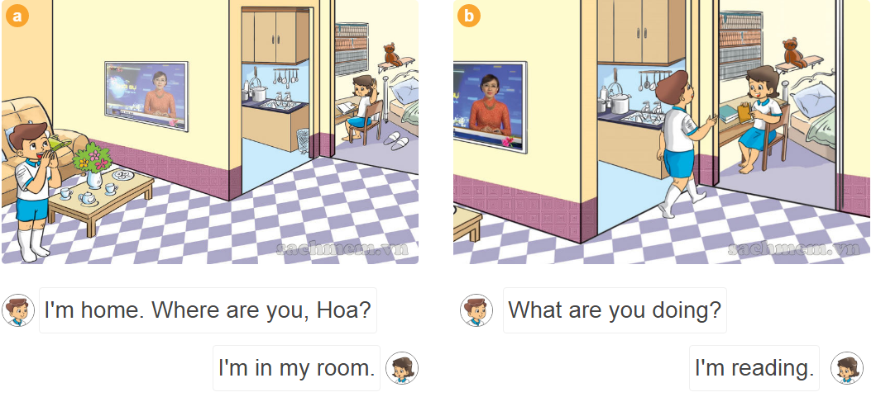
1.Look, listen and repeat.

Slide 21
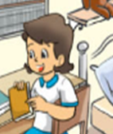
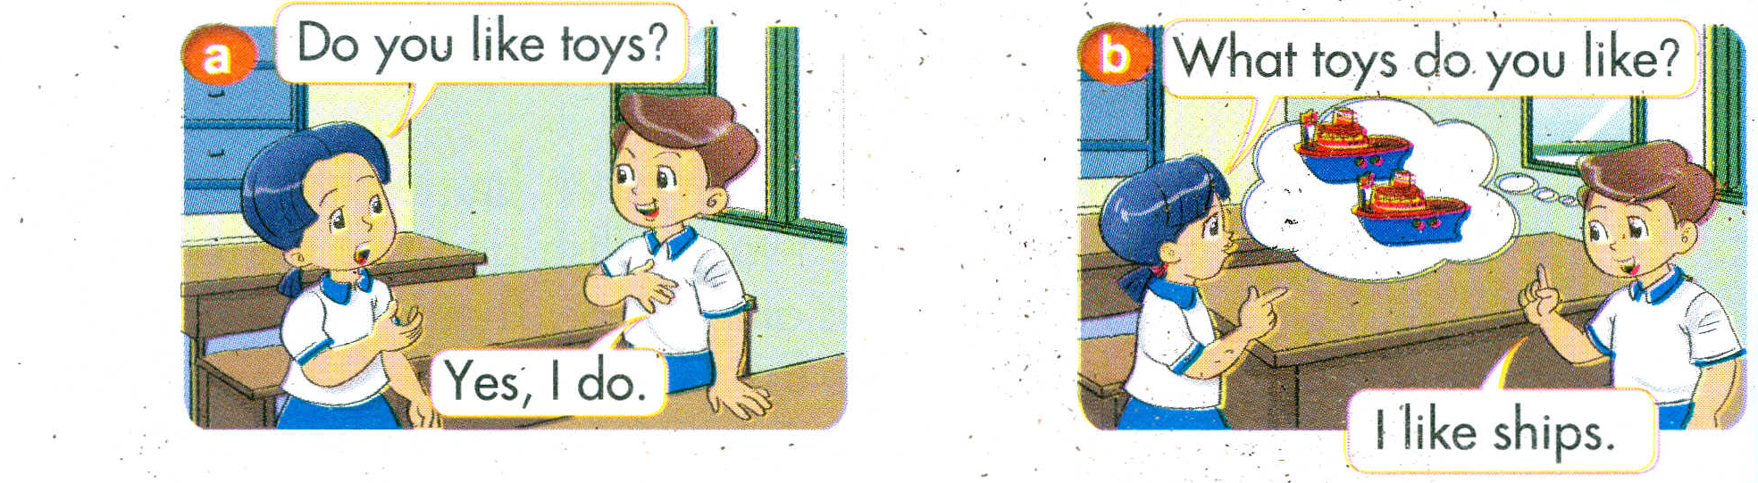
Sentence patterns:
What are you doing? ( Bạn đang làm gì thế?)
I’m +V-ing ( Mình đang ….)
I’m____________.
Reading book
Cooking
What are you doing ?

Slide 22
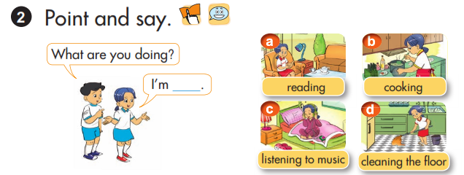
Pair work
Play a game: “One, two, show”

Slide 23
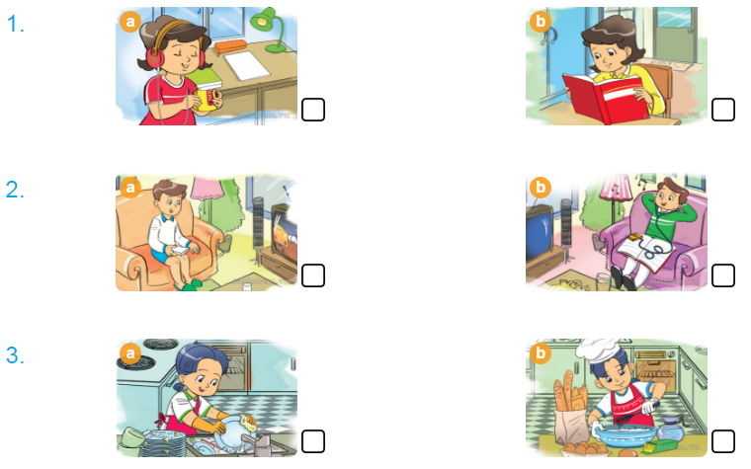
3.Listen and tick
√
√
√

Slide 24
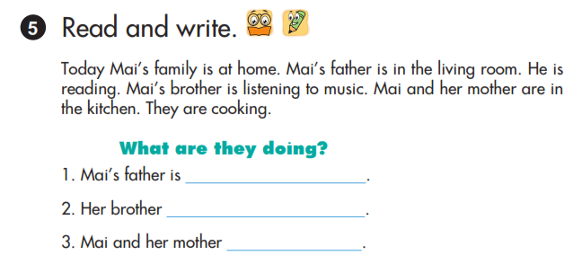
4.Read and write
reading
is listening to music
are cooking

Slide 25


Thank you very much
Good bye! See you again!

