Slide 1








English 4

Slide 2

Warm-up
Listen to the song.

Slide 3

Unit 18
What's your phone number?
Lesson 1(1,2)

Slide 4
New words

Slide 5




New Vocabulary
phone

Slide 6

New Vocabulary
mobile phone

Slide 7
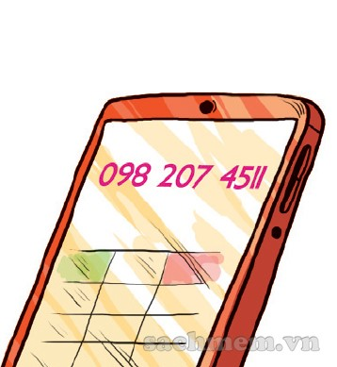
New Vocabulary
phone number

Slide 8

New Vocabulary
present

Slide 9
1. Look, listen and repeat

Slide 10
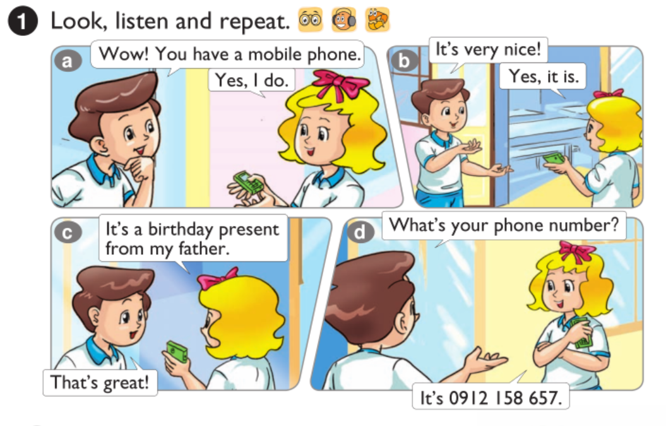



Slide 11
Sentence
What’s your phone number?
It’s 0912 158 657.

Slide 12

Example
It’s 0905 368 129.
What’s your phone number?

Slide 13
2. Point and say

Slide 14
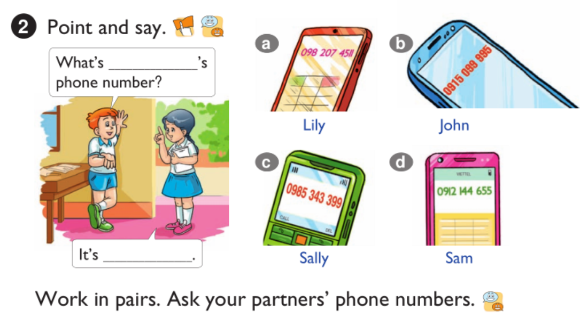

Slide 15


What’s____‘s phone number?
Lily
Lily
It’s_________________________________________________________________.
oh-nine-eight two-oh-seven
four-five-one-one

Slide 16

What’s_____‘s phone number?
John
John
It’s__________________________________________________________________.
oh-nine-one-five oh-nine-nine
nine-nine-five

Slide 17
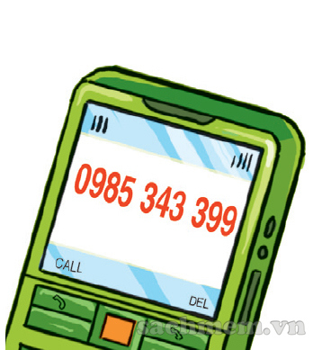
What’s_____‘s phone number?
Sally
Sally
It’s___________________________________________________________________.
oh-nine-eight-five three-four-three
three-nine-nine

Slide 18
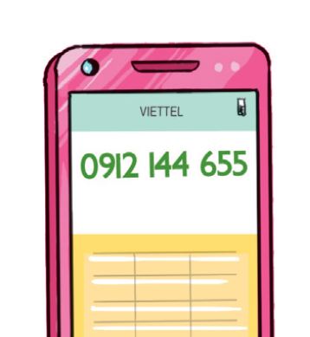
What’s____‘s phone number?
Sam
Sam
It’s____________________________________________________________________.
oh-nine-one-two one-four-four
six-five-five

Slide 19
consolidation

Slide 20


GO SHOPPING

Slide 21


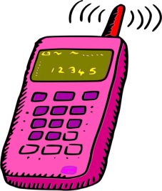
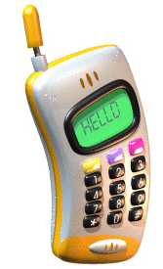


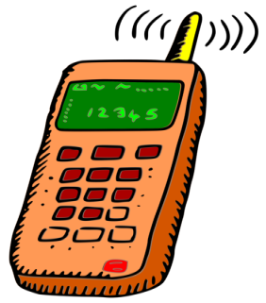



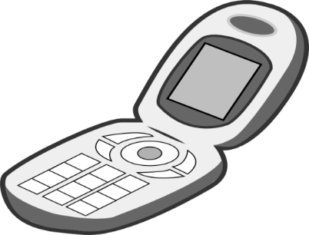



Slide 22

Oh-nine-eight two-oh-seven four-five-double three
What’s your phone number?
Oh-nine-eight two-oh-seven four-five-double one
Oh-nine-eight two-oh-seven five-four-double one

Slide 23
oh-nine-one-five
oh-double nine double nine-five
What’s your phone number?
oh-nine-one-five
oh-double nine double nine-six
oh-nine-one-five
oh-double nine double nine-one

Slide 24
oh-nine-eight-five
three-four-three
three-double-seven
What’s your phone number?
oh-nine-eight-five
three-four-three
three-double-eight
oh-nine-eight-five
three-four-three
three-double-nine

Slide 25
oh-nine-one-five
one-double four
six-double four
What’s your phone number?
oh-nine-one-two
one-double four
six-double five
oh-nine-one-five
one-double four
six-double six

Slide 26
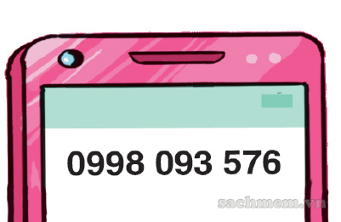
oh-double nine-eight
oh-nine-three
five-seven-five
What’s your phone number?
oh-double nine-eight
oh-nine-three
five-seven-six
oh-double nine-eight
oh-nine-three
five-seven-seven

Slide 27
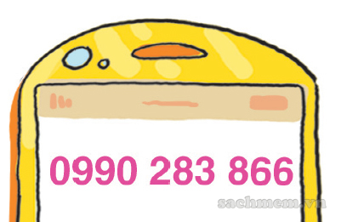
oh-double nine-oh
two-eight-three
eight-double six
What’s your phone number?
oh-double nine-oh
two-eight-three
eight-double seven
oh-double nine-oh
two-eight-three
eight-double eight

Slide 28

What is it?
mobile phone
number phone
phone number

Slide 29

number phone
What is it?
mobile phone
phone

Slide 30
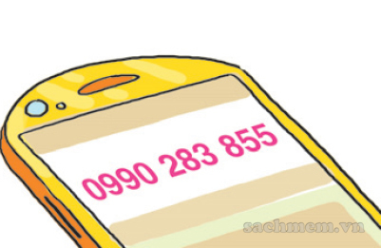
oh-nine-nine-oh
two-eight-three
eight-five-five
What’s your phone number?
oh-double nine-oh
eight-two-three
eight-double five
double nine-double oh
two-eight-three
double five-eight

Slide 31
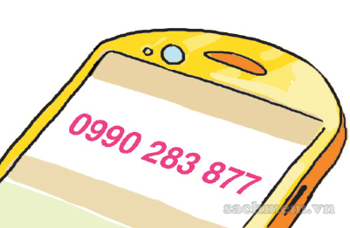
oh-double nine-oh
two-eight-three
eight-double seven
What’s your phone number?
oh-double nine-oh
two-eight-three
eight-double six
oh-double nine-oh
two-eight-three
eight-double five

Slide 32
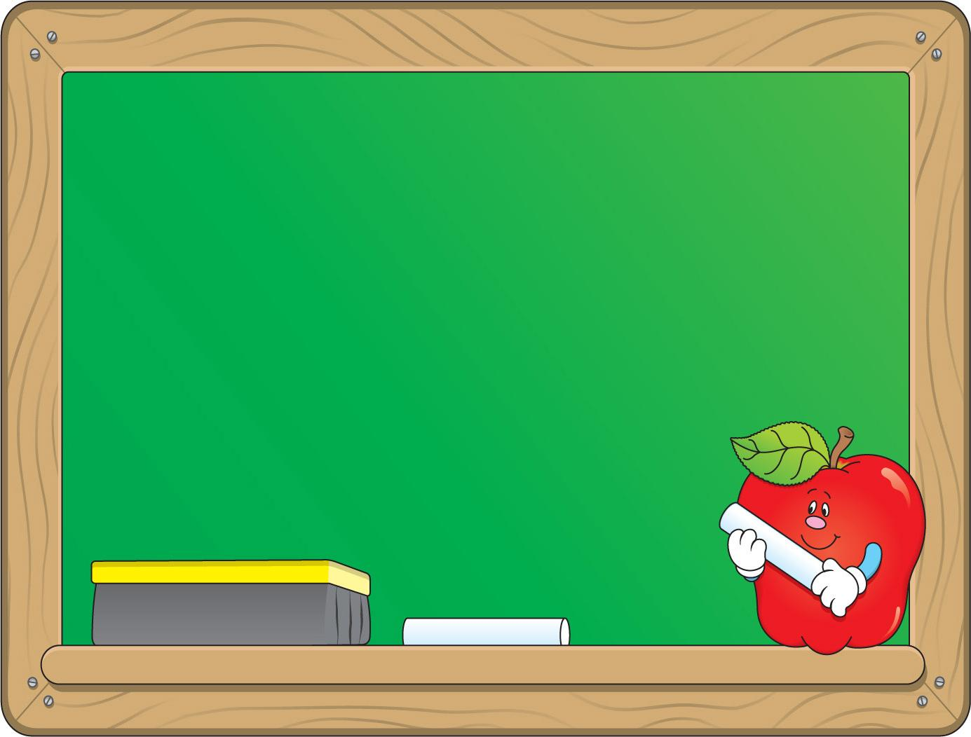
Tuesday, April 13th 2021
Unit 18: What’s your phone number?
Lesson 1
Look, listen and repeat
mobile phone : điện thoại di động
present : quà tặng
Point and say
phone number : số điện thoại
* Sentence pattern:
What’s your phone number?
It’s 0990 283 877.

Slide 33

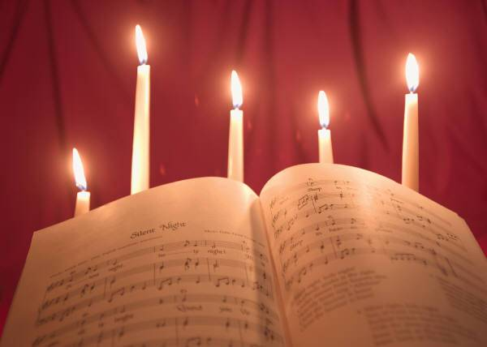


Homework
Learn all the new words.
Prepare for new lesson.

Slide 34
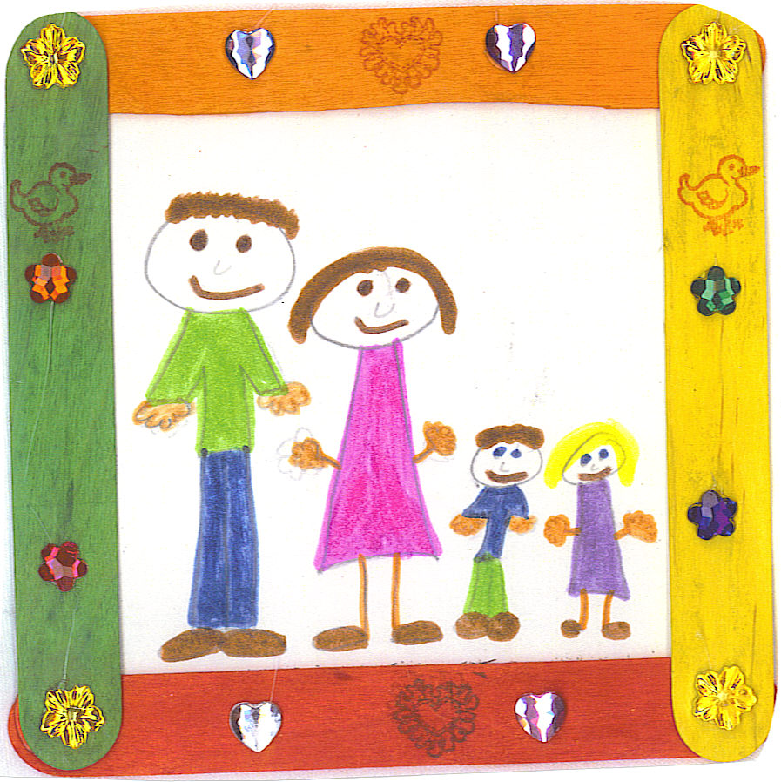


THANK YOU FOR ATTENTION!
GOODBYE
SEE YOU LATER

