Slide 1

WELCOME TEACHERS TO OUR CLASS
English 4

Slide 2
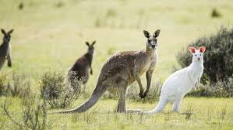
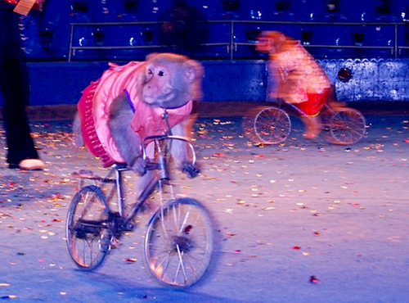
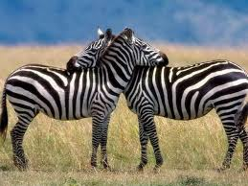
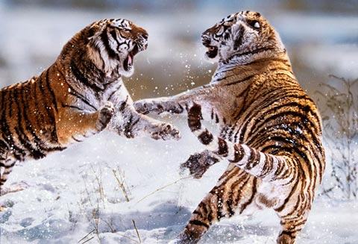
Unit 19: What animal do you want to see?
Lesson 2: 1,2,3
1. New words.
funny
scary
fast
zebra

Slide 3
Unit 19: What animal do you want to see?
Lesson 2: 1,2,3
scary
zebra
fast
funny

Slide 4
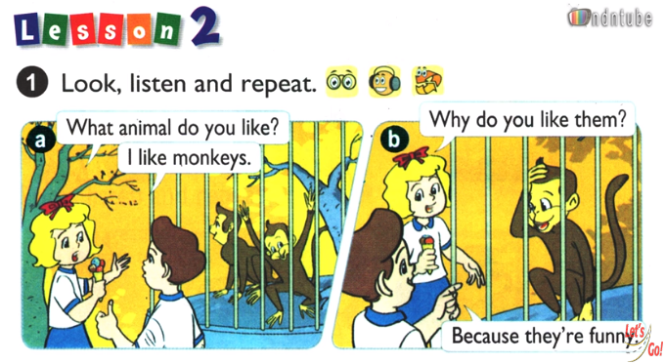

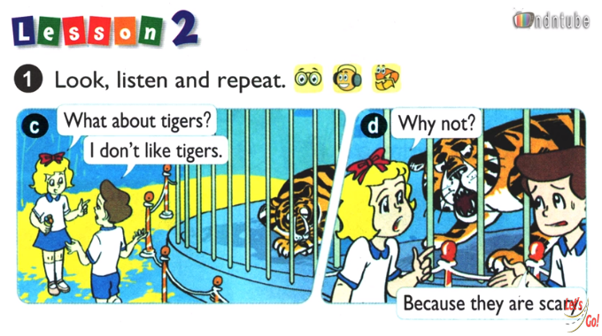

Slide 6
Unit 19: What animal do you want to see?
Lesson 2: 1,2,3
1. New words.
funny
scary
fast
zebra
2. Model sentences
S + like/likes……because they are + adjective
I like monkeys because they are funny
He likes kangaroos because they are fast
S + don’t/doesn’t like……because they are + adjective
I don’t like tigers because They are scary
She doesn’t like elephants because they are big

Slide 7
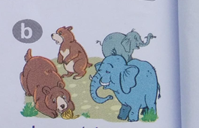
Unit 19: What animal do you want to see?
Lesson 2: 1,2,3
2. Point and say.
kangaroos/fast.
bears/elephants/big.
zebras/beautiful
tigers/scary

Slide 8
Unit 19: What animal do you want to see?
Lesson 2: 1,2,3
3. Let’s talk.
- What animal do you want to see?
- I like kangaroos because they are fast
- I don’t like tigers because they are scary.

Slide 9



Goodbye
See you later

