Slide 1






welcome the teachers to our class

Slide 2


S
H
O
P
P
I
N
G
This is an activity that the women like
MẤT LƯỢT
45
50
A
B
C
D
E
F
THÊM LƯỢT
G
H
I
J
K
L
60
M
N
O
P
Q
R
THE
BIG
WHEEL
40
S
T
U
V
W
X
MAY MẮN
Y
Z
100
75
25
30
MẤT ĐIỂM
60
Spin Wheel
K
POINTS

Slide 3

all class clap your hands

Slide 4
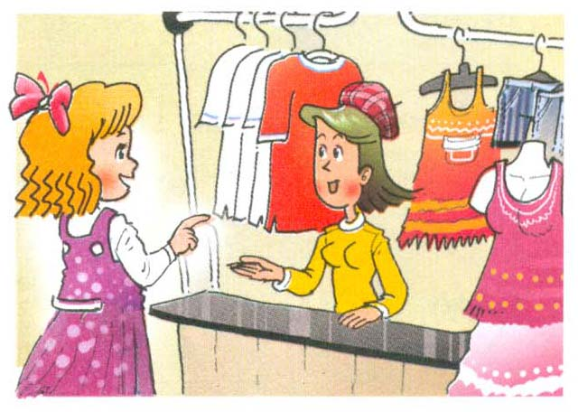
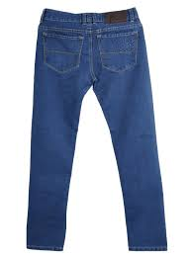
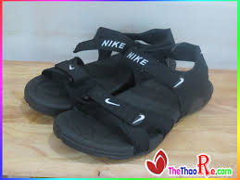
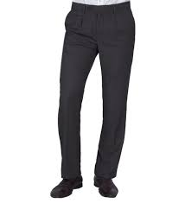
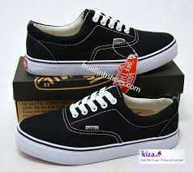
Unit 17: How much is the T – shirt?
Lesson 2: 1,2,3
1. Look ,listen and repeat
1. Look ,listen and repeat
Vocabulary
- trousers :
quần dài
- jeans:
quần bò ,quần rin
- shoes:
giày
- sandals :
dép có quai hậu
- sales assistant:
người bán hàng

Slide 5
GAME: SLAP THE BOARD
TROUSERS
SANDALS
SALES ASSISTANT
JEANS
SHOES

Slide 6
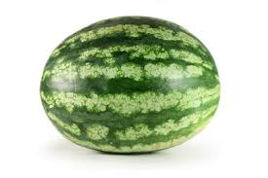

Slide 7
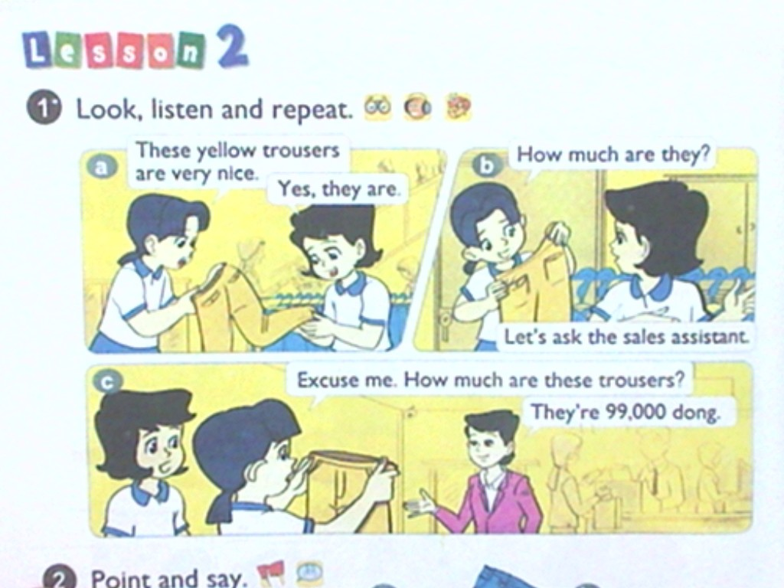


Slide 8
Unit 17: How much is the T – shirt ? Lesson 2: 1,2,3
Grammar
How much are the trousers?
They are 99.000 dong .
How much are the + P.N (danh từ số nhiều) ?
They are + money (số tiền )+ dong.

Slide 9
2. Point and say
Jeans / 75.000 dong
Shoes / 93.000 dong
How much are the ___________?
They are ____________________
Trousers / 98.000 dong
Sandals / 85.000 dong
a
b
c
d

Slide 10

3. Let's talk:
SUMMARY
Model sentence :
How much is the + S.N (danh từ số ít)?
It’s + money (số tiền) .
How much are the + P.N (danh từ số nhiều)?
They’re +money( số tiền) .

Slide 11
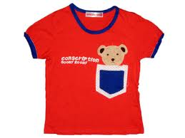
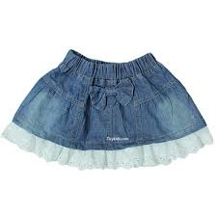
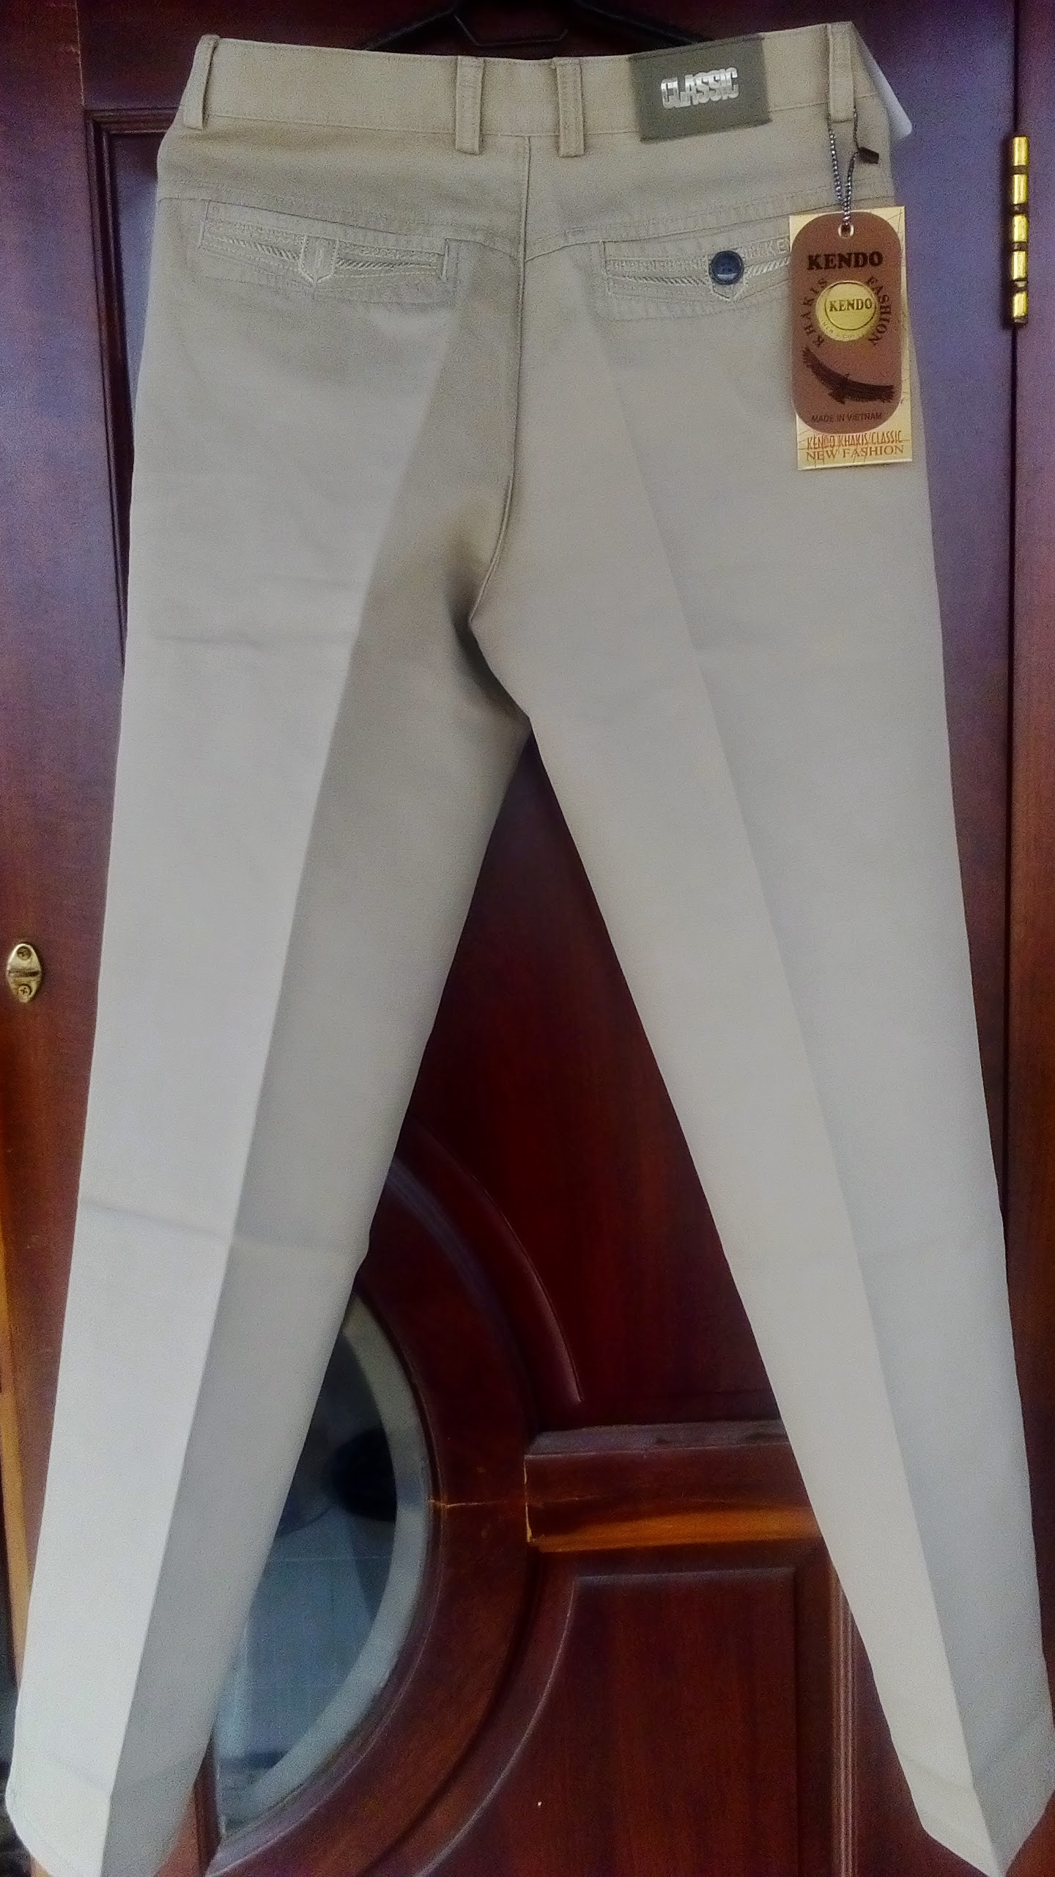
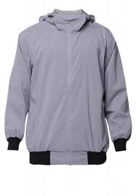
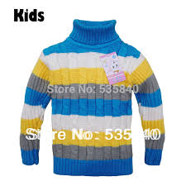
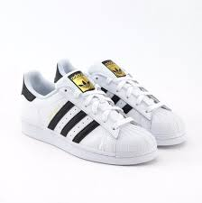
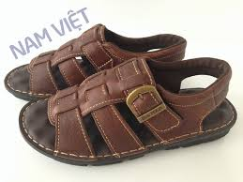
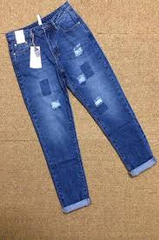
96,000 dong
64,000 dong
43,000 dong
99,000 dong
89,000 dong
72,000 dong
59,000 dong
55,000 dong

Slide 12
2. Point and say
a
b
Jeans / 75.000 dong
Shoes / 93.000 dong
How much are the ___________?
They are ____________________
How much are the ___________?
They are ____________________
c
d
Trousers / 98.000 dong
Sandals / 85.000 dong
How much are the ___________?
They are ____________________
How much are the ___________?
They are ____________________

Slide 13
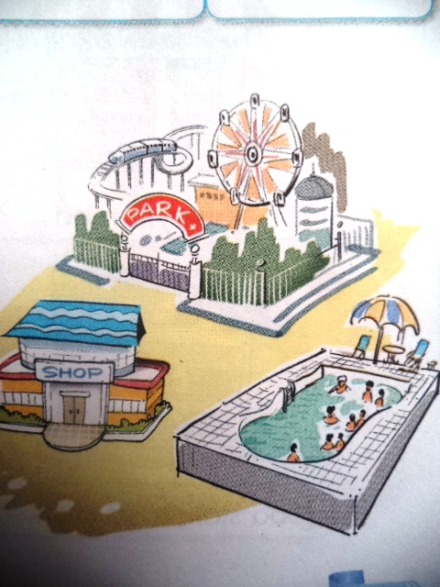
If You Want to go …
Do you want to go shopping?
Yes, I do.
Do you want to go shopping?
Yes, I do.
If you want to go shopping,
then you come along with me.
If you want to go shopping,
let’s go now

Slide 14

Homework:
Học thuộc từ mới
Luyện tập mẫu câu
How much is /are the____?
It's /They're ______
- Làm bài tập SBT

Slide 15


Slide 16
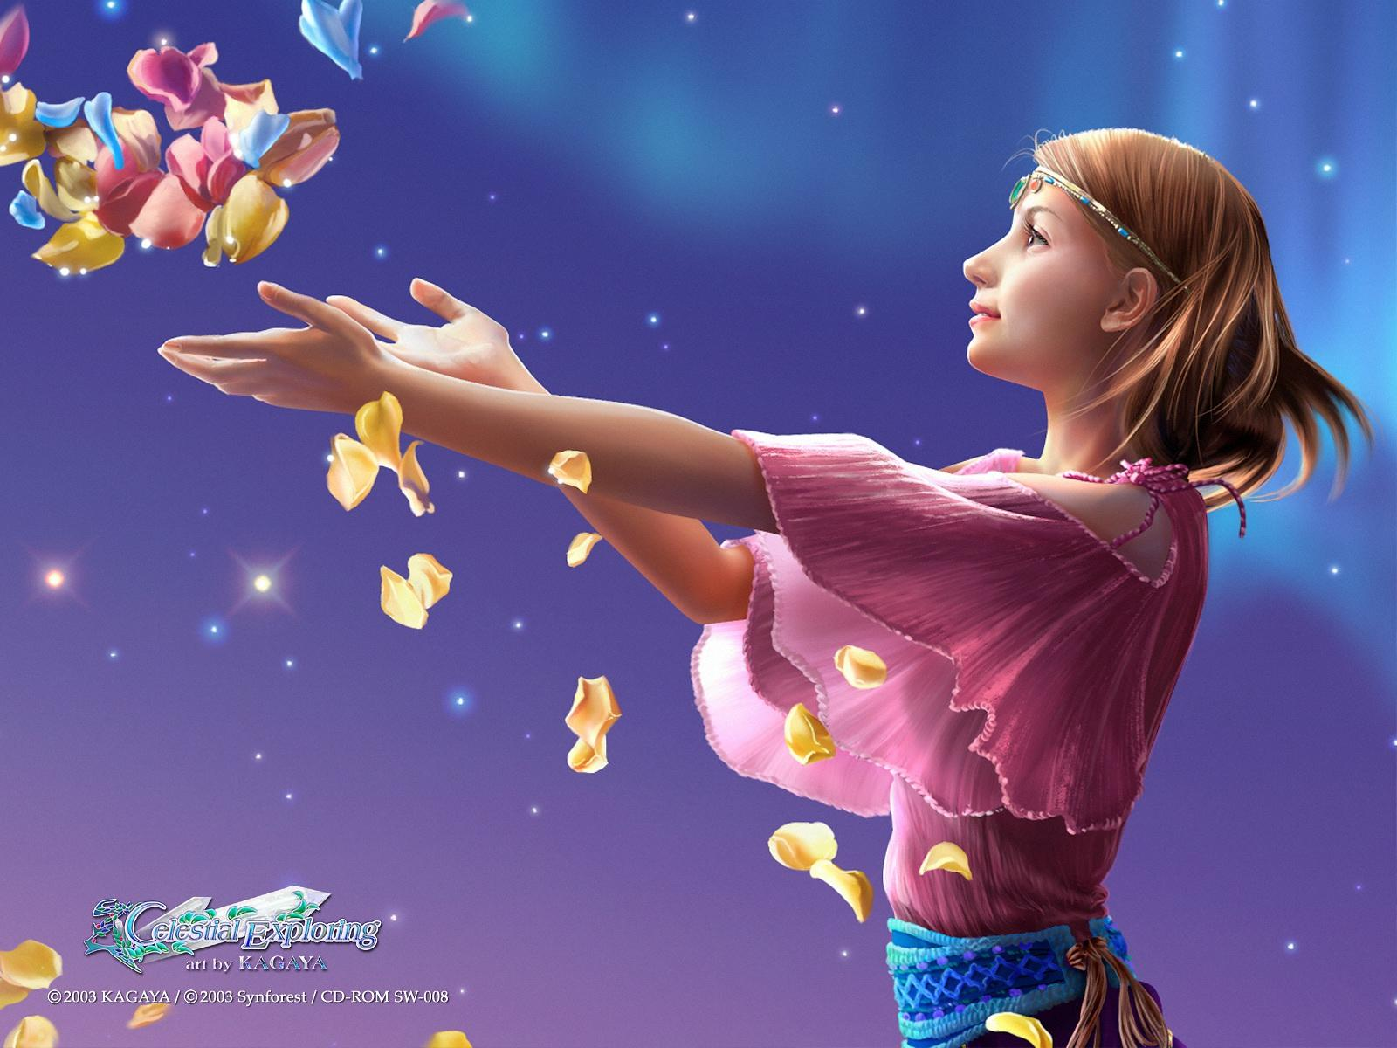


THANKS FOR YOUR ATTENDING!
Goodbye!
See you later.

