Slide 1
English 3
Unit 14: Are there any posters in the room? Lesson 1 (page 24)
Notes:
1

Slide 2
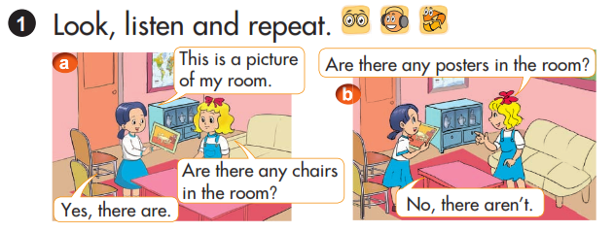

Slide 3
I. New words:
1. maps
:những tấm bản đồ
:những chiếc ghế xô-pha
:những chiếc tủ quần áo
:những chiếc tủ chén bát
2. sofas
3. wardrobes
4. cupboards

Slide 4
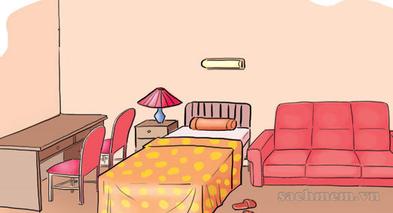
Ex 1:Are there any chairs in the room? Yes, there are.
II. Model sentences:
Are there any …. in the room?
+Yes, there are.
- No, there aren’t.
there aren’t = there are not
Ex 2:Are there any maps in the room? No, there aren’t.

Slide 5
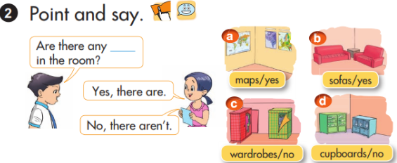

Slide 6
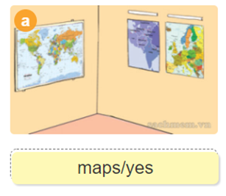
Are there any maps in the room?
Yes, there are.

Slide 7
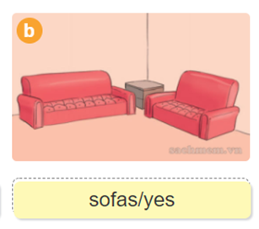
Are there any sofas in the room?
Yes, there are.

Slide 8
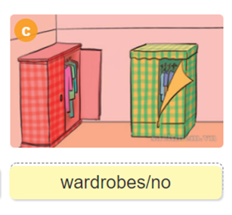
Are there any wardrobes in the room?
No, there aren’t.

Slide 9
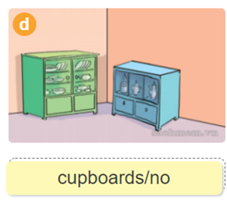
Are there any cupboars in the room?
No, there aren’t.

Slide 10
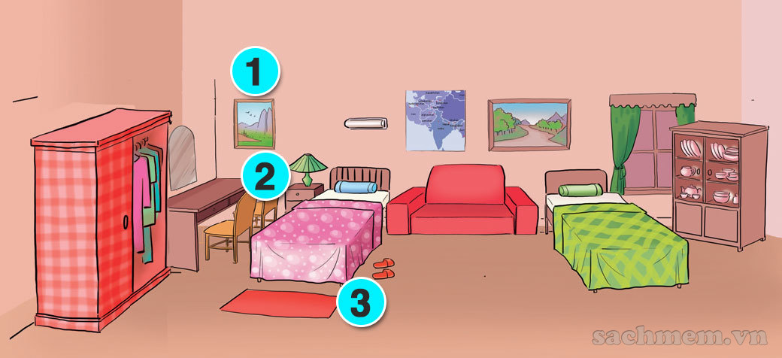
3. Let’s talk. 1,Are there any chairs in the room?............ 2,Are there any pictures in the room?............ 3,Are there any beds the in the room?........... 4,Are there any cupboards in the room?...........

Slide 11
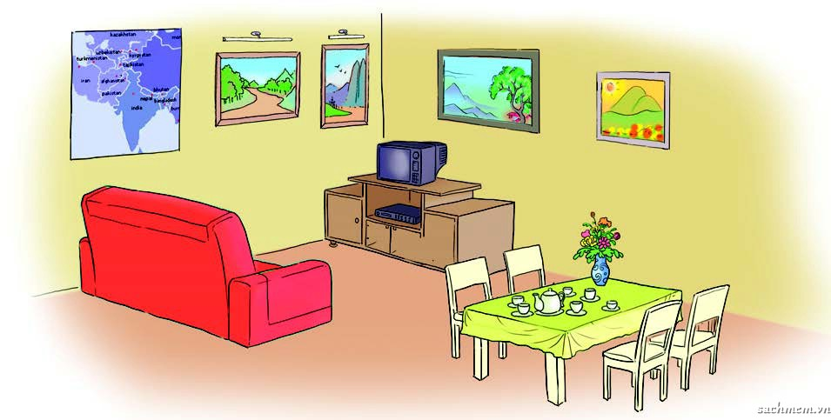
5. Look, read and write.
four pictures
One map
four chairs
One sofa
Are there any……..in the room?
Yes,there are
No,there aren’t

Slide 12

5. Look, read and write.
This is a living room.
2. There is a TV on the …….
in the room.
3. There are four pictures and a big
…… on the wall.
4. There are four ………… near the table.
cupboard
map
chairs

Slide 13
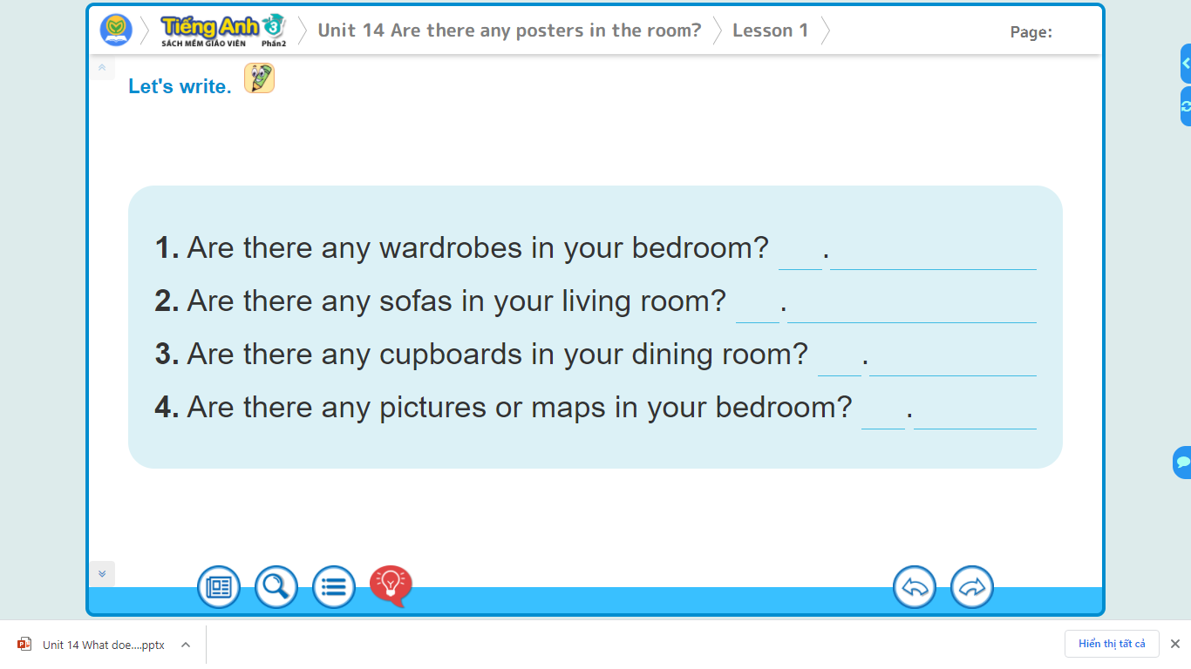
6. Let’s write.

