Slide 1


Unit 14: Are there any posters in the room?
Lesson 2

Slide 2
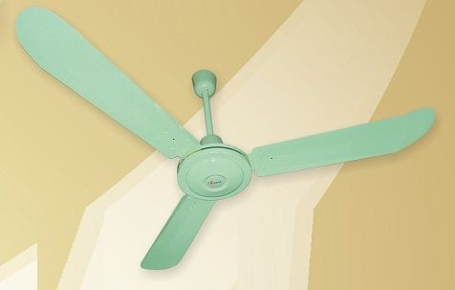

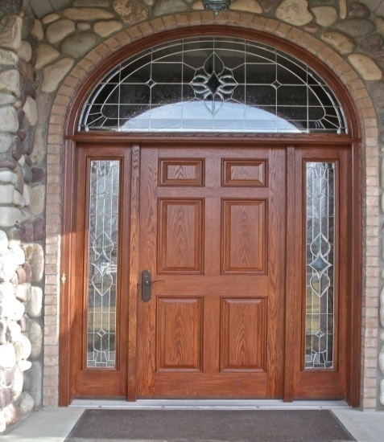
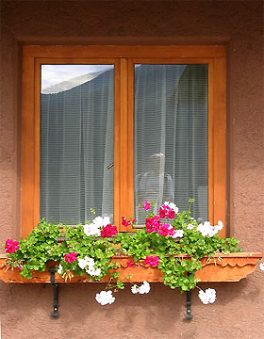
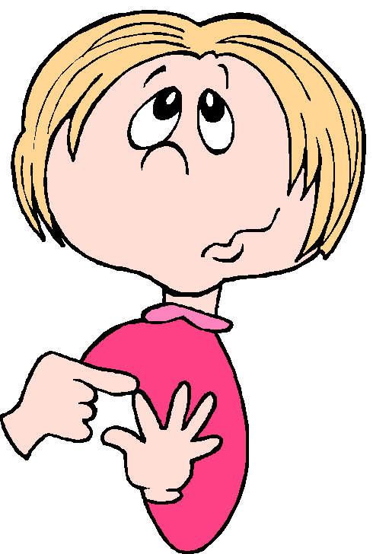
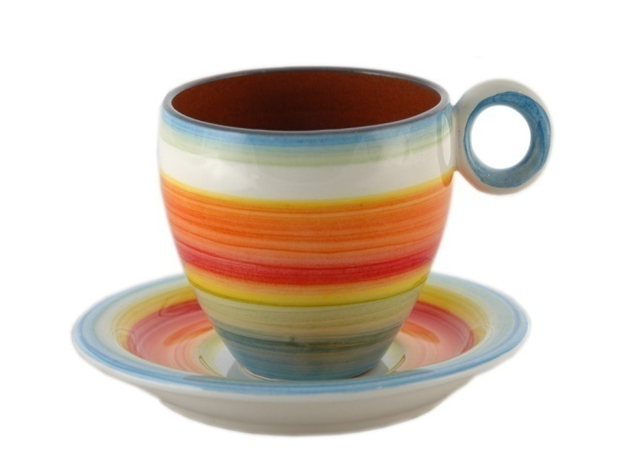
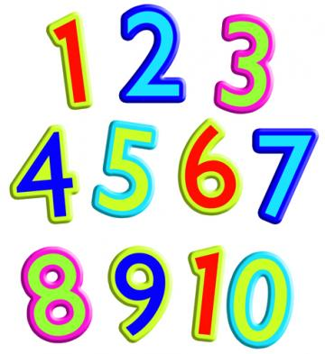
1. Vocabulary
Fan:
quạt trần
Mirror:
gương
cửa chính
Door :
Cup:
đếm
cửa sổ
tách, ly
Count:
Window:

Slide 3

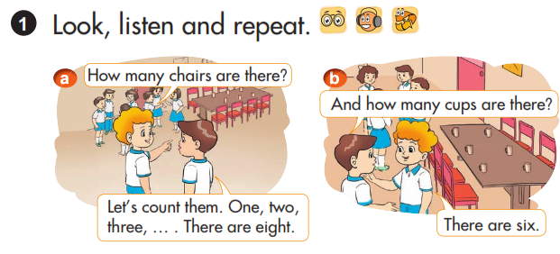
How many chairs are there?
And how many cups are there?
Let’s count them. One, two three,… .There are eight.
There are six.

Slide 4
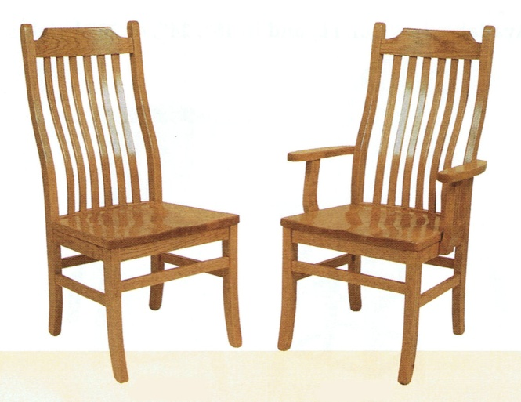

2. Sentence Patterns:
How many are there?
chairs
There are .
two
How many are there?
TVs
There is .
one

Slide 5
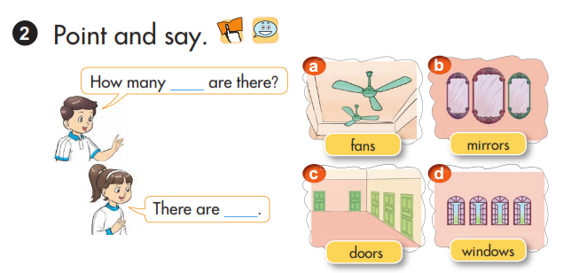
EX: Picture a: How many fans are there? => There are two.

Slide 6
PRACTISE
How many ______ are there in the room?
There is one.
There are two.

Slide 7
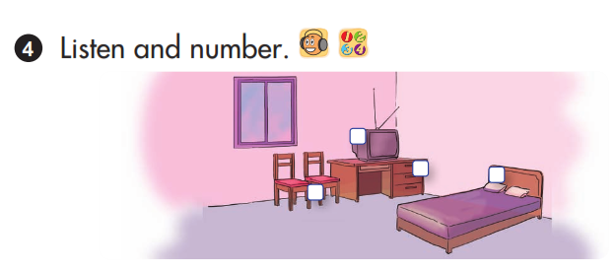
4
2
1
3

Slide 8
