Slide 1

UNIT 15
DO YOU HAVE ANY TOYS?
Lesson 1

Slide 2

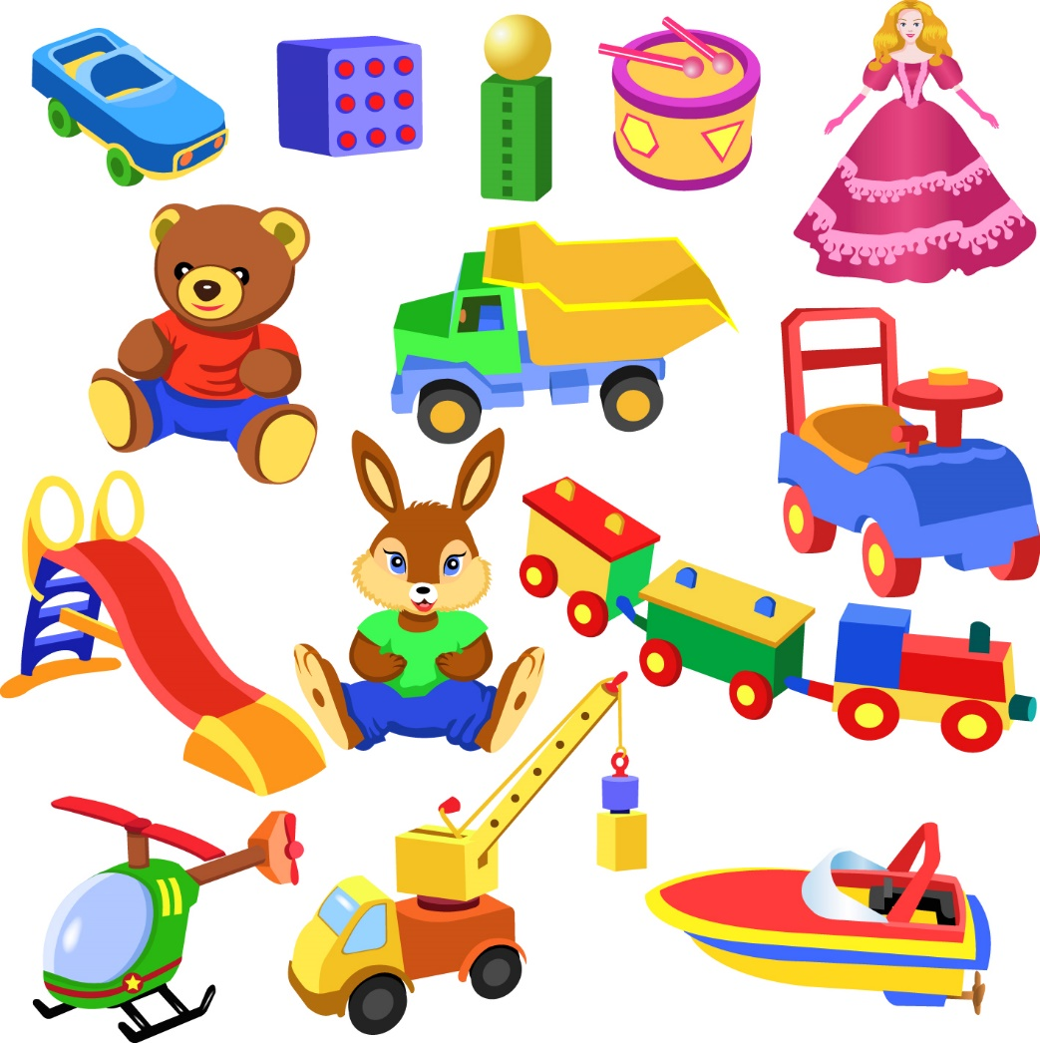
1. New words
toy ( n):
đồ chơi

Slide 3
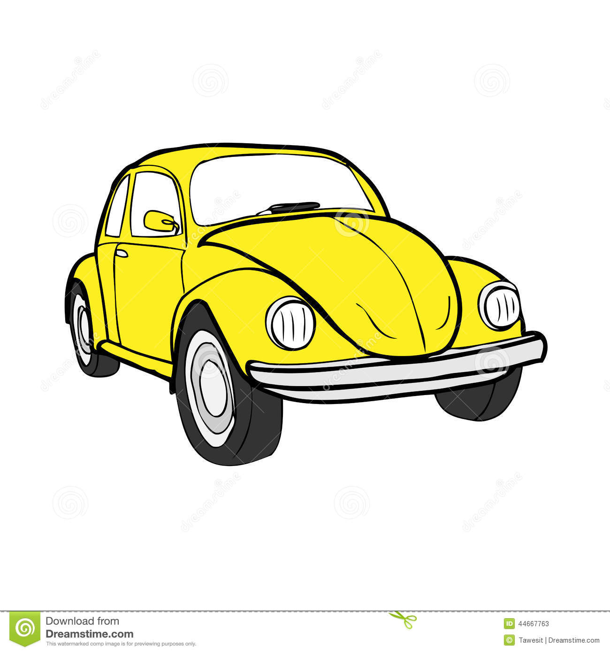
car ( n):
ô tô

Slide 4

doll ( n):
búp bê

Slide 5

robot ( n):
con rô bốt

Slide 6

teddy bear ( n):
Gấu bông

Slide 7
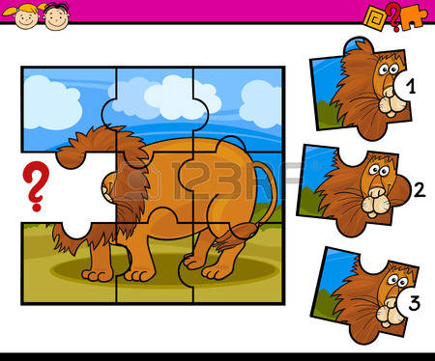
puzzle ( n):
Trò chơi ghép hình

Slide 8


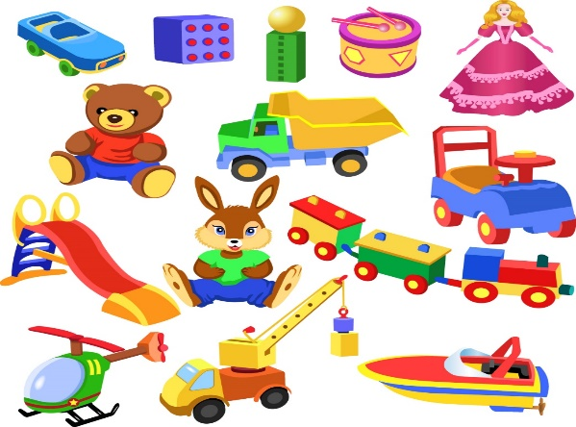
1
2
Matching
3
4
5
6
a. car
c. doll
e. puzzle
b. toy
d. robot
f. teddy bear

Slide 9
2. Model sentence
Ex1: Do you have a car?
Ex2: Do you have a doll?
Yes, I do
No, I don’t
No, I don’t
=>
/
Yes, I do
/
=>
Do you have+ ( tên đồ vật) ?
=>
Yes, I do
No, I don’t
/

Slide 10

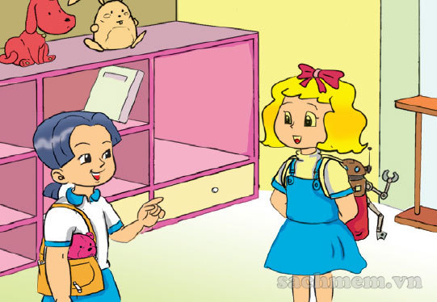
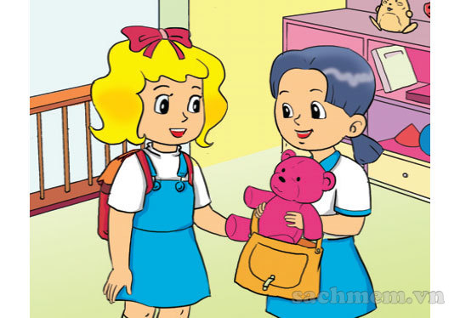
3. Practice
a. Look, listen and repeat
Do you have a teddy bear?
Yes, I do
It’s my robot.
Do you have a robot?
What’s that ?
No, I don’t

Slide 11

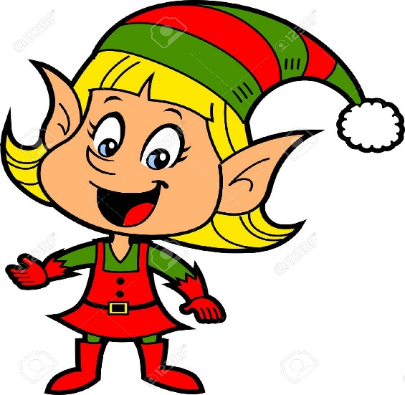
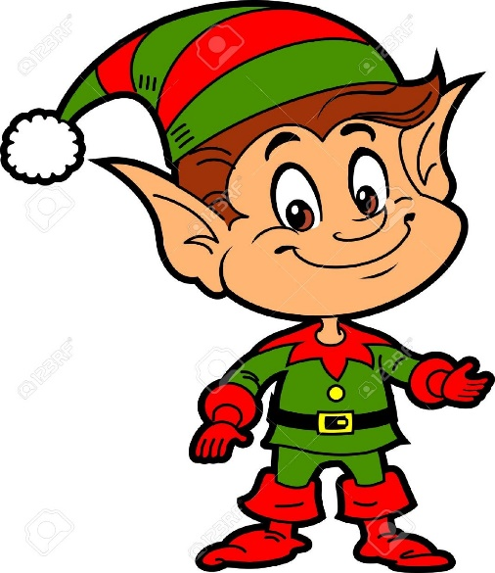
b. Point and say
Do you have ……..?
a doll
Yes, I do
a doll/ yes

