Slide 1
Unit 15:Do you have any toys?
Lesson 2

Slide 2
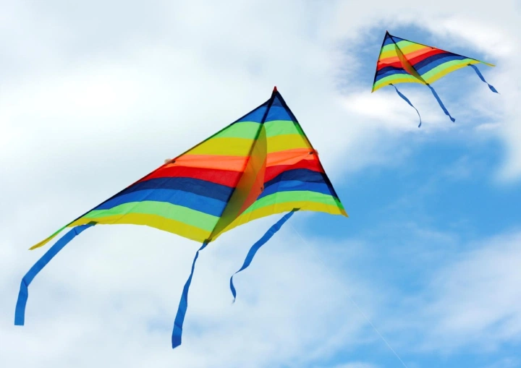
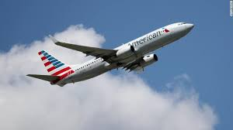
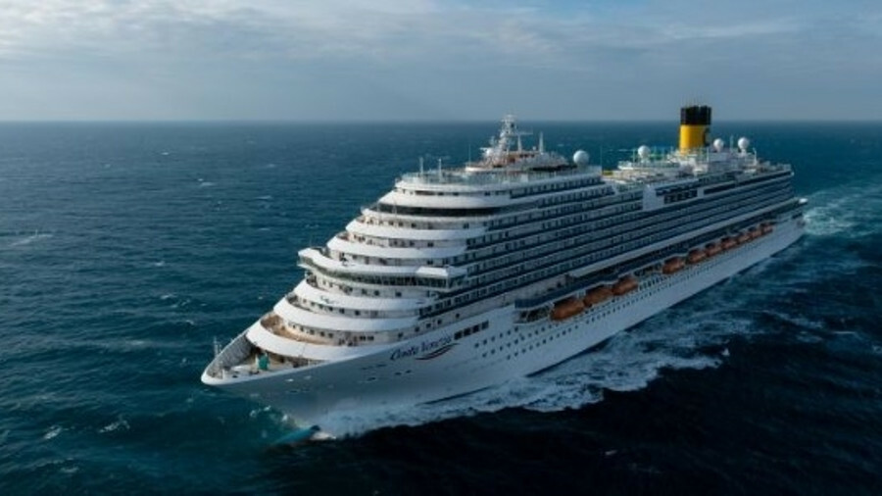
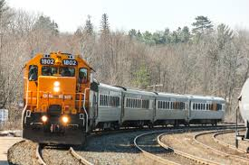
01.Vocabulary
Kite
Plane
Ship
Train

Slide 3

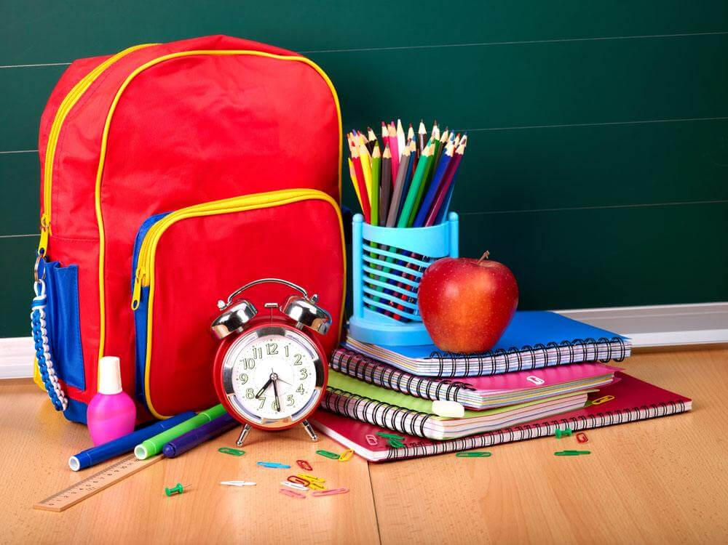
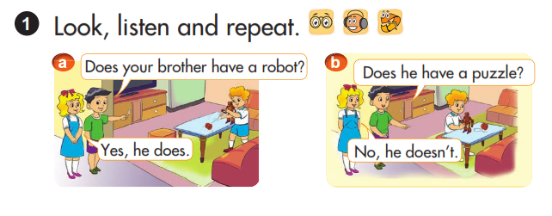
Look, listen and repeat

Slide 4

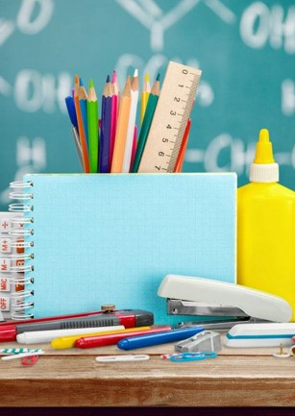
02. Model
Dose he/ she have ___?
Yes, he/ she does.
No, he/ she doesn’t.
Example:
Does he have a plane?
Yes, he does.

Slide 5
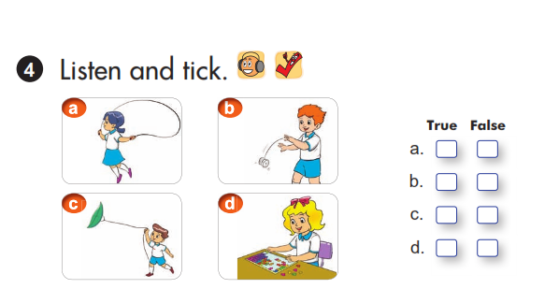
Listen and tick
√
√
√
√

Slide 6
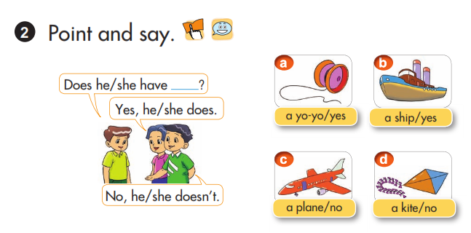
03. Practice
Practice
Vocabulary
Model

Slide 7


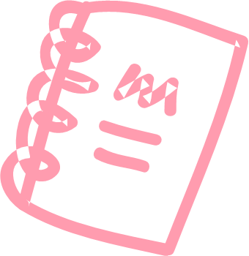
Let’s sing
Linda has a little doll
Linda has a little doll,
Little doll, little doll.
Linda has a little doll.
Its dress is white and brown.
Everywhere that Linda goes,
Linda goes, Linda goes.
Everywhere that Linda goes,
That doll is sure to go.

Slide 8


