Slide 1
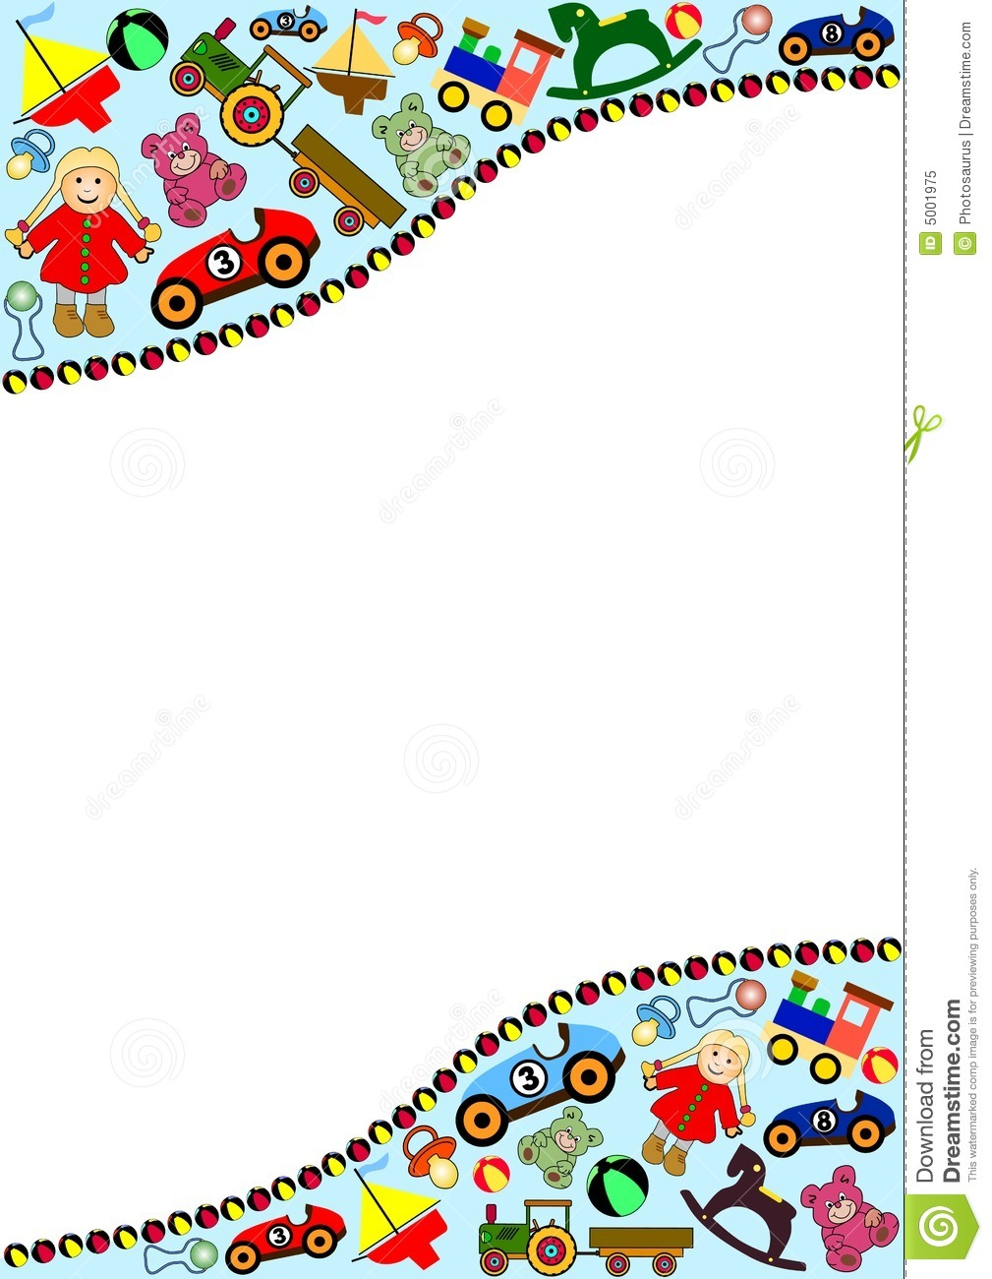
Unit 15:Do you have any toys?
Lesson 3 (1,2,3)

Slide 2
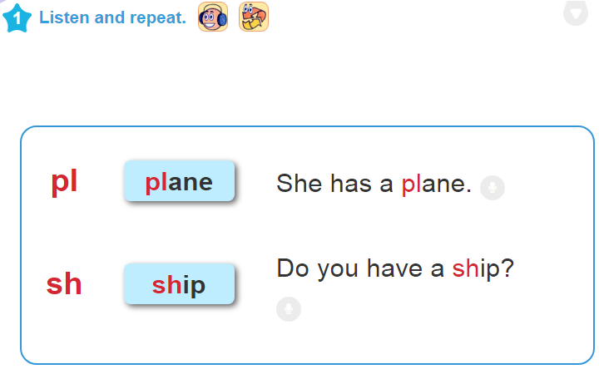


Unit 15: Do you have any toys?
Lesson 3 ( part 1,2,3 )
LOC BAC PRIMARY SCHOOL

Slide 3

Unit 15: Do you have any toys?
Lesson 3 ( part 1,2,3 )
1. Linda has a …………
2. My brother doesn’t have
a …………
ship
plane
LOC BAC PRIMARY SCHOOL

Slide 4

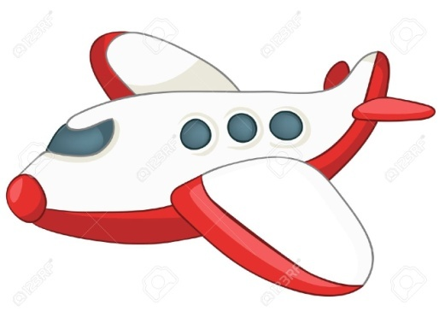
Unit 15: Do you have any toys?
Lesson 3 ( part 1,2,3 )
Lời bài nghe:
Linda has a ship.
(Linda có một con tàu)
2. My brother doesn’t have a plane.
(Anh/em trai của tôi không có máy bay)
LOC BAC PRIMARY SCHOOL

Slide 5
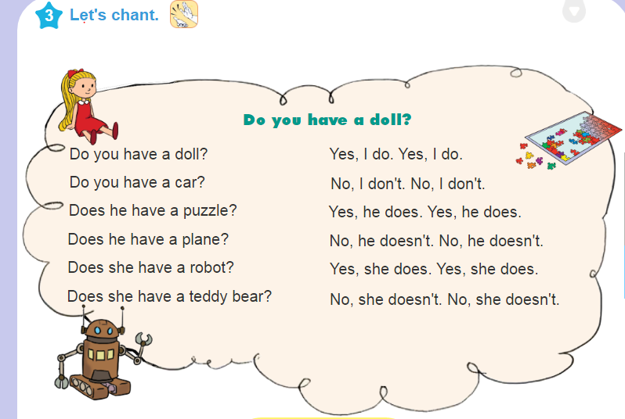
Unit 15: Do you have any toys?
Lesson 3 ( part 1,2,3 )
LOC BAC PRIMARY SCHOOL

