Slide 1
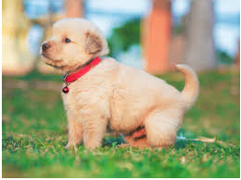
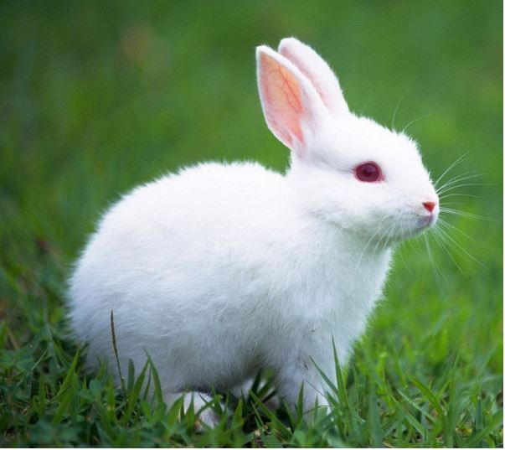

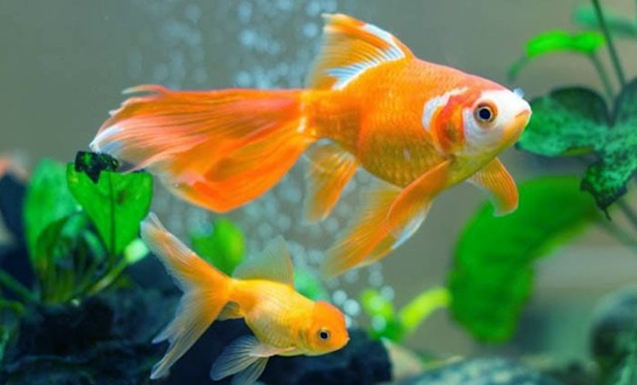
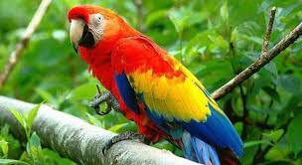
UNIT 16: DO YOU HAVE ANY PETS?
Lesson 2
1. Cat
2. Rabbit
3. Dog
4. Goldfish
5. Parrot

Slide 2
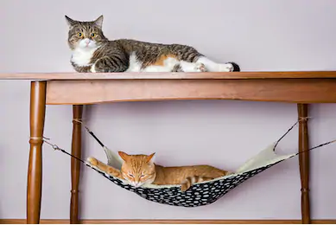
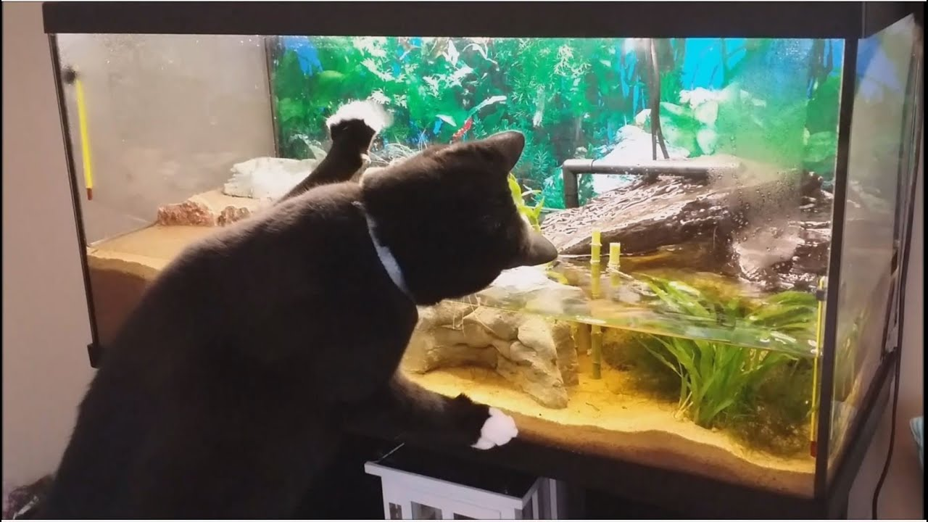
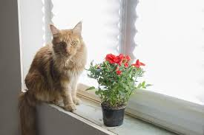
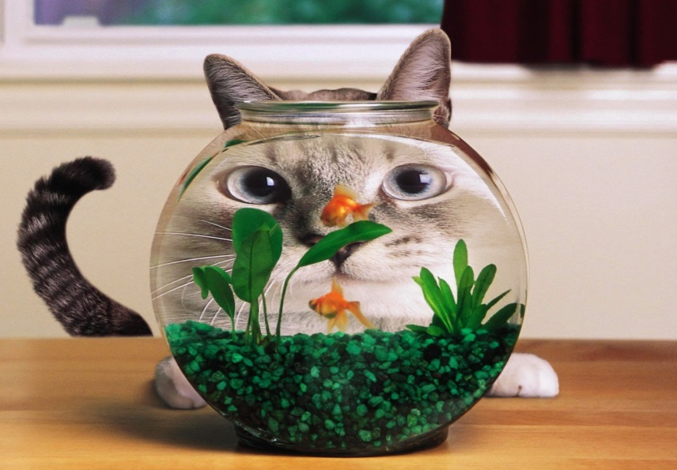
UNIT 16: DO YOU HAVE ANY PETS?
Lesson 2
- on the: ở trên
- under the: ở dưới
- in front of the: phía trước
- behind : phía sau
- next to : kế bên
- flower pot: bình hoa
- fish tank: bể cá

Slide 3
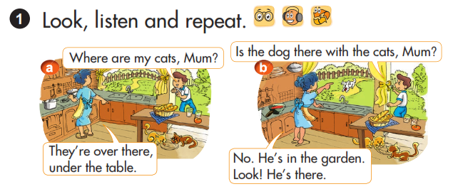

UNIT 16: DO YOU HAVE ANY PETS?
Lesson 2
Where are the ______? (_________ ở đâu?
=> They’re _______. ( Chúng ở ______.)

Slide 4
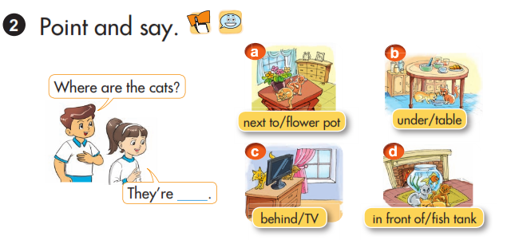
UNIT 16: DO YOU HAVE ANY PETS?
Lesson 2
Where are the cats?
next to/ flower pot
under/ table
They’re ____.
behind/ TV
in front of/ fish tank
Ex: Picture a: Where are the cats? ( Những con mèo ở đâu?)
=> They’re next to the flower pot. ( Chúng ở kế bên chậu hoa.)

Slide 5
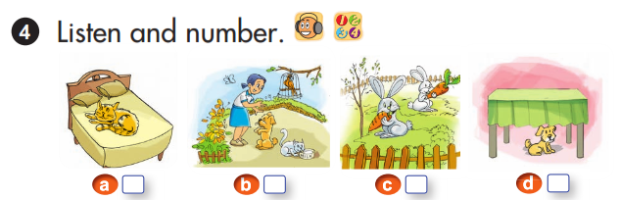
UNIT 16: DO YOU HAVE ANY PETS?
Lesson 2
2
1
4
3
Notes:
✓

Slide 6
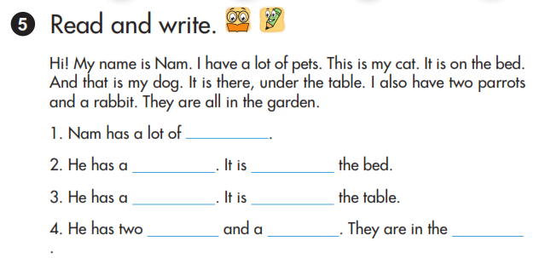
UNIT 16: DO YOU HAVE ANY PETS?
Lesson 2
pets
cat
on
dog
under
parrots
rabbit
garden.
Notes:
✓

