Slide 1

UNIT 16: DO YOU HAVE ANY PETS?
LESSON 3 ( 1,2,3)

Slide 2
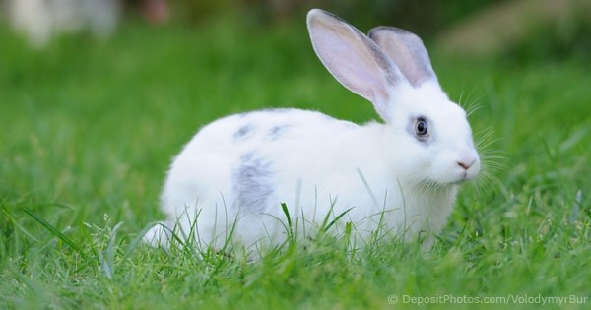
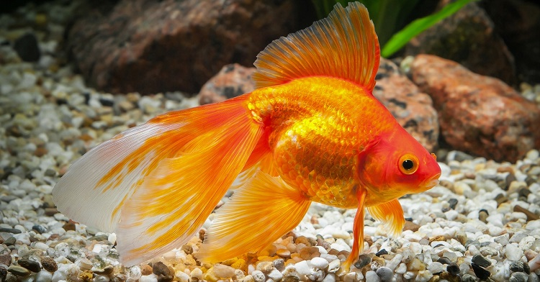
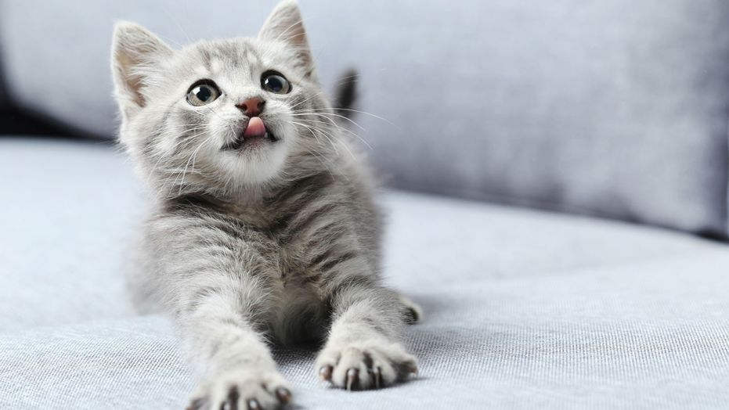
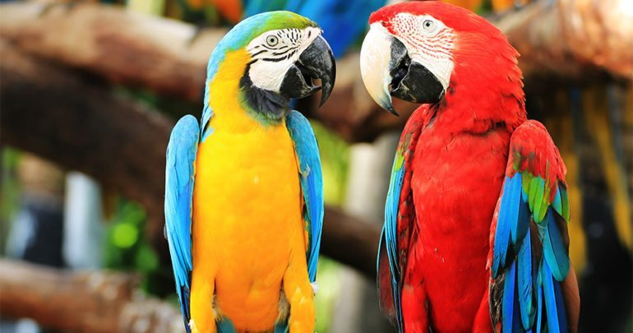
1
2
Rabbit
Goldfish
3
4
Cat
Parrot

Slide 3
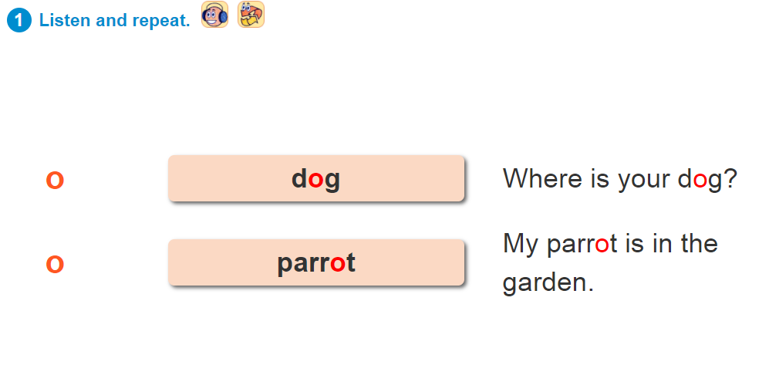

UNIT 16:DO YOU HAVE ANY PETS?
1: Listen and repeat.
ɔ
ə

Slide 4
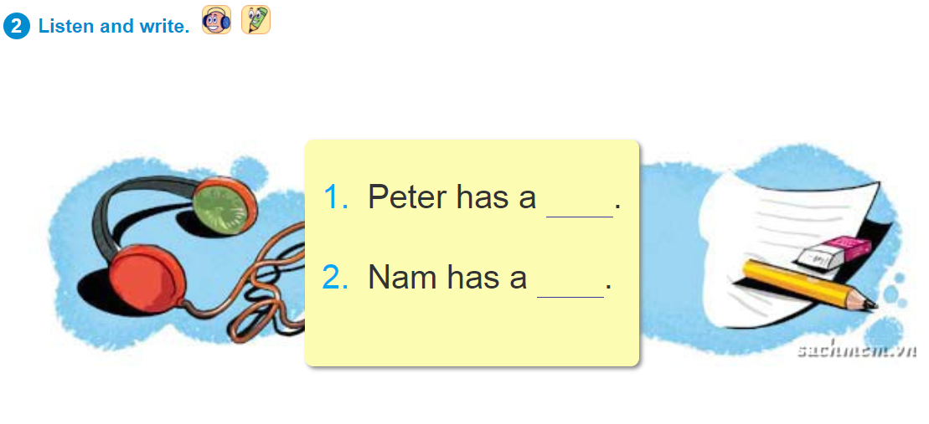
UNIT 16:DO YOU HAVE ANY PETS?
1: Listen and write.
parrot
dog

Slide 5
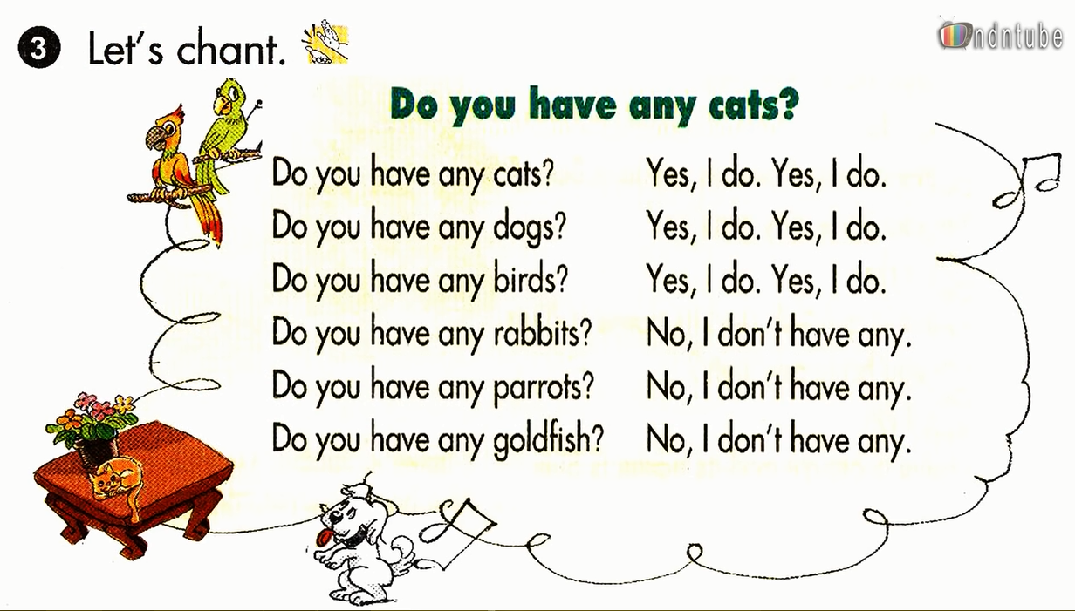
UNIT 16:DO YOU HAVE ANY PETS?

Slide 6
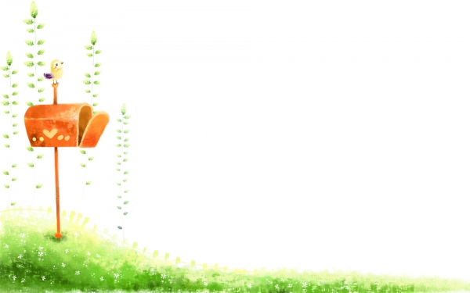
th
Monday, March 19 2018
UNIT 16:DO YOU HAVE ANY PETS?
Sound
o
ɔ
ə
dog
parrot

