Slide 1






Welcome to
our class 4
F
F

Slide 2

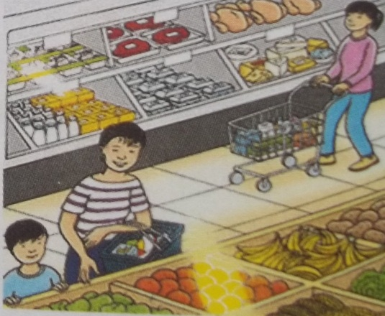
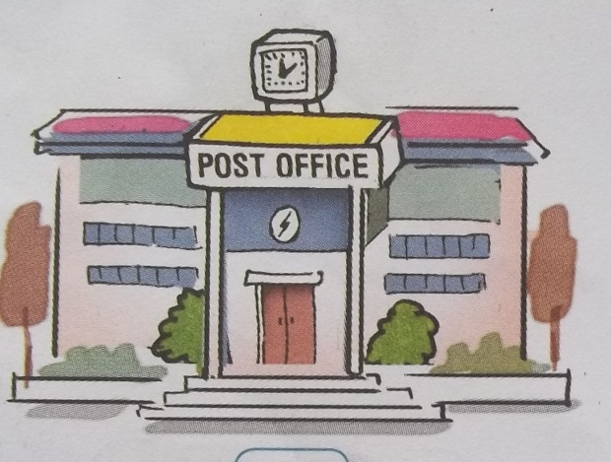
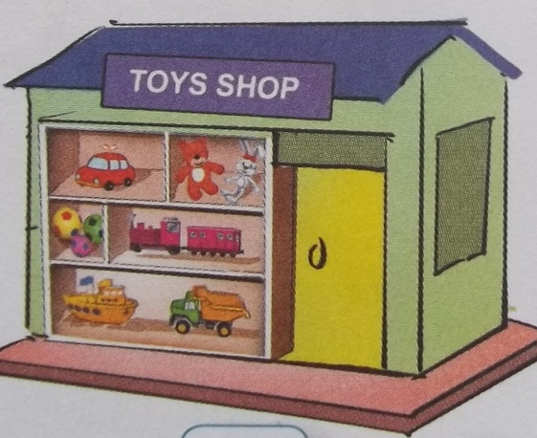
Warm up :
Look at the pictures. Ask and answer

Slide 3
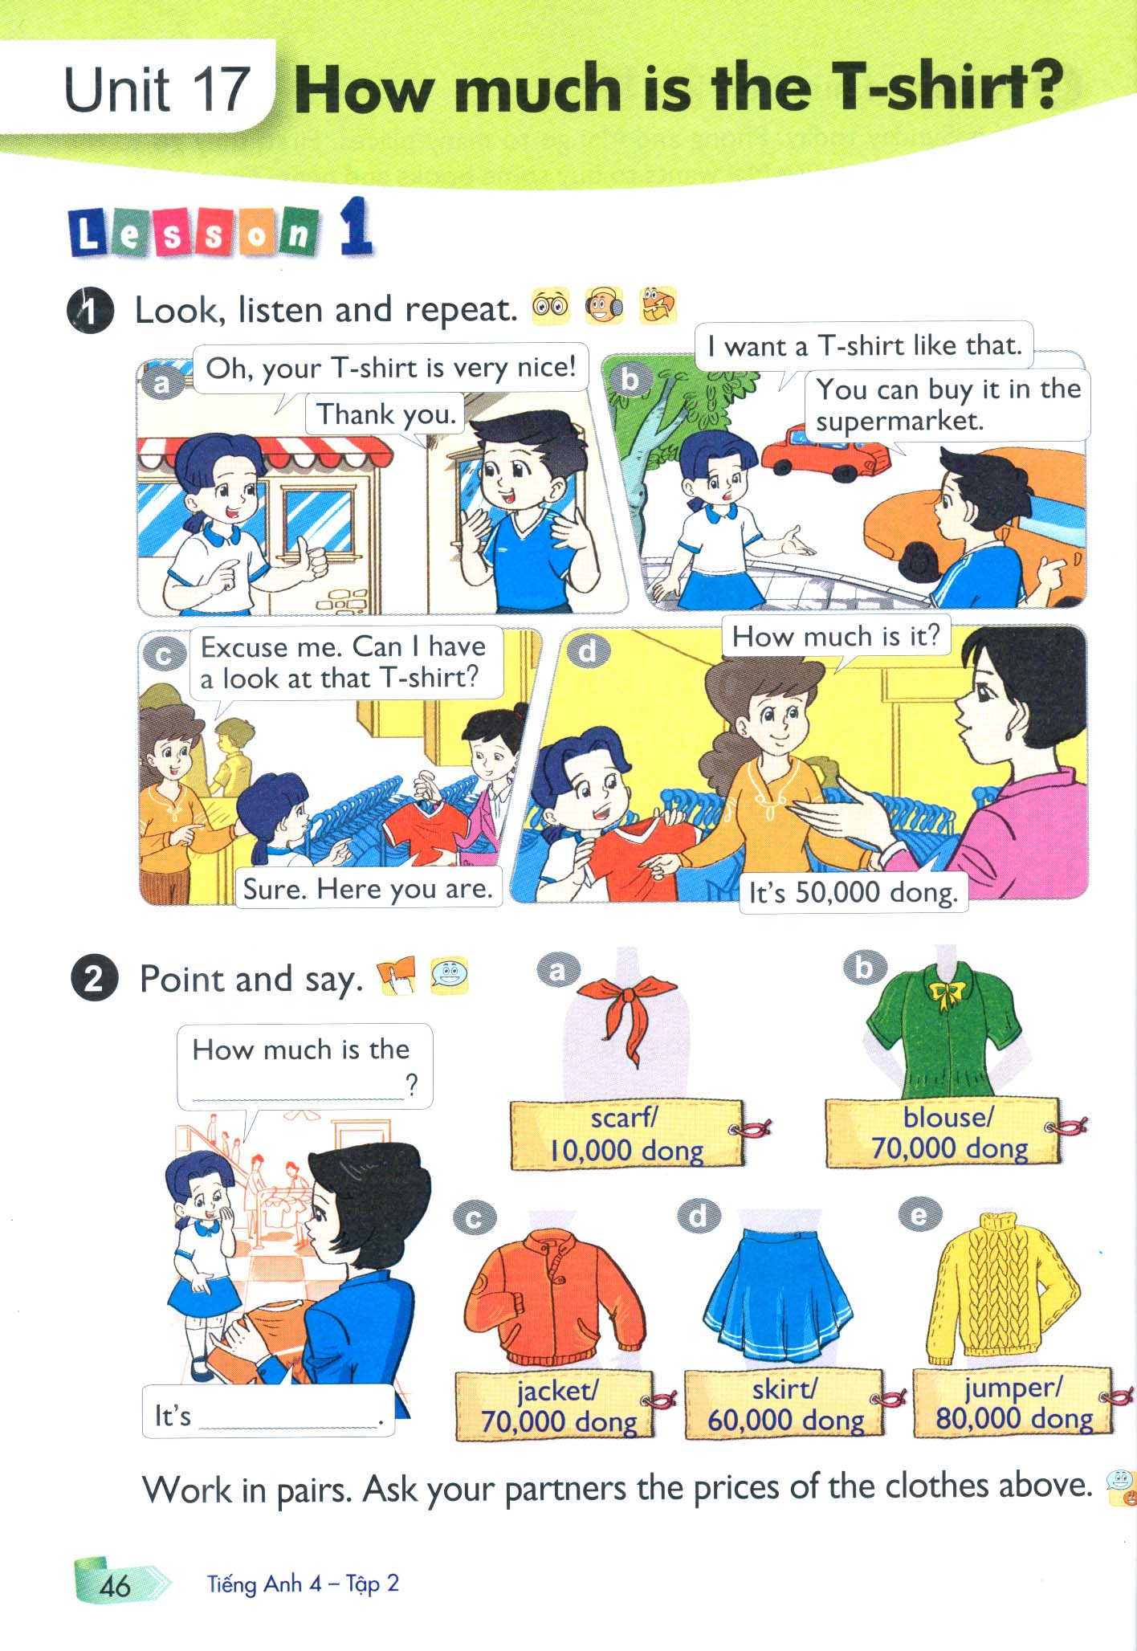
Unit 17 : How much is the T-shirt
Lesson 1

Slide 4

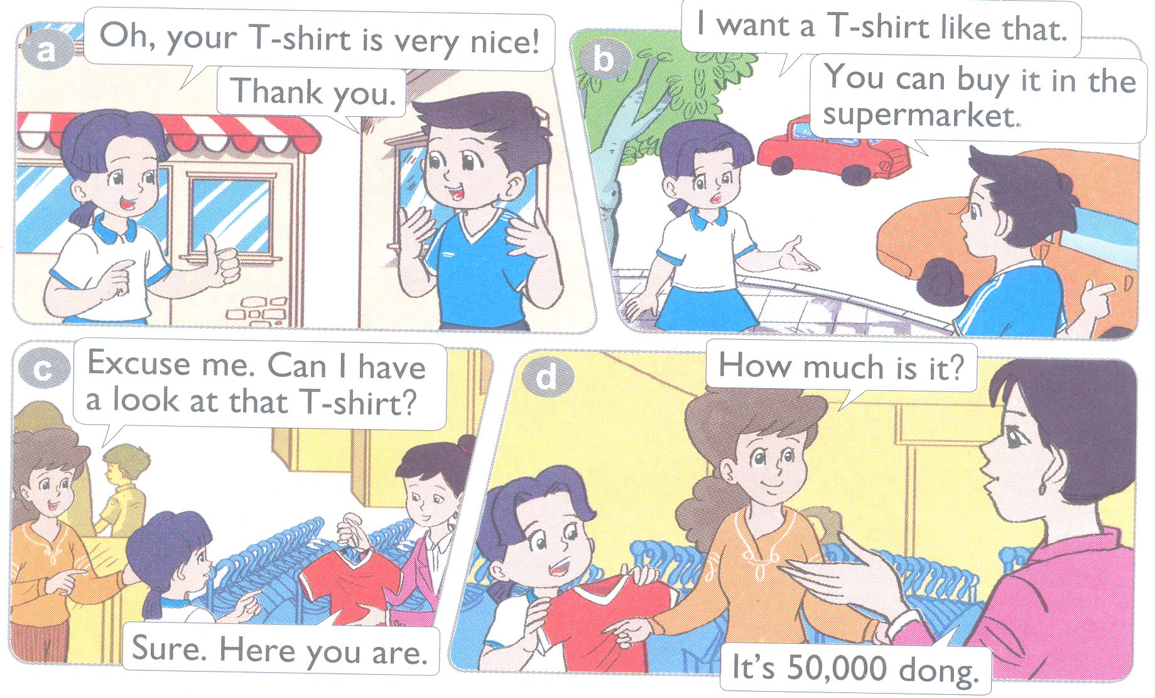
1. Look, listen and repeat:

Slide 5
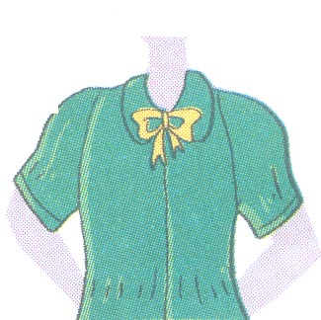
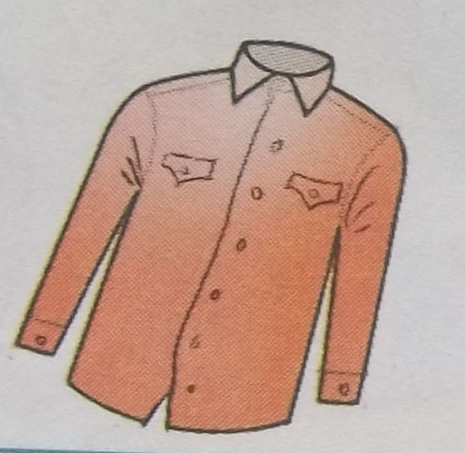
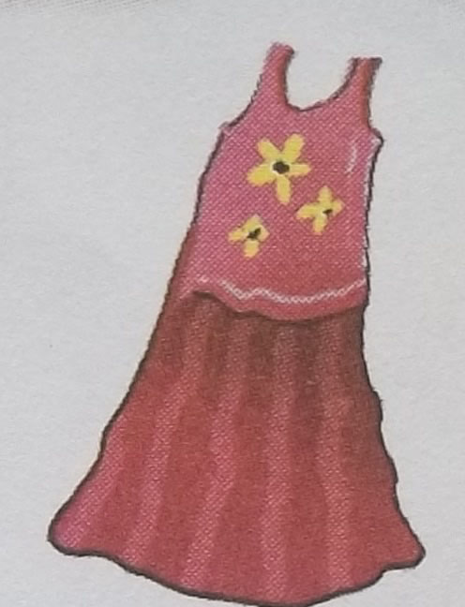
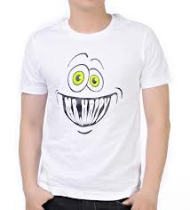
Unit 17 : How much is the T-shirt
Lesson 1
1, Vocabulary :
- Wear :
mặc
- T-shirt :
áo thun ngắn tay
- Shirt :
áo sơ mi
- Dress :
áo đầm
- Blouse :
Áo sơ mi nữ

Slide 6
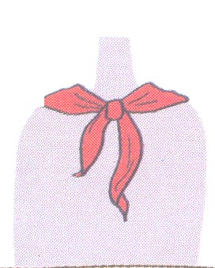
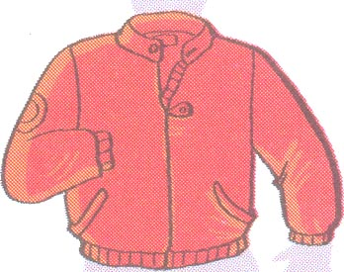
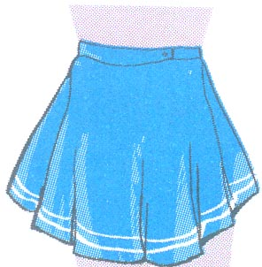
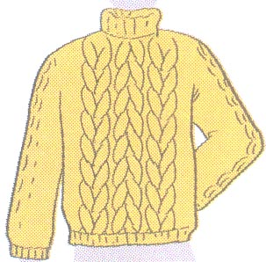
Unit 17 : How much is the T-shirt
Lesson 1
1, Vocabulary :
Jacket : áo khoác
Skirt : váy ngắn
scarf : khăn quàng
jumper : áo len cổ lọ
Thousand: ngàn
One thousand : một ngàn
Ten thousands : mười ngàn

Slide 7
a
b
c
d
e

Slide 8
a
scarf

Slide 9
b
blouse

Slide 10
c
jacket

Slide 11
d
skirt

Slide 12
e
jumper

Slide 13
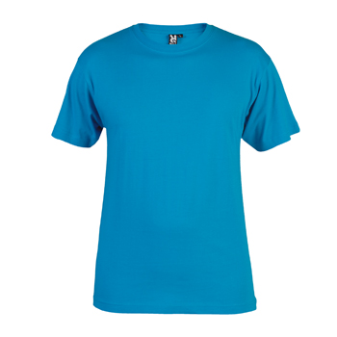
T- shirt

Slide 14
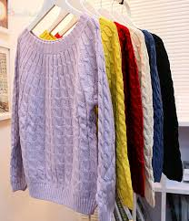
jumpers

Slide 15
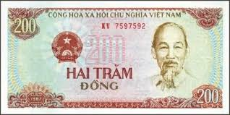

Slide 16

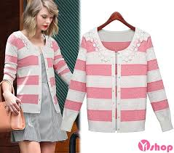
* Matching
row A
1 | 2 | 3 | 4 | 5 | 6
row B
a blouse | b skirt | c jumper | d dong | e jacket | g Scarf

Slide 17
2. Point and say :
Để hỏi giá tiền của một đồ vật ?
Model sentence :
How much is the + S.N (danh từ số ít)?
It’s + money (số tiền) .
How much is the T – shirt ?
It’s 50,000dong.

Slide 18
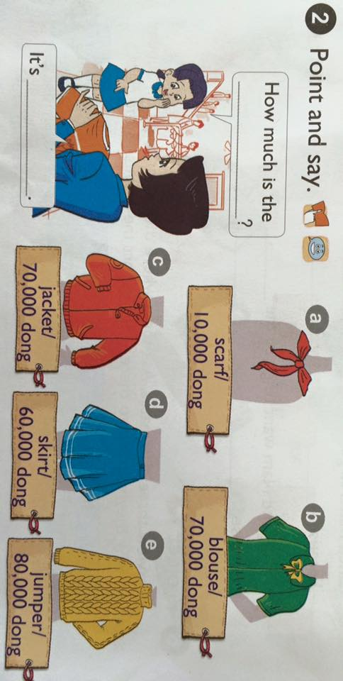
2. Point and say:

Slide 19
a
b
scarf
blouse
c
d
e
jacket
skirt
jumper

Slide 20
a
b
Scarf/
10,000 dong
Blouse/
70,000 dong
c
d
e
Jacket/
70,000 dong
Skirt/
60,000 dong
Jumper/
80,000 dong

Slide 21
a
b
How much is the
__________?
scarf
It’ s __________
10,000 dong.
Scarf/
10,000 dong
Blouse/
70,000 dong
c
d
e
Jacket/
70,000 dong
Skirt/
60,000 dong
Jumper/
80,000 dong

Slide 22
Work in pairs. Ask your partner the prices of the clothes above.

Slide 23
How much is the
__________?
scarf
It’ s __________
10,000 dong.
Blouse/
70,000 dong
Scarf/
10,000 dong
Jacket/
70,000 dong
Skirt/
60,000 dong
Jumper/
80,000 dong

Slide 24
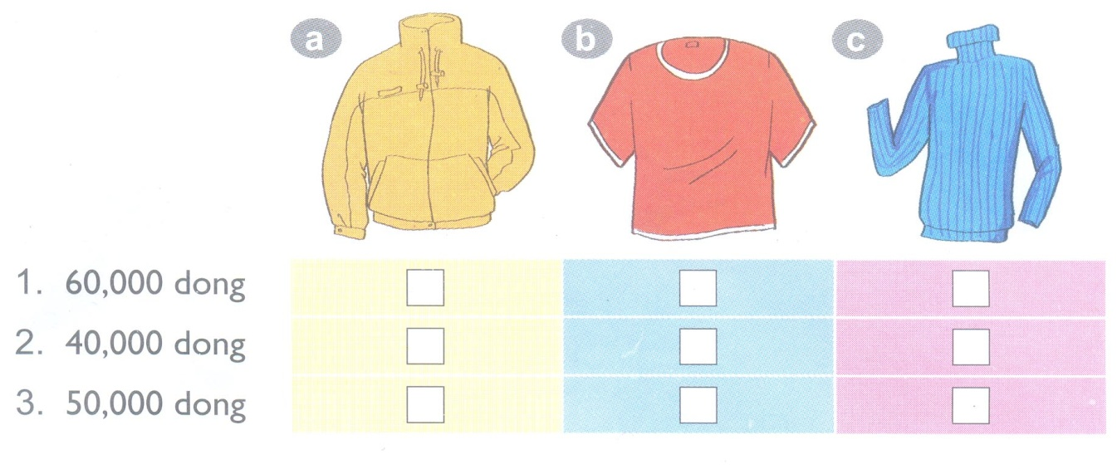
3. Listen and tick:

Slide 25
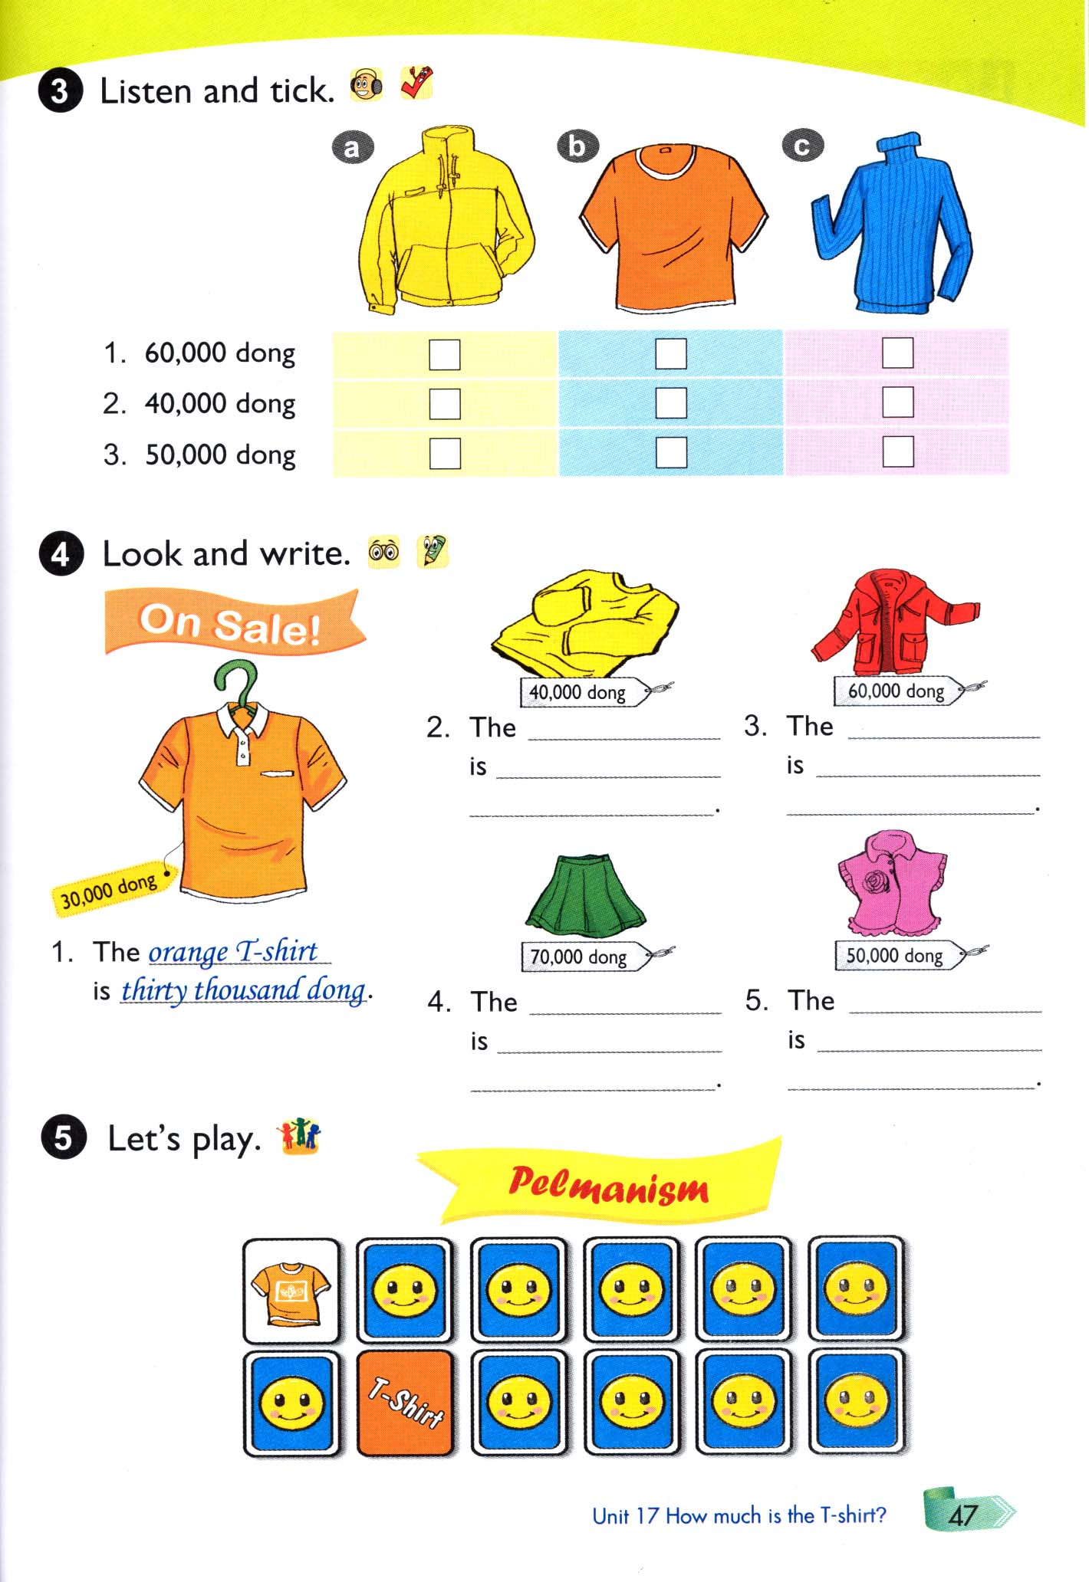

Slide 26
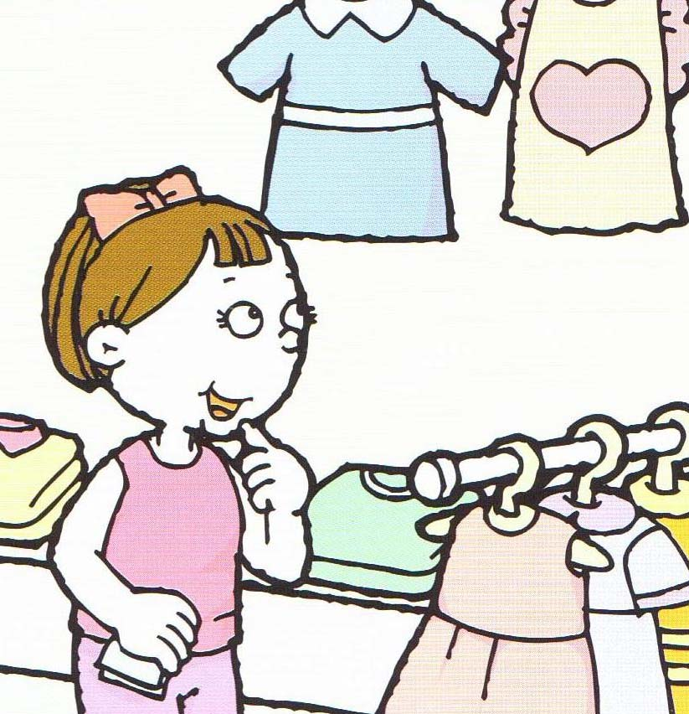

LET’S GO SHOPPING!

Slide 27
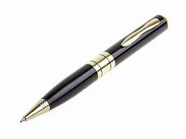
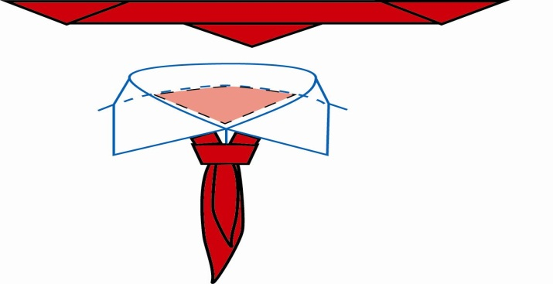
How much is the pen ?
It’s 5.000 dong.
How much is the scarf ?
It’s 10.000 dong
Note:5.000 dong (thousand)

Slide 28
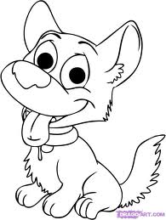

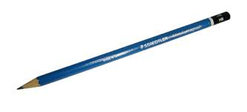
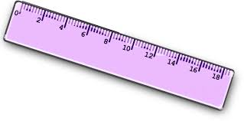
2.000
9o.000
50.000
3.000
5.000
80.000

Slide 29


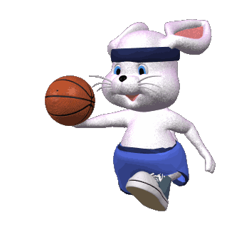


Thank you for your attention !
Good Bye!

