Slide 1

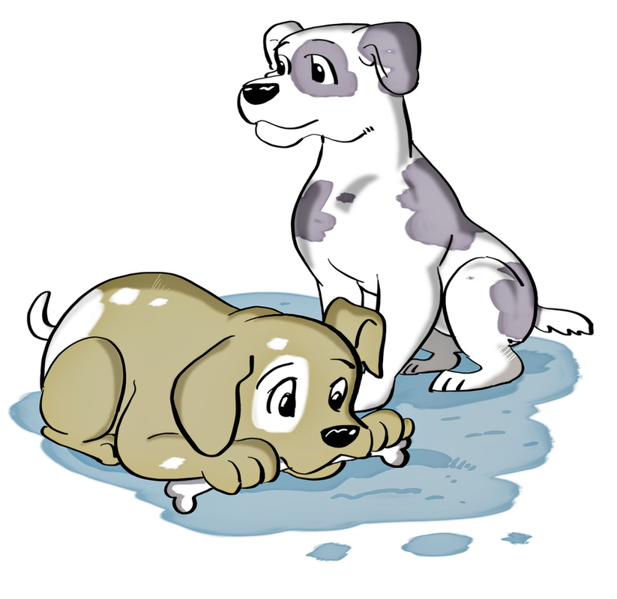
1. Do you have any _______?
A. cats
B. dogs
C. parrots

Slide 2
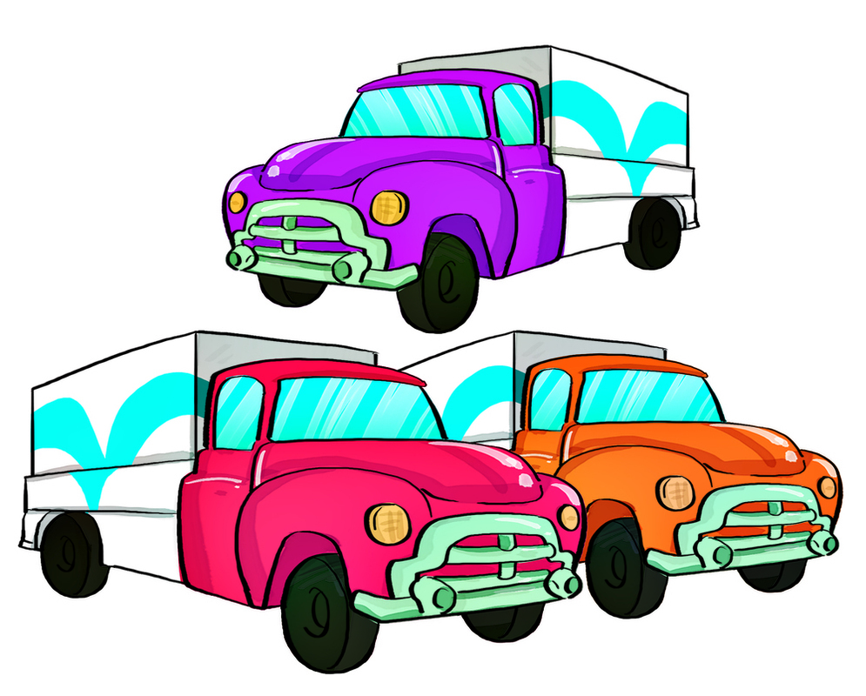
2. A: What toys do you like?
B: I like _________.
A. trucks
B. dolls
C. ships

Slide 3
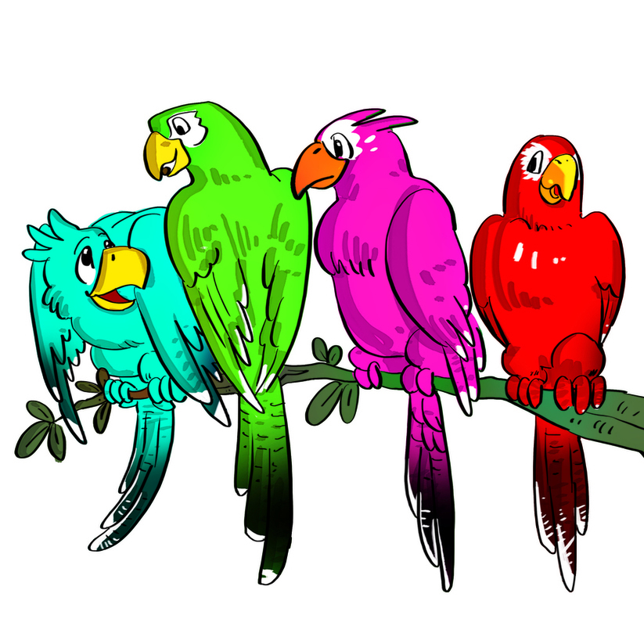
3. A: How many parrots do you have?
B: I have ________.
A. two
B. three
C. four

Slide 4
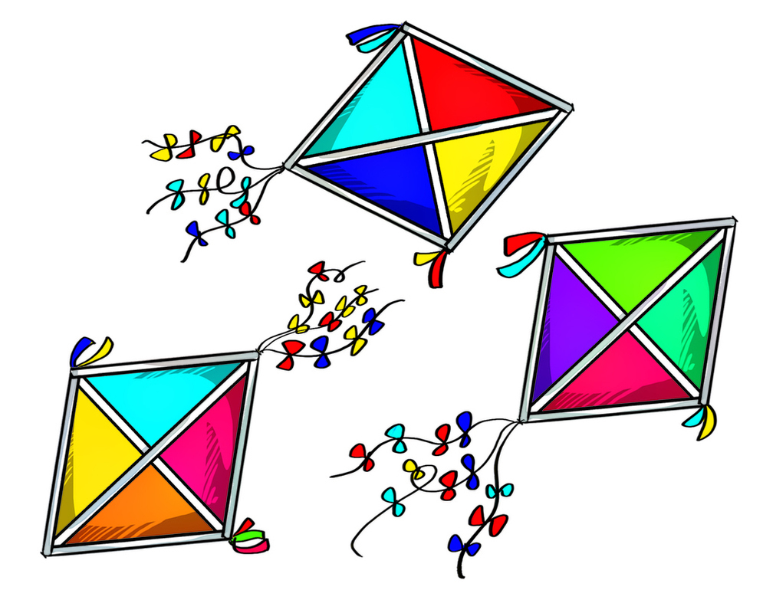
4. A: Do you have three kites?
B: Yes, _______.
A. I has
B. I have
C. I do

Slide 5
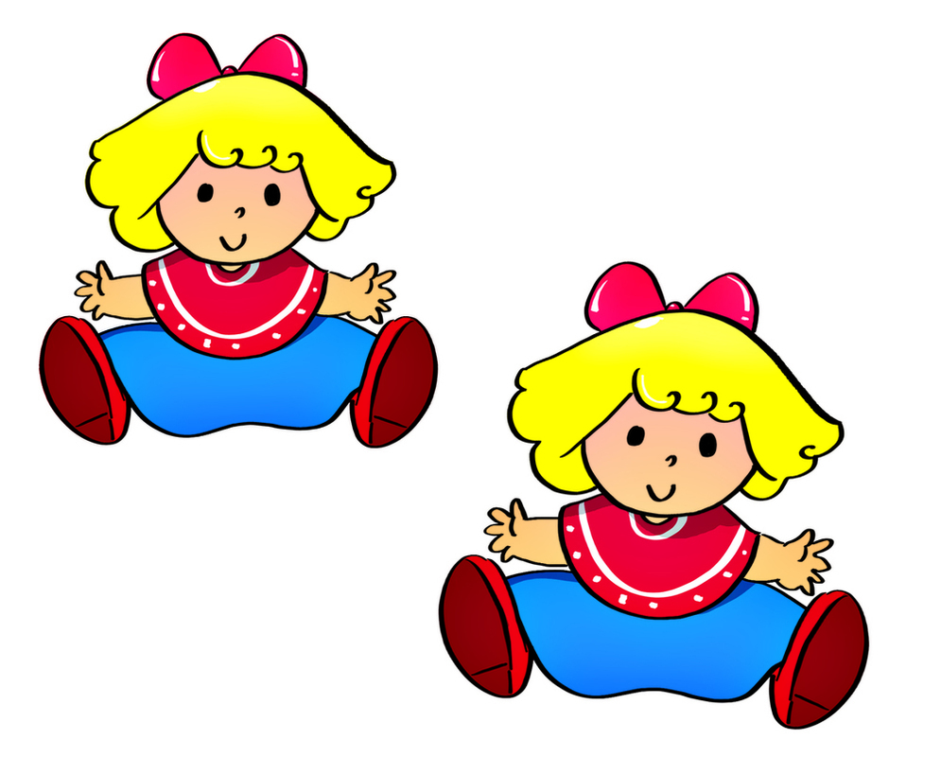
5. A: Are there any dolls?
B: Yes, _______.
A. there is
B. I have
C. there are

Slide 6
Unit 18: What are you doing? Lesson 1

Slide 7
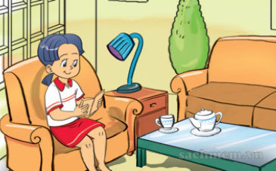
reading

Slide 8
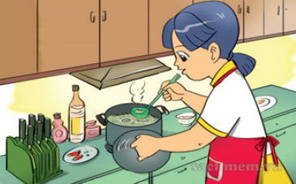
cooking

Slide 9
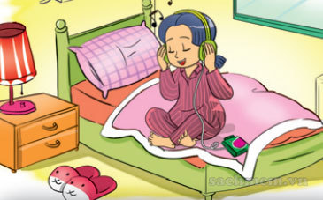
Listening to music

Slide 10
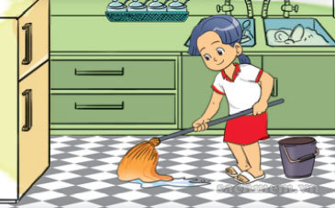
cleaning the floor

Slide 11
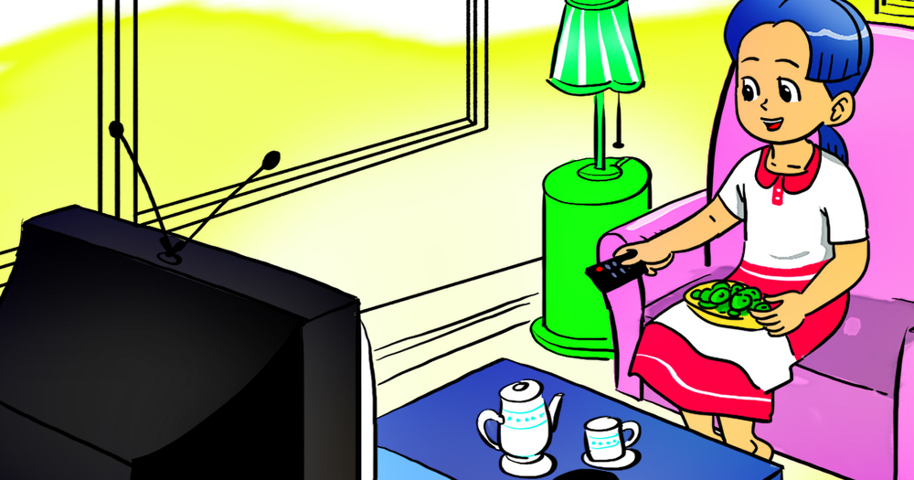
Watching TV

Slide 12
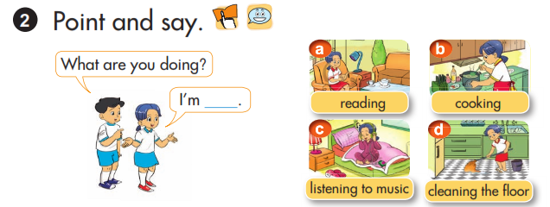

Slide 13
Let’s sing!
What are you doing?
I’m reading.
What are you doing?
I’m cooking.
What are you doing?
I’m listening to music.
What are you doing?
I’m cleaning the floor.
What are you doing?
I’m cleaning the floor.

