Slide 1
Unit 18: What are you doing ?
Lesson 2

Slide 2

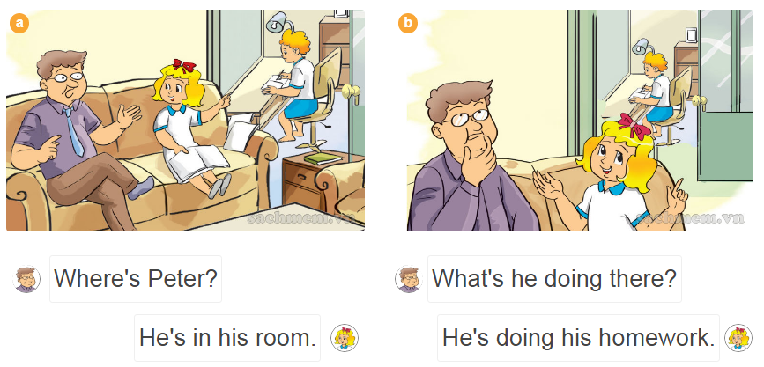
1.Look, listen and repeat:

Slide 3
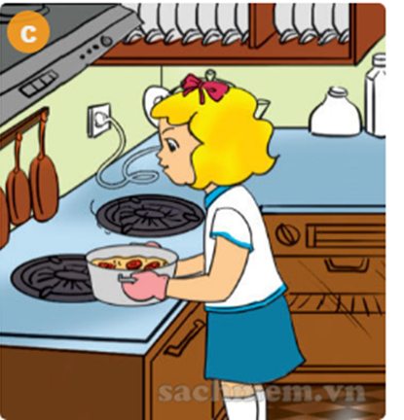
Model sentence :
What is she/ he doing ?
(Cô ấy/ anh ấy đang làm gì?)
She / he is + V- ing.
( Cô ấy/ anh ấy đang …)
What is she doing?
She is cooking.

Slide 4
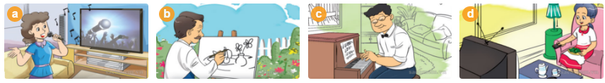
Vocabulary

Slide 5
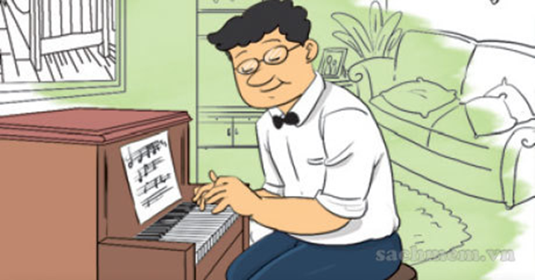
Vocabulary

Slide 6
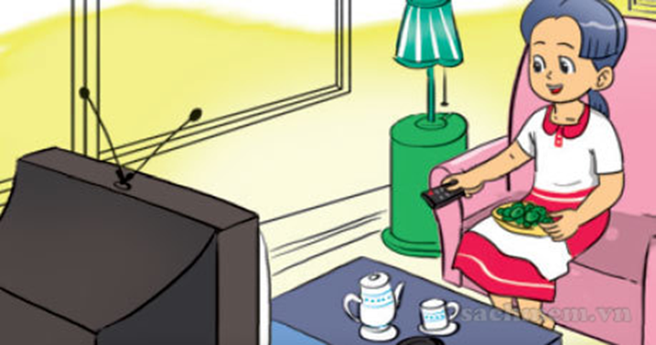
Vocabulary

Slide 7

Vocabulary

Slide 8


2.Point and say
What’s she doing?
She’s …

Slide 9


2.Point and say
What’s he doing?
He’s …

Slide 10
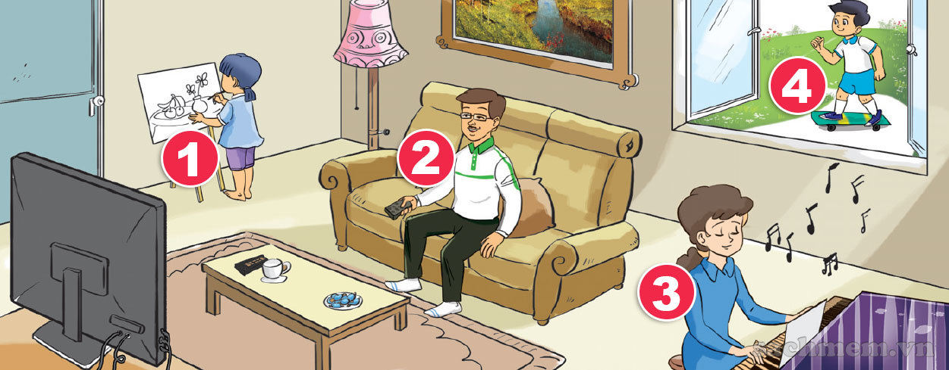
3.Let’s talk

Slide 11

4.Listen and number
3
1
4
2

Slide 12
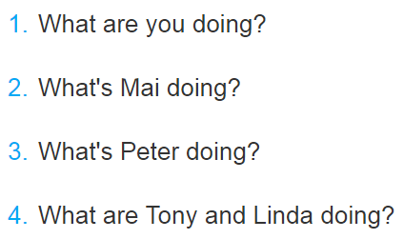




5.Read and match

