Slide 1
Unit 19: They’re in the park. Lesson 3

Slide 2

1/Listen and repeat
ai rainy It’s rainy today.
a-e skate I often skate in the park.

Slide 3
2/Listen and write
1.I like________days.
2.My sister and I__________in the playground.
rainy
skate

Slide 4
3/Let’s chant
Where are you?
Where are you? In the park.In the park.
What’s the weather like? It’s sunny.It’s sunny.
What are you doing? I’m cycling.I’m cycling.
What are your friends doing? They’re skating.They’re skating.
What are your friends doing? They’re skipping. They’re skipping.

Slide 5
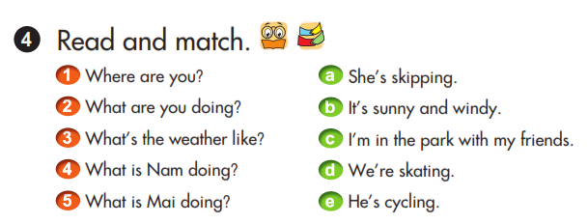

Slide 6
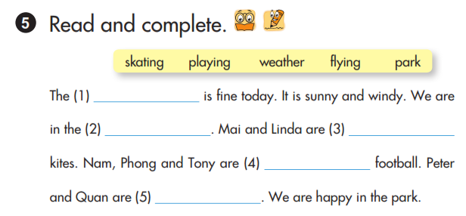
skating
playing
weather
flying
park

